Slide 1
Improved Signal detection in Direct Imaging of Exoplanets
Jacob Shapiro

Slide 2
Introduction and Background

Slide 3
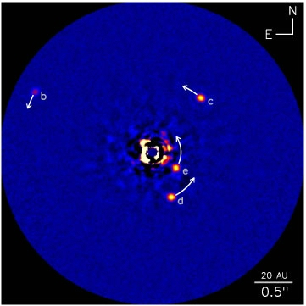
Direct Imaging
https://vimeo.com/115786948
Christian Marois et al. (2008, 2010)
Notes:
Direct Imaging is the search for exoplanets. Take a bunch of pictures of stars throughout the night, with the star itself covered up with a coronograph. What’s left is noise and diffraction and other sources of light. Namely, reflected light from a planet. Through the night, those sources stay the same, and the planet moves. Left video. Results look like something from the right. My data is on the right.

Slide 4
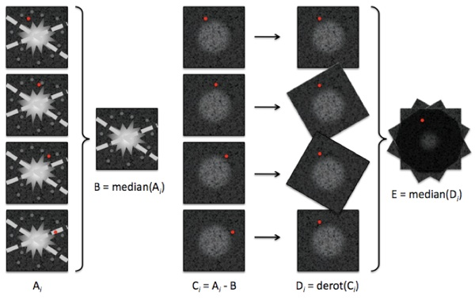
Image Subtraction
Jessica Donaldson, astrobites.org, 2013

Slide 5
Algorithms

Slide 6
Karhunen-Loève Image Processing
The Current Standard
Notes:
Same as it always is, this is what we will use to compare everything to.

Slide 7
KLIP
Least Squares estimate of one image based on others
Truncated Singular Value Decomposition improves slightly
Requires a different noise estimate (B) for each A_{i}
Problems:
Over subtraction
Self Subtraction
Computationally expensive

Slide 8
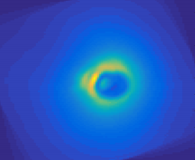
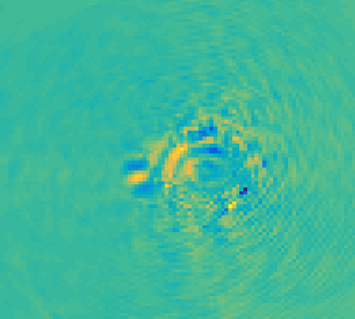
KLIP – β Pic b

Slide 9
Independent Component Anaylysis

Slide 10
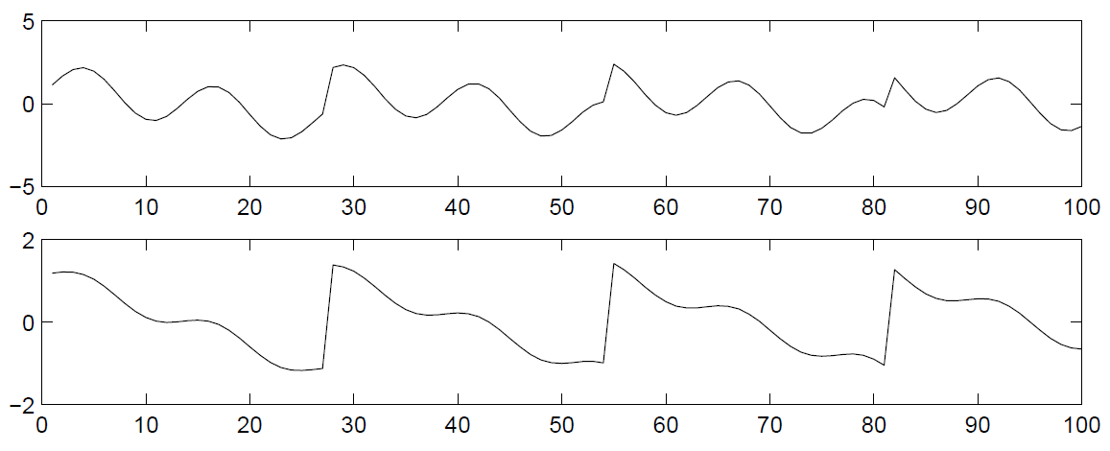
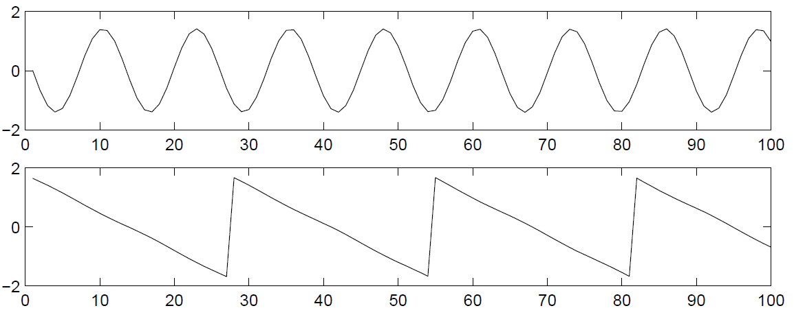
ICA
All Data is a combination of multiple independent data sources:
Hyvarenin, 2000
$$x=As$$

Slide 11
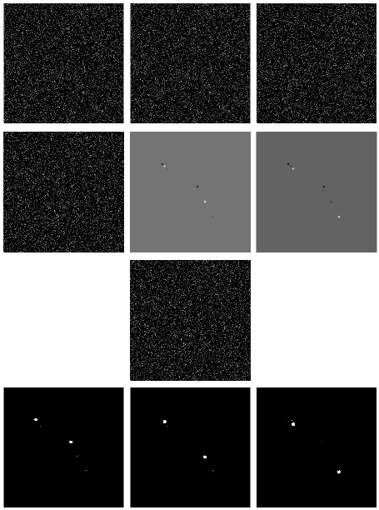
ICA – Motion Tracking
Three input images
Three ICA output images
Reconstructed background
Moving targets isolated

Slide 12
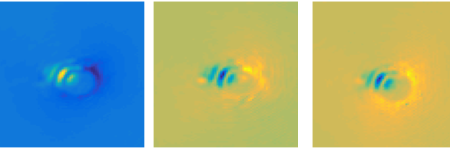
ICA – Direct Imaging
1. Do a KLIP analysis of the data. Instead of derotating and stacking all images, do so in 3 bins:
2. Conduct ICA on those 3 images:

Slide 13
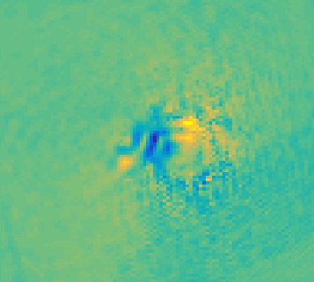
ICA - Results
After optimally derotating and stacking:

Slide 14
Stationary Subspace Analysis

Slide 15
SSA
Assumes both stationary and nonstationary components
Stationary refers to both the moving variance and average
$$x\left(t\right)=As\left(t\right)= \left[A^{𝔰} A^{n}\right]\left[\begin{matrix}s^{𝔰}(t) \\ s^{n}(t)\end{matrix}\right]$$

Slide 16
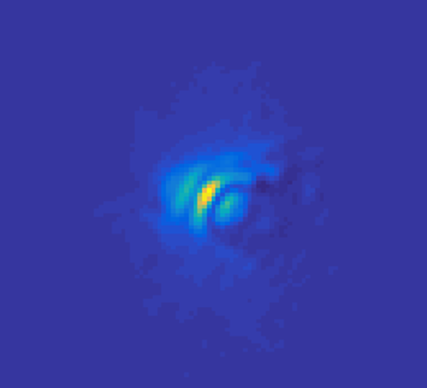
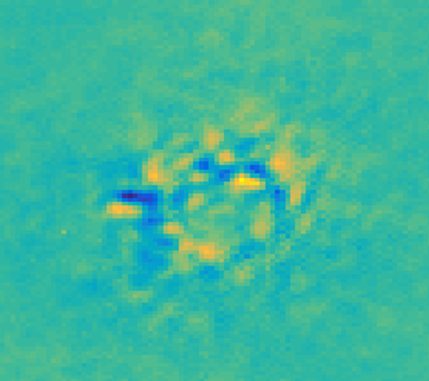
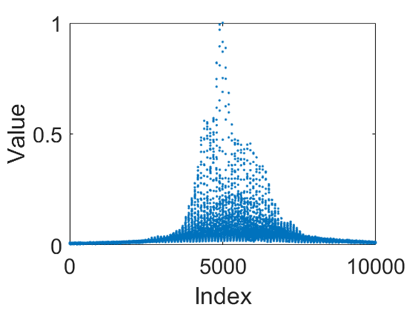
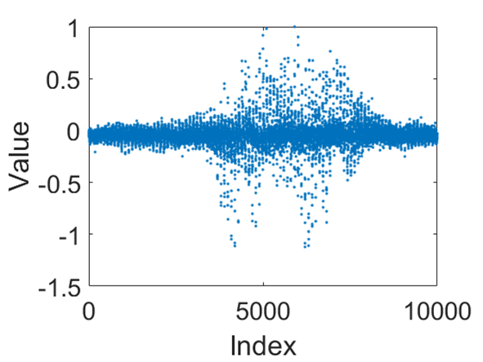
SSA – Direct Imaging
Nonstationary
Stationary
Use Nonstationary components as noise estimates, B, to subtract away from each image

Slide 17
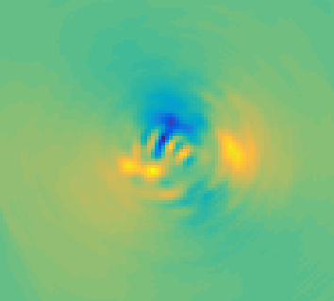
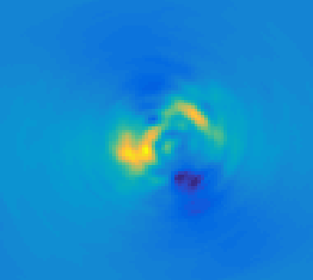
SSA - Results
3 Nonstationary
10 Nonstationary

Slide 18
Common Spatial Pattern Filtering

Slide 19
CSP
Finding a vector the maximizes the difference between distributions:
$$w= \begin{matrix}argmax \\ w\end{matrix}\frac{{\left\|{wX}_{1}\right\|}^{2}}{{\left\|wX_{2}\right\|}^{2}}$$

Slide 20
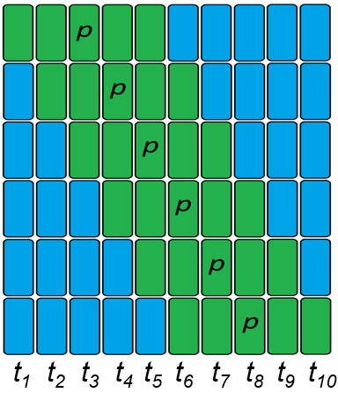
CSP – Direct Imaging
Divide the dataset in half chronologically, with X₁ centered on a target image p.
For images taken at n different times, $n/4<p< {3n}/4$
Find w for each p.
For each analysis, Signal$=\left[{{(w}^{T}w)X_{1} \atop −{{(w}^{T}w)X}_{2}}\right]$

Slide 21
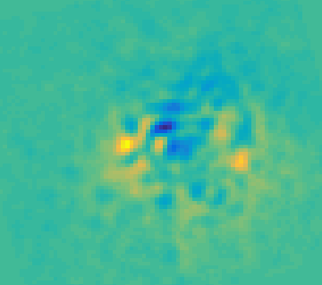
CSP - Results

Slide 22
Comparing the Algorithms

Slide 23
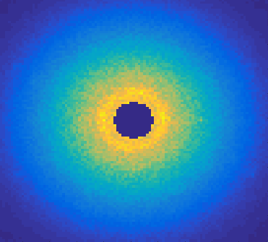
Synthetic Data
Total Image Just Planet Signal

Slide 24
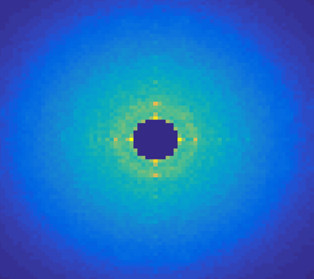
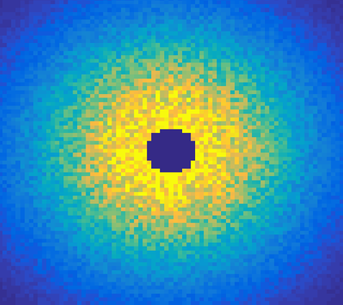
Synthetic Data: Different Image Regimes
Correlated Speckle Noise Pure Poisson Noise

Slide 25
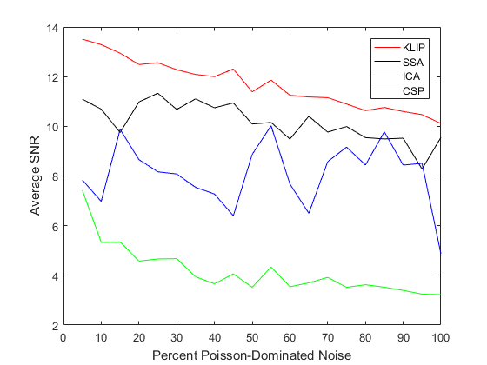
Results and Conclusions
Algorithms perform worse than KLIP
All perform worse as correlated noise is lessened
New methods are at least similar order of magnitude, and suggest further work

Slide 26
Future Work
Improve SSA and CSP
More localized selection for CSP
Optimal number of nonstationary signals for SSA
Investigate further astrometric error
Investigate order of complexity for each algorithm

Slide 27
Improved Signal detection in Direct Imaging of Exoplanets
Jacob Shapiro

Slide 28
Extra Slides
Comparison to other methods of exoplanet detection
Future of direct imaging
KLIP, in detail
ICA, SSA, CSP in detail

