Slide 1


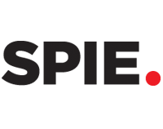

Planet signal extraction from direct imaging using common spatial pattern filtering
August 10, 2017
Paper 10400-56
J. Shapiro, N. Ranganathan, D. Savransky, J.B. Ruffio, B. Macintosh, and the GPIES Team
Notes:
Good afternoon, and thank you for being here today. I’m going to talk about a new method to aid in detecting exoplanets from direct imaging: common spatial pattern Filtering.
But first, let’s look at the very basics: direct imaging.

Slide 2
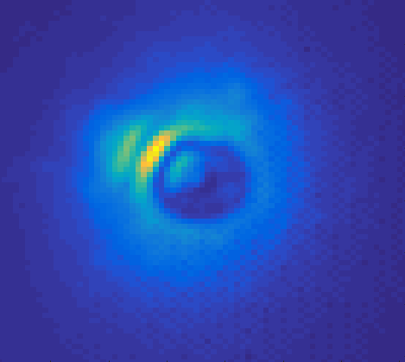
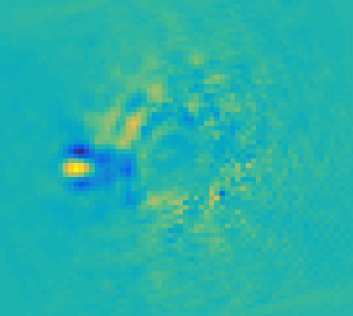
Direct Imaging Standards
Introduction | Application | Mode Thresholding | Methodology | Results | Conclusion
Exoplanet imaging is difficult:
  Faint signal
  Significant noise
The Current Standard: Principal Component Analysis (PCA)^{(Wold, 1987)}
β Pic, GPIES Nov 2015
Notes:
Direct Imaging, as many of you may know, is the science of detecting exoplanets by observing them and blocking out the parent star. Many of you also know that this is not easy. While a coronagraph blocks the majority of the stellar light, the noise in the images nearly completely obscures the planet signal, so extracting it is difficult.
One example is a current technique for doing this. Go from an image on the left, to one on the right, where the yellow dot is a clear planet signal.

Slide 3
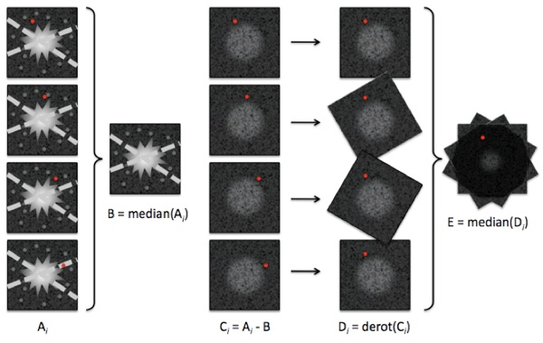
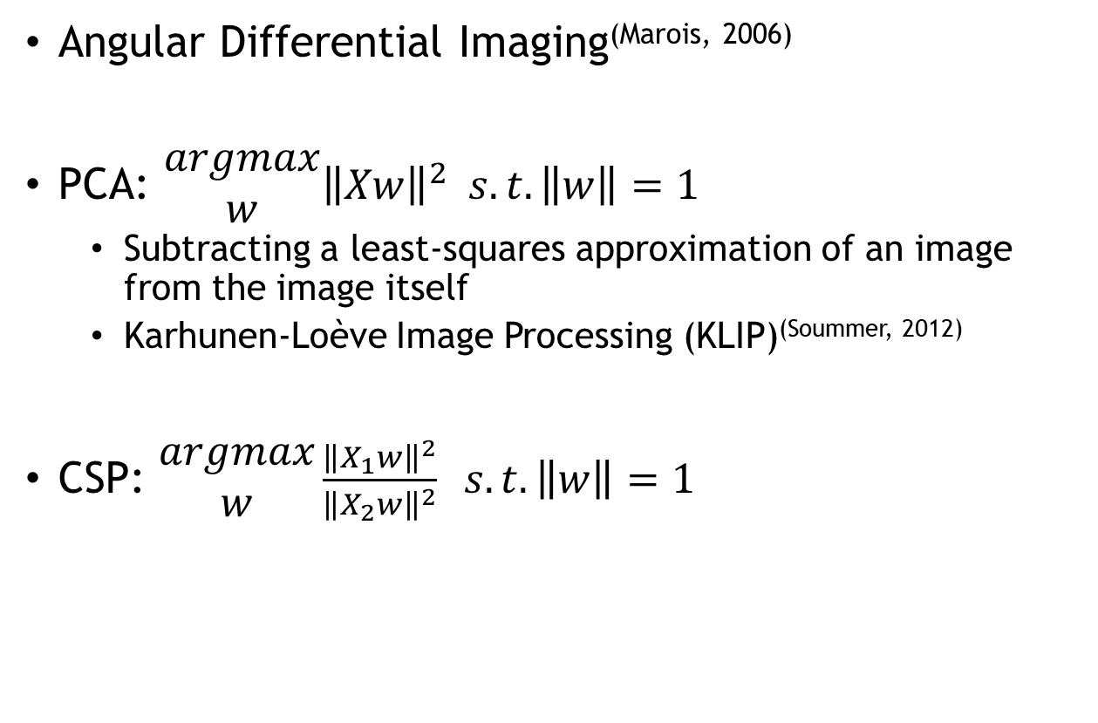
PCA and Common Spatial Patterns^{(Wang,2005)}
Introduction | Application | Mode Thresholding | Methodology | Results | Conclusion
Angular Differential Imaging^{(Marois, 2006)}
PCA: $\begin{matrix}argmax \\ w\end{matrix}{\left\|Xw\right\|}^{2} s.t. \left\|w\right\|=1$
  Subtracting a least-squares approximation of an image from the image itself
  Karhunen-Loève Image Processing (KLIP)^{(Soummer, 2012)}
CSP: $\begin{matrix}argmax \\ w\end{matrix}\frac{{\left\|X_{1}w\right\|}^{2}}{{\left\|X_{2}w\right\|}^{2}} s.t. \left\|w\right\|=1$
Jessica Donaldson
astrobites, 2013
Notes:
How do we get the transition from the previous slide? The core of KLIP, and the new process I will be describing today. For KLIP, let X be a distribution of images from a set of observations, and we find a new set of basis vectors to visualize the image. In the new basis vectors,
If you compare the two, there’s a very similar approach, but fundamentally different question. And that question is, what are the major differences between two data sets?

Slide 4

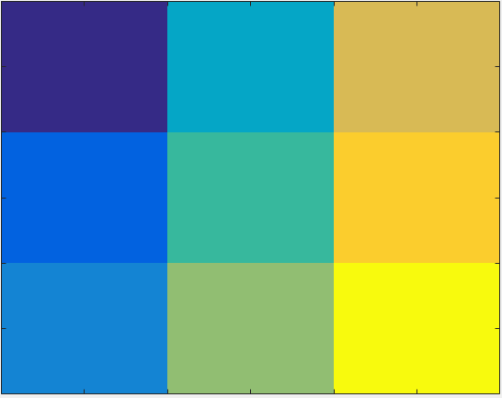
Problem Definition
Introduction | Application | Mode Thresholding | Methodology | Results | Conclusion
Let X₁ be all the images from one observing sequence
Let X₂ be the same data, derotated
Columns of X_{n} are single vectorized images
Notes:
If we set up X1 and X2 like this, where X2 is the same dataset, but derotated, the movement of the planets is a PART of that answer.

Slide 5
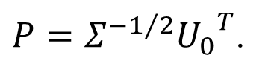

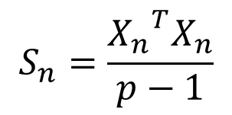
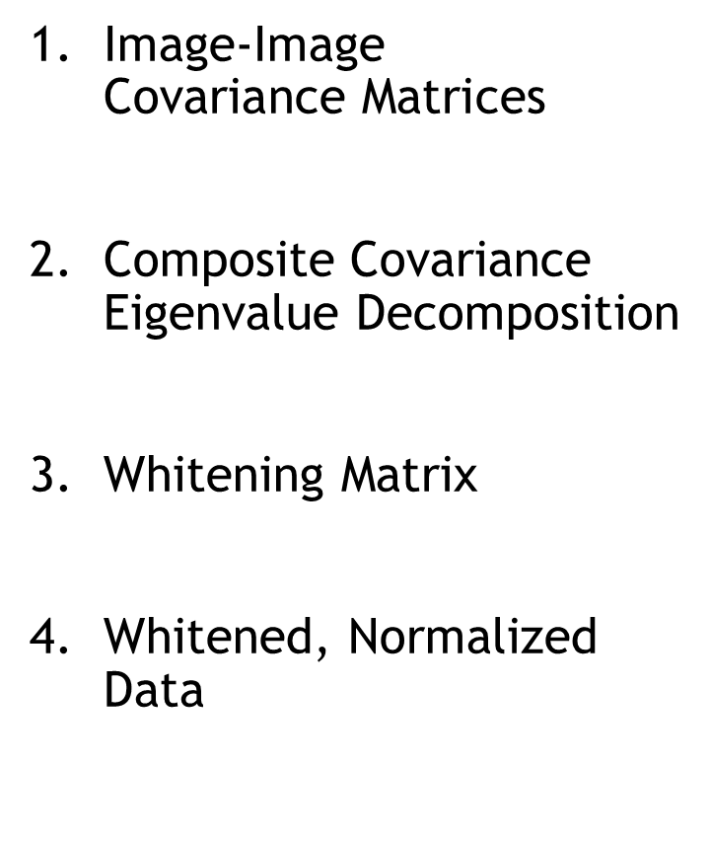


Solving $\begin{matrix}argmax \\ w\end{matrix}\frac{{\left\|X_{1}w\right\|}^{2}}{{\left\|X_{2}w\right\|}^{2}} s.t. \left\|w\right\|=1$
Introduction | Application | Mode Thresholding | Methodology | Results | Conclusion
$\text{Image}\text{−}\text{Image} \text{Covariance} \text{Matrices}$
Composite Covariance Eigenvalue Decomposition
Whitening Matrix
Whitened, Normalized Data
$$S_{n}=\frac{{X_{n}}^{T}X_{n}}{p−1}$$
$$S= S_{1}+S_{2}=U_{0}Σ{U_{0}}^{T}$$
$P=Σ^{{−1}/2}{U_{0}}^{T}$.
$$\overline{S_{n}}=PS_{n}P^{T}$$

Slide 6
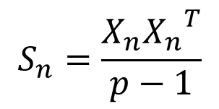
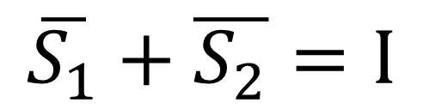
Solving $\begin{matrix}argmax \\ w\end{matrix}\frac{{\left\|X_{1}w\right\|}^{2}}{{\left\|X_{2}w\right\|}^{2}} s.t. \left\|w\right\|=1$
Introduction | Application | Mode Thresholding | Methodology | Results | Conclusion
$\text{Image}\text{−}\text{Image} \text{Covariance} \text{Matrices}$
Composite Covariance Eigenvalue Decomposition
Whitening Matrix
Whitened, Normalized Data
$$S_{n}=\frac{X_{n}{X_{n}}^{T}}{p−1}$$
$$S= S_{1}+S_{2}=U_{0}Σ{U_{0}}^{T}$$
$P=Σ^{{−1}/2}{U_{0}}^{T}$.
$$\overline{S_{1}}+\overline{S_{2}}=I$$
$$\overline{S_{n}}=PS_{n}P^{T}$$

Slide 7
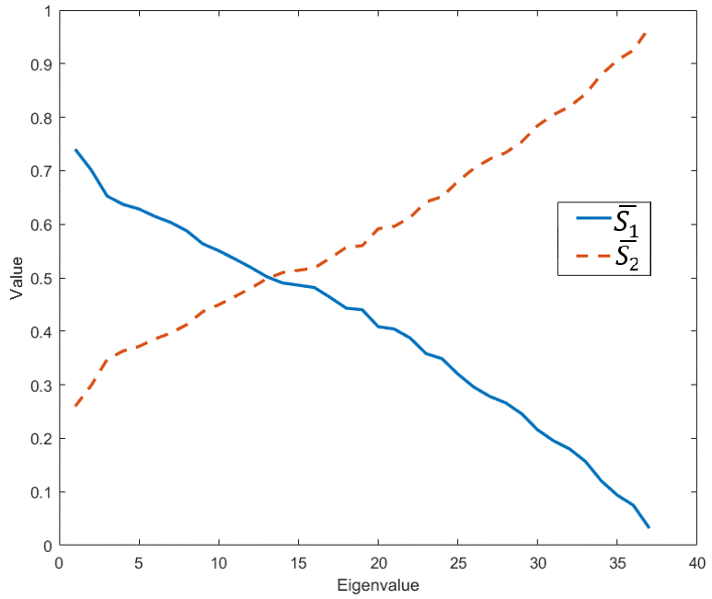


Solving $\begin{matrix}argmax \\ w\end{matrix}\frac{{\left\|X_{1}w\right\|}^{2}}{{\left\|X_{2}w\right\|}^{2}} s.t. \left\|w\right\|=1$
Introduction | Application | Mode Thresholding | Methodology | Results | Conclusion
Reformulation
$$\begin{matrix}argmax \\ w\end{matrix}{\left\|\overline{X_{1}}w\right\|}^{2} s.t. \left\|(\overline{S_{1}}+\overline{S_{2}})w\right\| =1$$
Solution
$$L\left(w,λ\right)=w^{T}{\overline{X_{1}}}^{T}\overline{X_{1}}w−λ[w^{T}\left(\overline{S_{1}}+\overline{S_{2}}\right)w−1]$$
$${\overline{S}}_{1}w=λw$$
...
Notes:
The w’s that solve the optimization, the initial question, are the eigenvectors of the whitened covariance matrix.
${\hat{S}}_{1}$ and ${\hat{S}}_{2}$ share common eigenvectors.
The eigenvectors with the largest eigenvalues for ${\hat{S}}_{1}$ have the smallest eigenvalues for ${\hat{S}}_{2}$. These correspond to eigenvectors that contain more information describing $X_{1}$ rather than $X_{2}.$
$Σ_{1}+Σ_{2}=I$.

Slide 8

Extracting the Planet Signal
Introduction | Application | Mode Thresholding | Methodology | Results | Conclusion
$${\overline{S}}_{n}=UΣU^{T}$$
$$Z=U^{T}P{X_{1}}^{T}$$
Z_{k} is final k rows from Z
Signal for a given target image t is ${{(Z}_{k}}^{T}Z_{k})t$
Notes:
For Z, we know that the eigenvectors associated with the highest eigenvalues correspond to more information content, big modes of the images. The planetary movement exists on the opposite end of the spectrum, associated with the smallest eigenvalues. So, we select the final K rows.
For each target Image, derotate and stack.

Slide 9
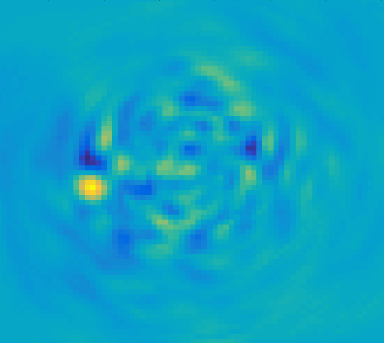

Extracting the Planet Signal
Introduction | Application | Mode Thresholding | Methodology | Results | Conclusion
$${\hat{S}}_{n}=UΣU^{T}$$
$$Z=U^{T}PX_{1}$$
Z_{k} is final k rows from Z
Signal for a given target image t is ${{(Z}_{k}}^{T}Z_{k})t$
Notes:
And there you have it. It works. How well does it work? Well, the answer is…it depends. On a lot of things, but one of the key factors is the third line. How many modes of the system do we want to examine?

Slide 10
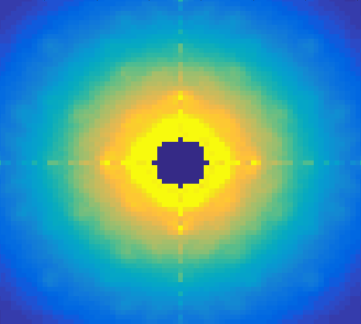
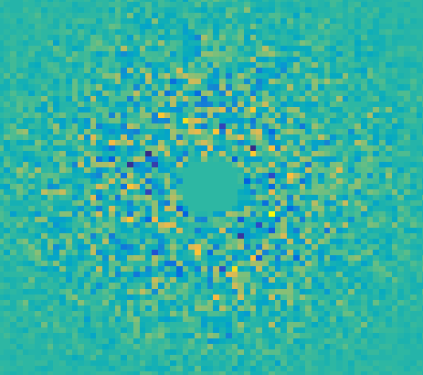
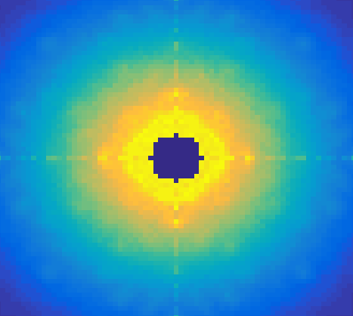
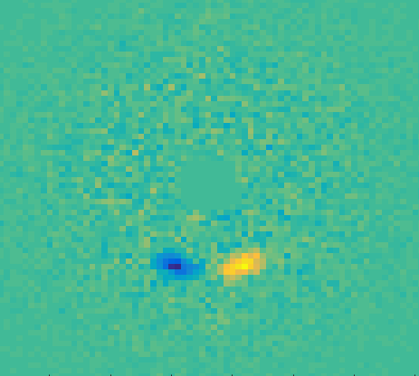
Modes Overview
Introduction | Application | Mode Thresholding | Methodology | Results | Conclusion
Original Image:
Maximum Eigenvalue
Eigenvalue ~ 0.5
Minimum Eigenvalue
Notes:
This is very straightforward data, true data is NEVER this clear.
So, these are 3 different modes in Z. The first is the maximum eigenvalue. The most information content in X1, but not in X2. middle is information content in both. Final is content that would explain X2 relative to X1. So…a planet signal moving from a derotated spot to it’s original.
The bottom ones all have a little bit of the planet signal. So how many do you select, and what happens if you get it wrong?

Slide 11
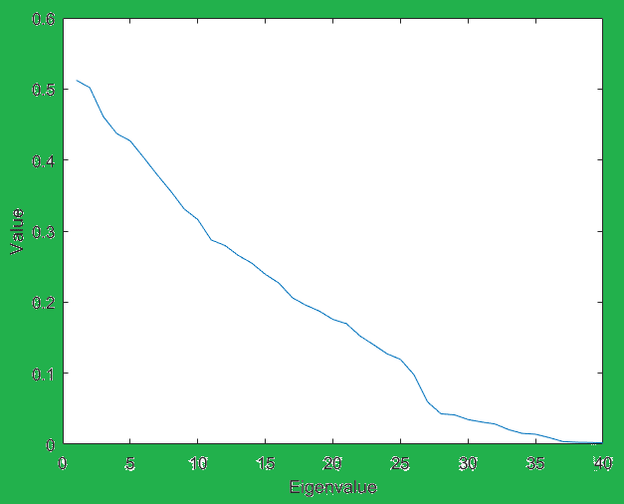
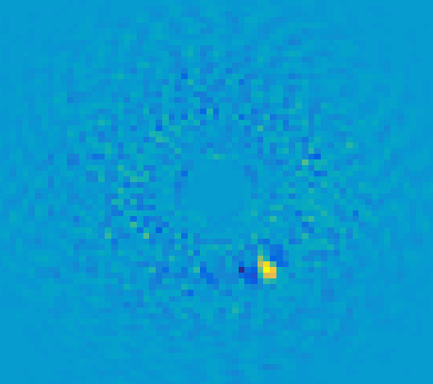
Threshold – Too High, 0.05
Introduction | Application | Mode Thresholding | Methodology | Results | Conclusion
Notes:
Background noise is strong

Slide 12
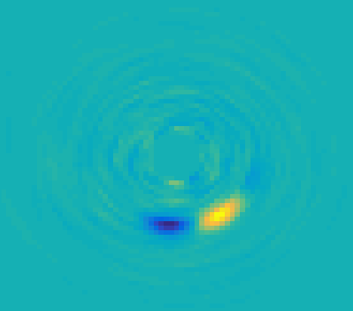
Threshold – Too Low, 0.002
Introduction | Application | Mode Thresholding | Methodology | Results | Conclusion
Notes:
Signal is VERY distorted

Slide 13
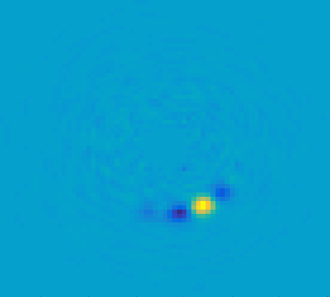
Threshold – Just Right, 0.005
Introduction | Application | Mode Thresholding | Methodology | Results | Conclusion
Notes:
Arc Length
More area swept out needs more modes to capture the motion
Signal Strength
Stronger signal requires more modes
With an unknown signal, thresholding will likely require iteration
These simple examples were with injected planets into very simple synthetic noise I generated. The whole problem becomes more complicated when you look at more complex data with different correlations. So that’s what I did next.

Slide 14
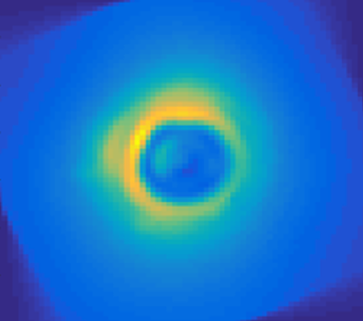
Data Sources
Introduction | Application | Mode Thresholding | Methodology | Results | Conclusion
GPIES, Nov 2015, β Pic b
Limited to ADI
Repeated analysis on HD 1466
Planetary Injection
  2D Gaussian fit to β Pic b
  Same strength as β Pic b
  Rotate with Parallactic Angle
  5 injected
Notes:
Gemini Planet Imager Exoplanet Survey Instrument at the Gemini Observatory in Chile.
Stayed within the same wavelength. HD 1466 as an arbitrary choice to confirm findings.
2D Gaussian is not exactly the PSF, but it’s an approximation I believe to be sufficient for this analysis
Each injected is 60 degrees apart, leaving room for the known planet signal. Didn’t want interference.

Slide 15
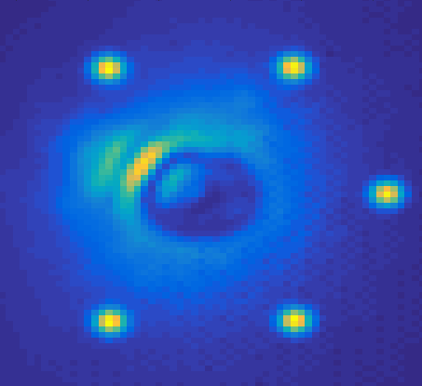
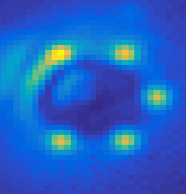
Methodology
Introduction | Application | Mode Thresholding | Methodology | Results | Conclusion
Angular Separation
  From inner ring to outer ring
  Measurements averaged at given radius
  Moving through noise regimes
Varied signal strength
  0.5 to 4.5 percent of max value
  Each set of 5 averaged together
Iterated through different thresholds
  Kept the strongest Signal-Noise Result
Notes:
One of the variables I wanted to look at to evaluate performance. Here, the two superimposed images have greatly exaggerated signals to demonstrate my point

Slide 16
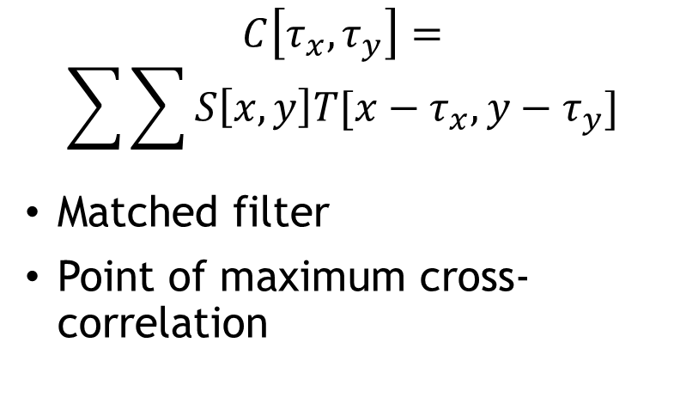
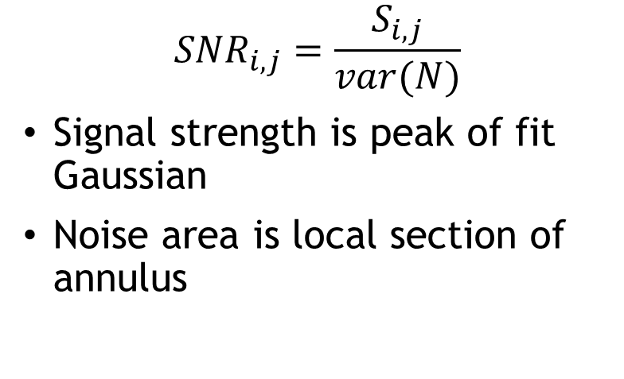
Evaluation Metrics
Introduction | Application | Mode Thresholding | Methodology | Results | Conclusion
Signal – Noise Ratio
Astrometric Biases
$${SNR}_{i,j}=\frac{S_{i,j}}{var(N)}$$
Signal strength is peak of fit Gaussian
Noise area is local section of annulus
$$C\left[τ_{x},τ_{y}\right]=$$
$$\sum{\sum{S\left[x,y\right]T[x−τ_{x},y−τ_{y}}]}$$
Matched filter
Point of maximum cross-correlation

Slide 17
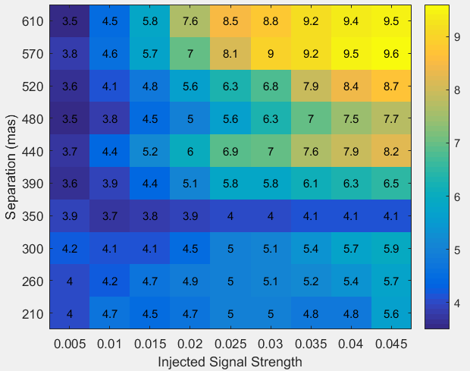
Signal to Noise Ratio
Introduction | Application | Mode Thresholding | Methodology | Results | Conclusion
Notes:
Bars across I think are a result of needing finer fidelity in the thresholding. I iterated across fairly large jumps. .05 to 0.1 to .15. I think smaller movements for a more optimal threshold would avoid blanket discrepancies like that. Also, some of the really high ones are just where the algorithm could likely not detect a planet.

Slide 18
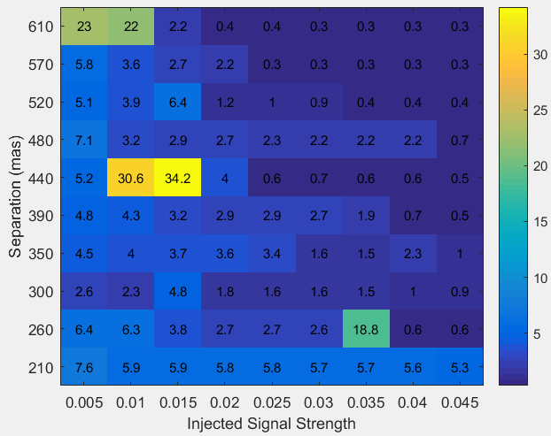
Centroiding Error
Introduction | Application | Mode Thresholding | Methodology | Results | Conclusion
Notes:
Bars across I think are a result of needing finer fidelity in the thresholding. I iterated across fairly large jumps. .05 to 0.1 to .15. I think smaller movements for a more optimal threshold would avoid blanket discrepancies like that. Also, some of the really high ones are just where the algorithm could likely not detect a planet.
These results fine on own, but really tell a story when compared with KLIP.

Slide 19
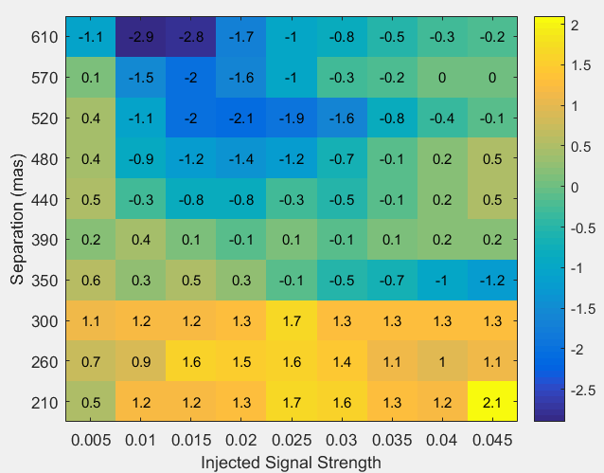
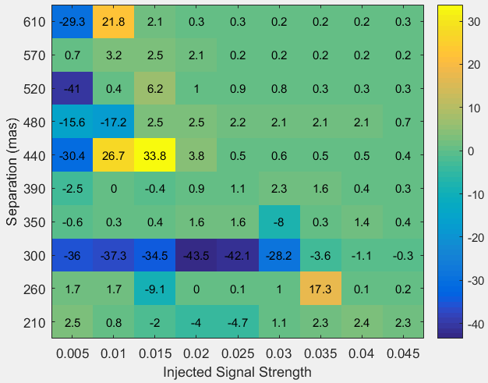
CSP – KLIP Comparison, Beta Pic
Introduction | Application | Mode Thresholding | Methodology | Results | Conclusion
SNR
Centroiding Error
Notes:
Performs better closer to the IWA.
This is my own implementation of KLIP. Not quite as sophisticated as perhaps the GPIES data cruncher, but neither is the CSP method I’m testing. I suspect both are at similar levels of sophistication, which somewhat levels the playing field.

Slide 20
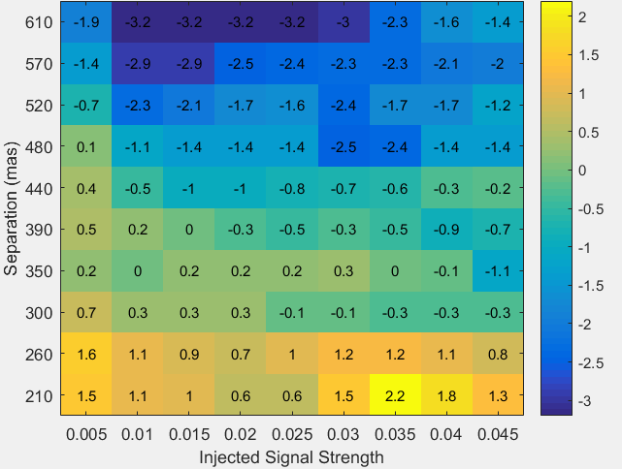
CSP – KLIP SNR Comparison, HD 1466
Introduction | Application | Mode Thresholding | Methodology | Results | Conclusion
Notes:
Confirms trends.

Slide 21
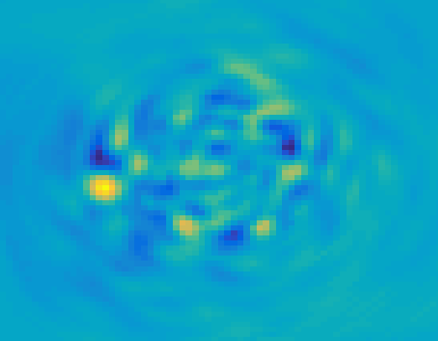
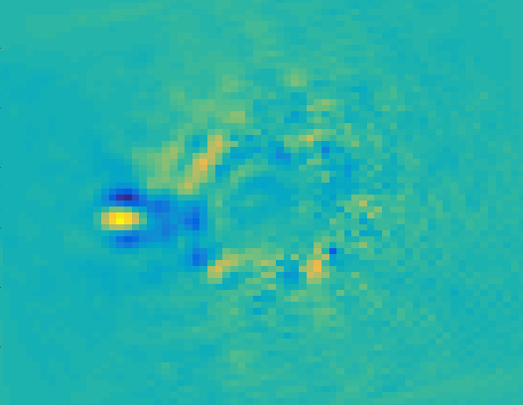
Images (Left: CSP, Right: KLIP)
Introduction | Application | Mode Thresholding | Methodology | Results | Conclusion
Notes:
Both find Beta Pic very well, and both mostly miss on the top 2 planets. CSP does a better job at identifying the bottom 2 and the one opposite from Beta Pic

Slide 22
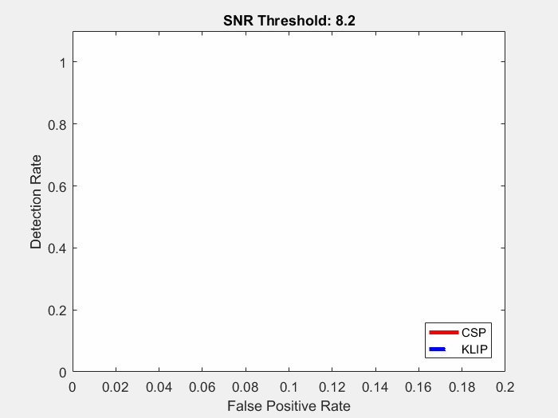
ROC Curve
Introduction | Application | Mode Thresholding | Methodology | Results | Conclusion
Notes:
Both find Beta Pic very well, and both mostly miss on the top 2 planets. CSP does a better job at identifying the bottom 2 and the one opposite from Beta Pic

Slide 23
Conclusions and Future Work
Introduction | Application | Mode Thresholding | Methodology | Results | Conclusion
Common Spatial Pattern Filtering can be used to extract planet signals from direct imaging
Tentatively, CSP has higher SNR near inner working angle
Higher rate of false positives
Matched Filter
Validate on more star backgrounds
Develop procedure for SDI inclusion
Optimally sized regions

Slide 24

Acknowledgements
SIOSLab
  Dmitry Savransky
  Christian Delacroix
  Joyce Fang
  Daniel Garrett
  Dean Keithly
  Nikhil Ranganathan
  Amlan Sinha
  Gabriel Soto
The GPIES Team
Stanford Collaborators
  Bruce Macintosh
  J.B. Ruffio
This work is supported by NASA Grant No. NNX16AI13G.

Slide 25
Planet signal extraction from direct imaging using common spatial pattern filtering
August 10, 2017
Paper 10400-56
J. Shapiro, N. Ranganathan, D. Savransky, J.B. Ruffio, B. Macintosh, and the GPIES Team
Paper 10400-57
Notes:
Good afternoon, and thank you for being here today. I’m going to talk about a new method to aid in detecting exoplanets from direct imaging: common spatial pattern Filtering.
But first, let’s look at the very basics: direct imaging.

