Slide 1





Simulating Known Exoplanet Orbits for WFIRST CGI Imaging
Dmitry Savransky, Daniel Garrett, Nathaniel Kinzly Dean Keithly, Vanessa Bailey, Natasha Batalha, Nikole Lewis, Mark Marley, Bruce Macintosh

Slide 2
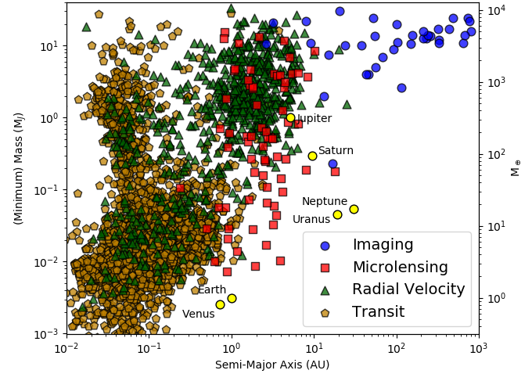
WFIRST CGI Needs Targets!
Fortunately, we know of a lot!
3,869 confirmed exoplanets!

Slide 3
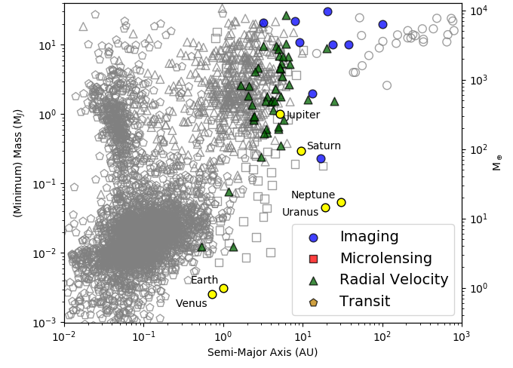
WFIRST CGI Needs Targets!
Well, maybe a few…
56 currently known exoplanets that are potentially visible to WFIRST CGI

Slide 4
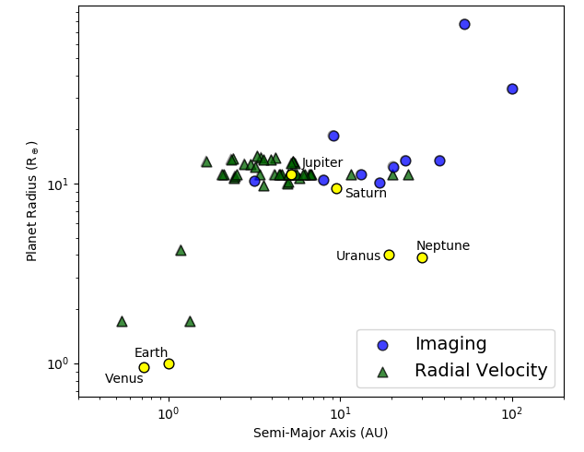
And, it’s reflected light
So we really care more about radii than masses, but these are all RV & Imaging detections

Slide 5
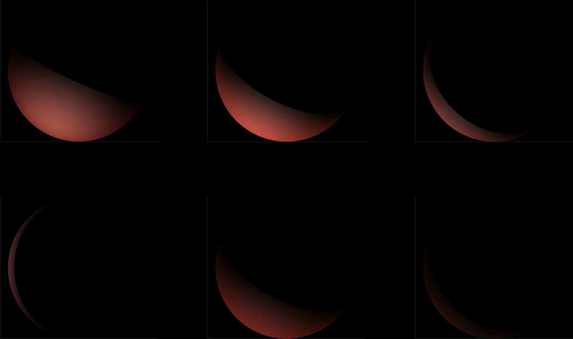
Just Because You Know Something is There…
Doesn’t mean you’ll see it

Slide 6
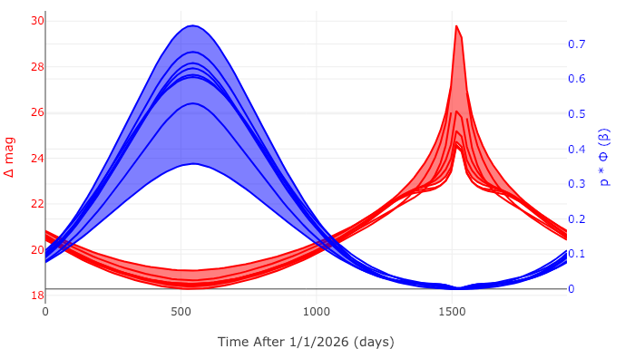
Clouds Make Huge Differences
See: Batalha et al. (2018) "Color Classification of Extrasolar Giant Planets: Prospects and Cautions."

Slide 7
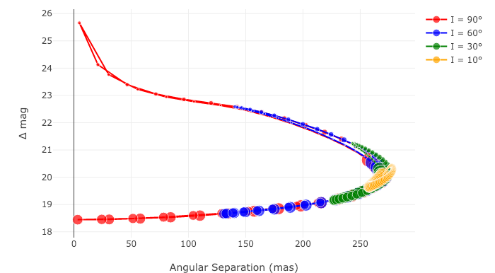
And RV Planets Have Unknown Inclinations

Slide 8
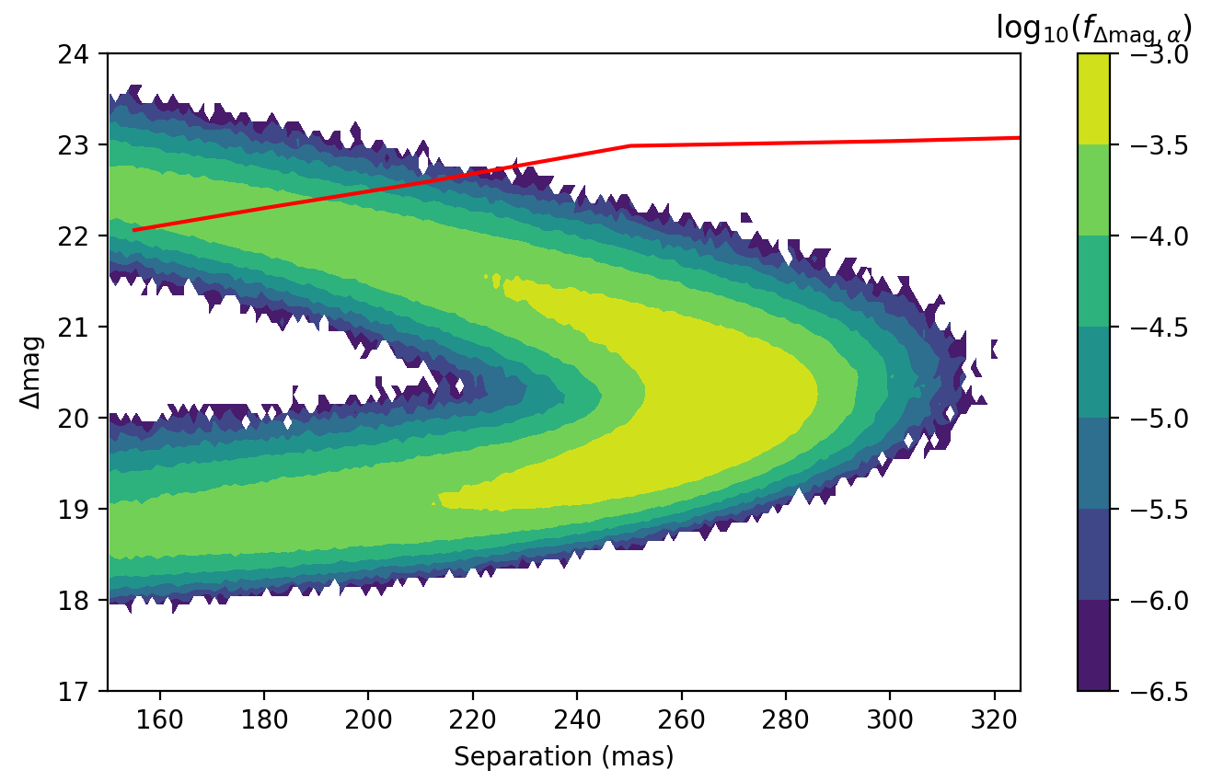
Putting it All Together

Slide 9
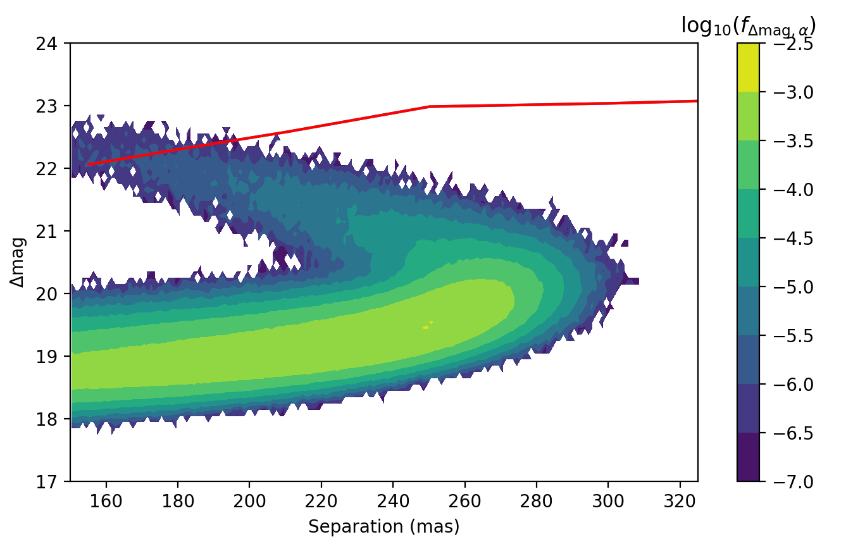
GJ 849 b on JD 2461585.66

Slide 10
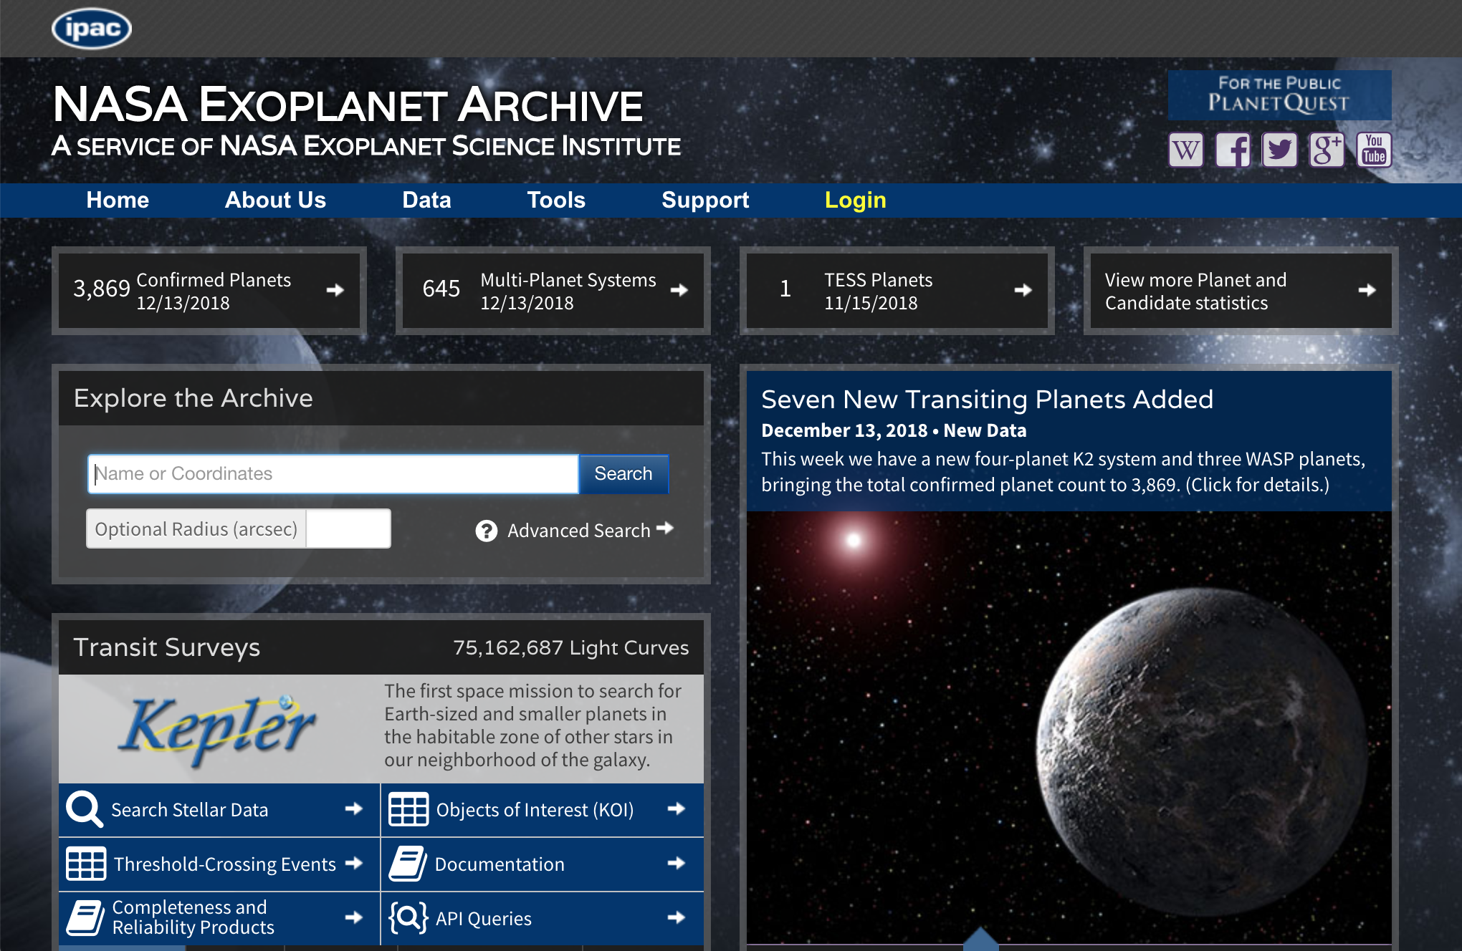
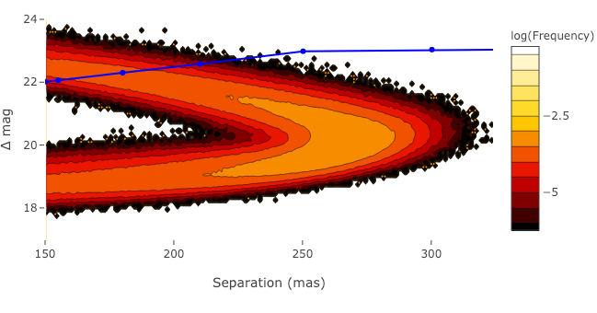
How It’s Done
Batalha et al. (2018)
Pick best orbital fits
Calculate Additional Properties
+
+
=

Slide 11
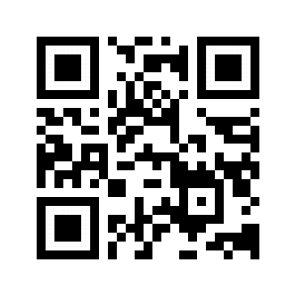
100% of the Code and Data I’ve shown here is available for public use
https://plandb.sioslab.com
https://github.com/dsavransky/plandb.sioslab.com

