Slide 1


Solar Sail Trajectories and Orbit Phasing of Modular Spacecraft for Segmented Telescope Assembly about Sun-Earth L2
Gabriel Soto, Erik Gustafson, Dmitry Savransky, Jacob Shapiro, Dean Keithly
Paper Number: AAS 19-774
15th August 2019

Slide 2
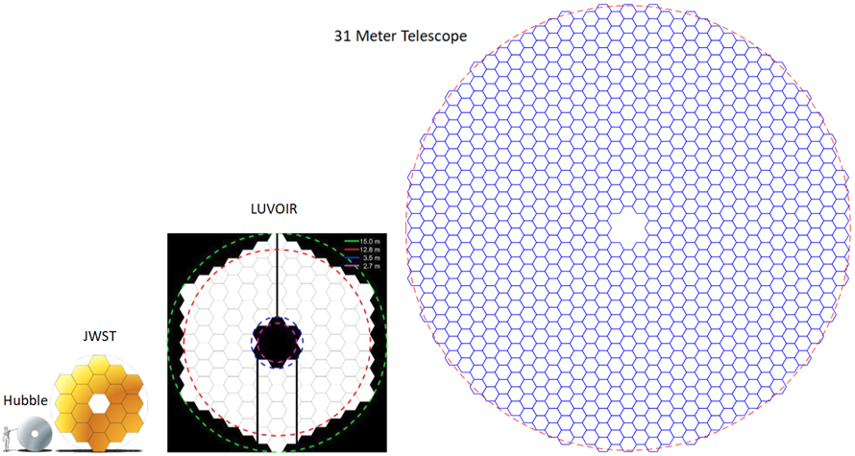
Motivation
LUVOIR and future space telescopes require bigger primary mirrors
Easier to segment the mirrors
  Manufacturing costs reduced if fabricated in bulk
>15m mirror required to observe main sequence turnoff point past the local group¹
  31m primary mirror, needs 840 mirrors²
¹D. A. Fischer, B. Peterson, LUVOIR Team, et al., “The LUVOIR Mission Concept Study Interim Report,” arXiv preprint arXiv:1809.09668, 2018.
²J. Shapiro, D. Keithly, G. Soto, D. Savransky, and E. Gustafson, “Optical design of a modular segmented telescope,” Proc. SPIE, Vol. 11116-12, 2019
Notes:
LUVOIR and future space telescopes will require larger primary mirrors to surpass the sensitivity and resolution capabilities currently offered by Hubble and the future JWST.
Current designs use segmented mirrors because a giant 15m mirror is almost impossible to manufacture, polish and bring to space in one go.
Segmented mirrors are the way to go, especially if we fabricate identical ones.
But if we want a 30m telescope, we’re gonna need 840 mirrors and a way to get them to the desired orbit.

Slide 3

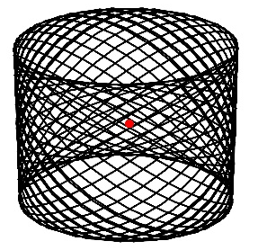
Mission Concept
Modular spacecraft start on Earth orbits with mirror as payload.
Solar sails unfurl and propel the mirrors to L2.
Spacecraft are assembled on a Lissajous orbit.
Notes:
We propose a novel mission concept for a segmented space telescope where each identical mirror segment is placed on modular spacecraft.
Individual modules are launched as payloads of opportunity from Earth.
They will be propelled by solar sails from Earth orbit to L2
Once near L2, they will be injected on a Lissajous orbit in which they can begin assembly.

Slide 4
Mission Concept
1000 km
Notes:
On the Lissajous orbit, there are opportunities for modules to come into close proximity to each other.
We assume a relative distance of 1000 km should be enough to begin communications and begin rendezvous.
After rendezvous, the two sails are steered to make contact and stick via embedded hook-and-loop material.
The sails reef their facing sides, the two modules dock using controllable electromagnets and link using mechanical interconnects and the sails unfurl again.
Ultimately, a 30 meter mirror is created and the solar sails overlap to create a sunshield for the telescope.

Slide 5
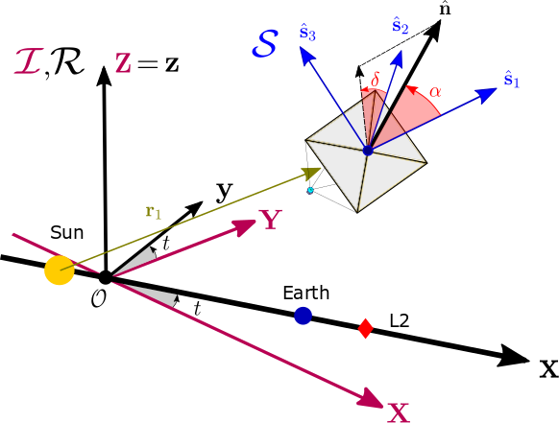
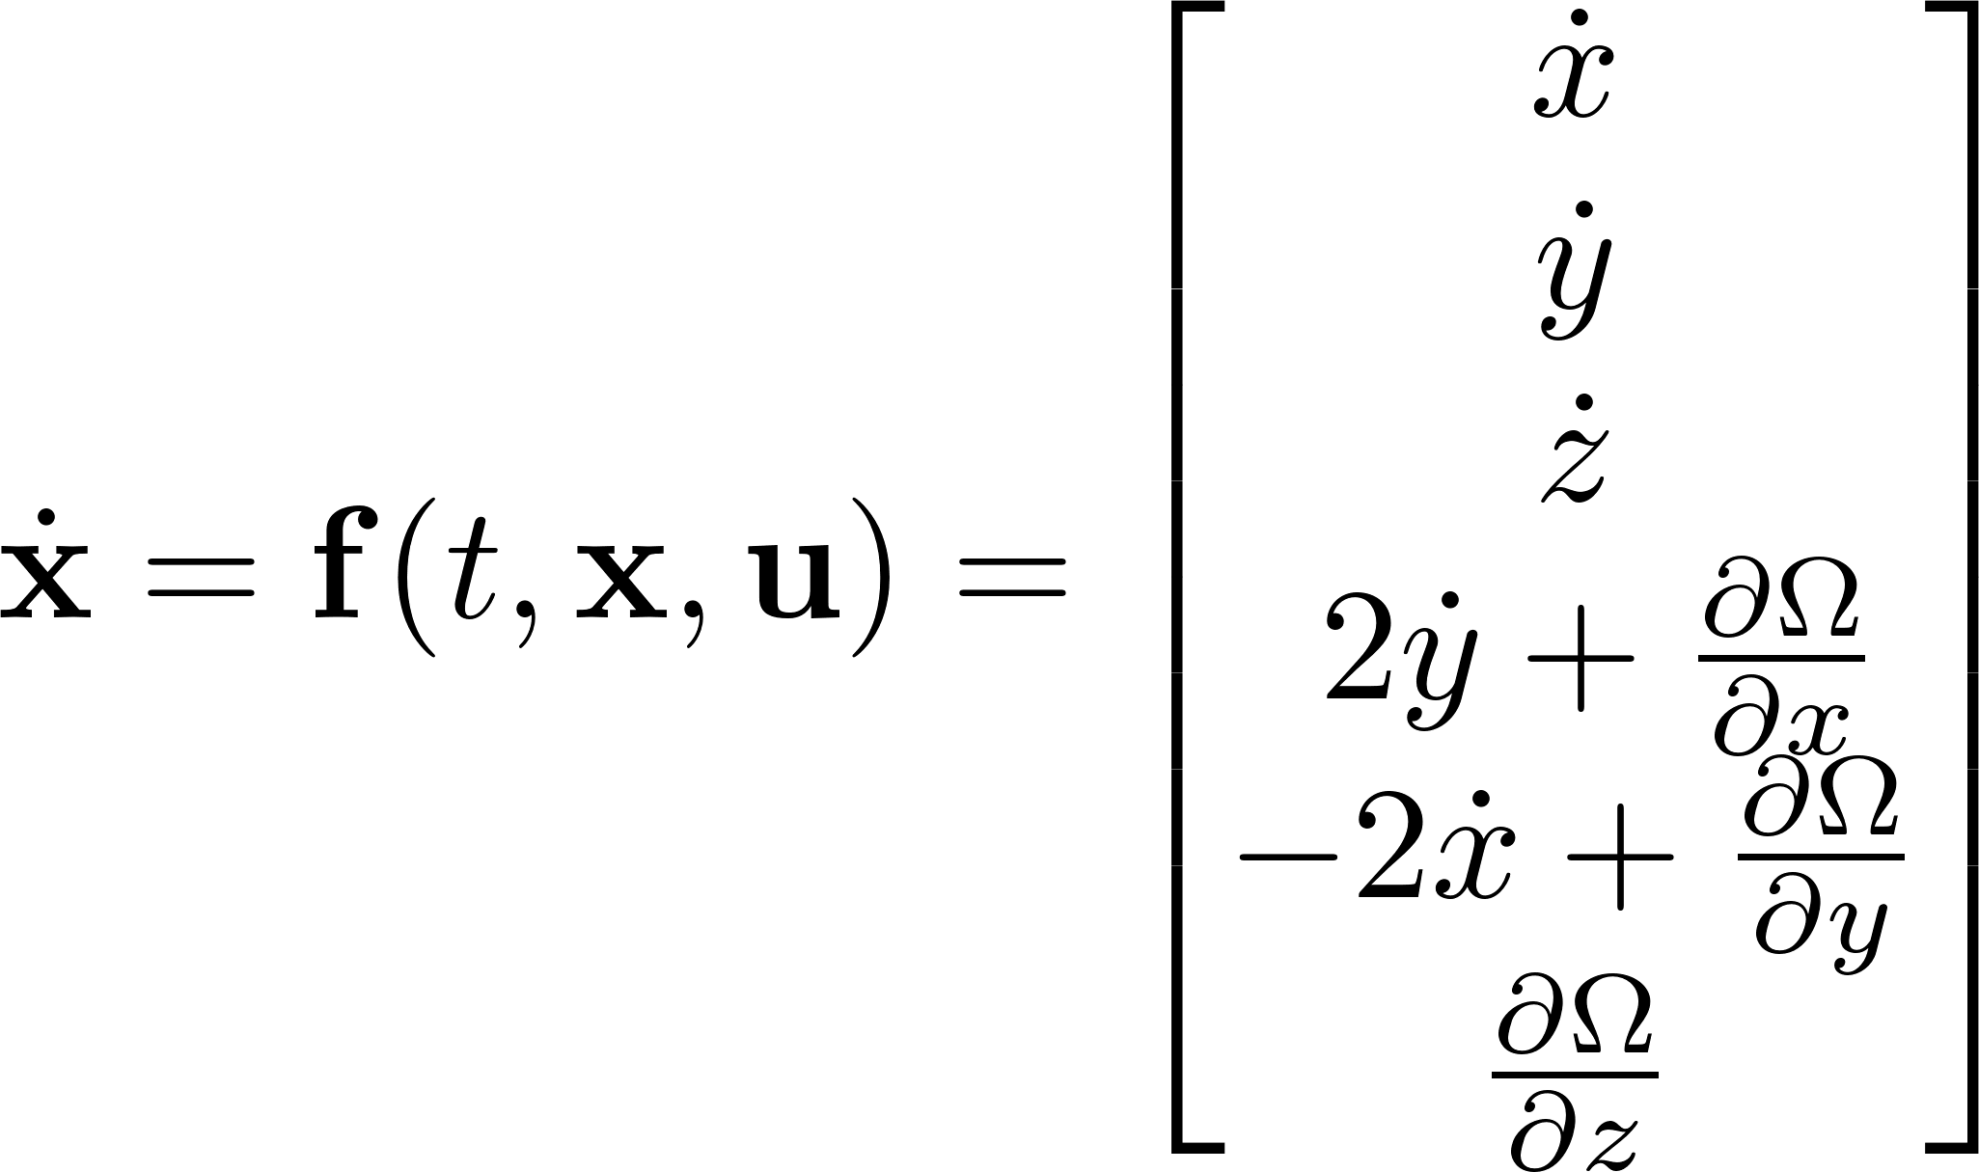
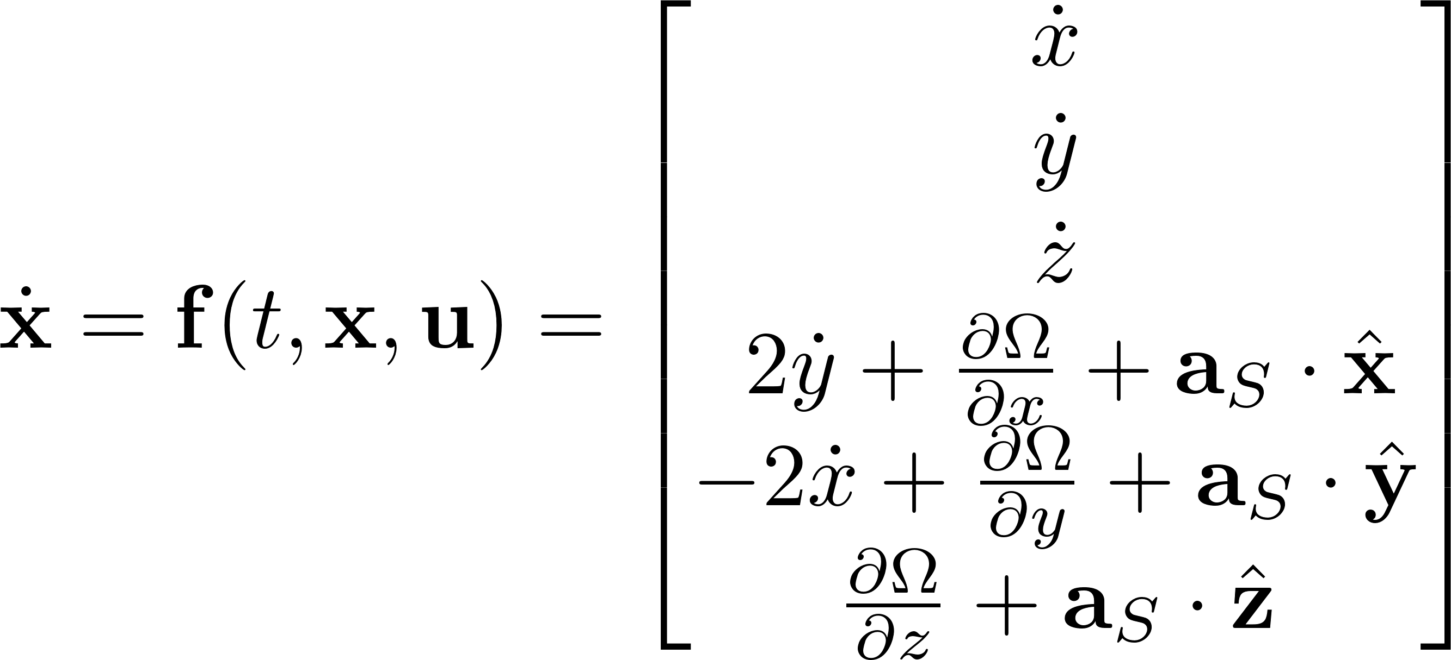
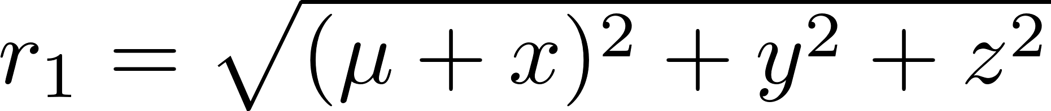
Dynamical Model
CR3BP equations of motion
Effective potential and relative distances:
Notes:
So how do we create this monstrosity?
We begin by moduling the dynamics of the modules in the CR3BP model, where motion is studied in rotating frame R which rotates with the motion of the Sun and Earth relative to an inertial frame I.
Additional solar sail perturbations can be added to the equations as accelerations projected onto the rotating frame R.

Slide 6
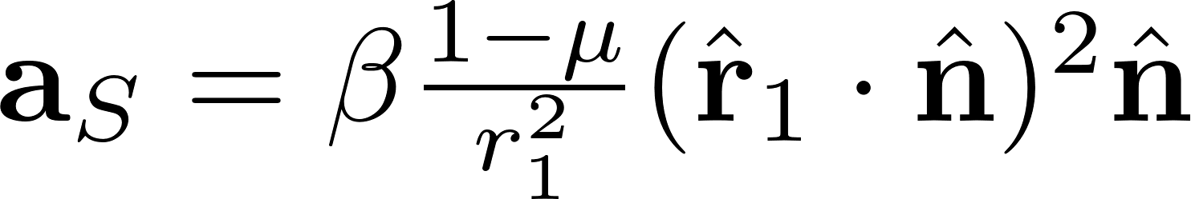
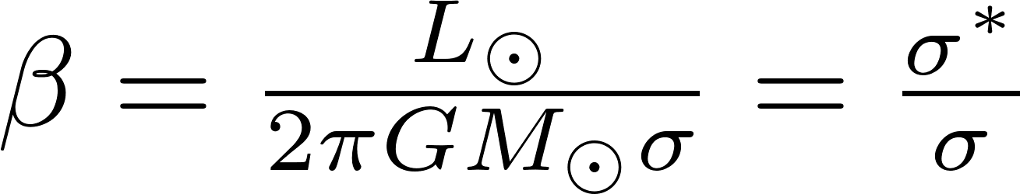
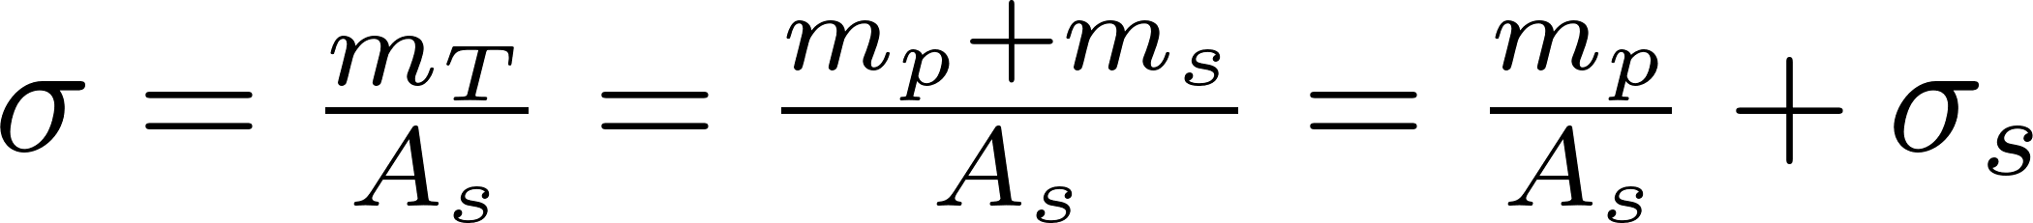
Dynamical Model
Solar Sail acceleration term²
Solar Sail performance factor
²C. McInnes, Solar Sailing: Technology, Dynamics and Mission Applications. Springer-Praxis Books, 1999.
Notes:
The solar sail acceleration is a function of its distance from the Sun, r1, and the pointing of its normal vector.
On the right we can see the pointing defined by spherical angles, the pitch and clock angles alpha and delta, defined on an auxiliary S frame. This frame points in the direction of the Sun vector.
The acceleration is also dependent on the sail performance factor Beta, which, in turn, is dependent on the sail loading factor sigma.
We decompose the total mass of the spacecraft into two terms to help us in our design study: a sail mass (that includes the sail and sail structures and supports) and a payload mass (which includes the structure, mirror and subcomponents).
The sail mass is abstracted to a sail loading term sigma s.

Slide 7
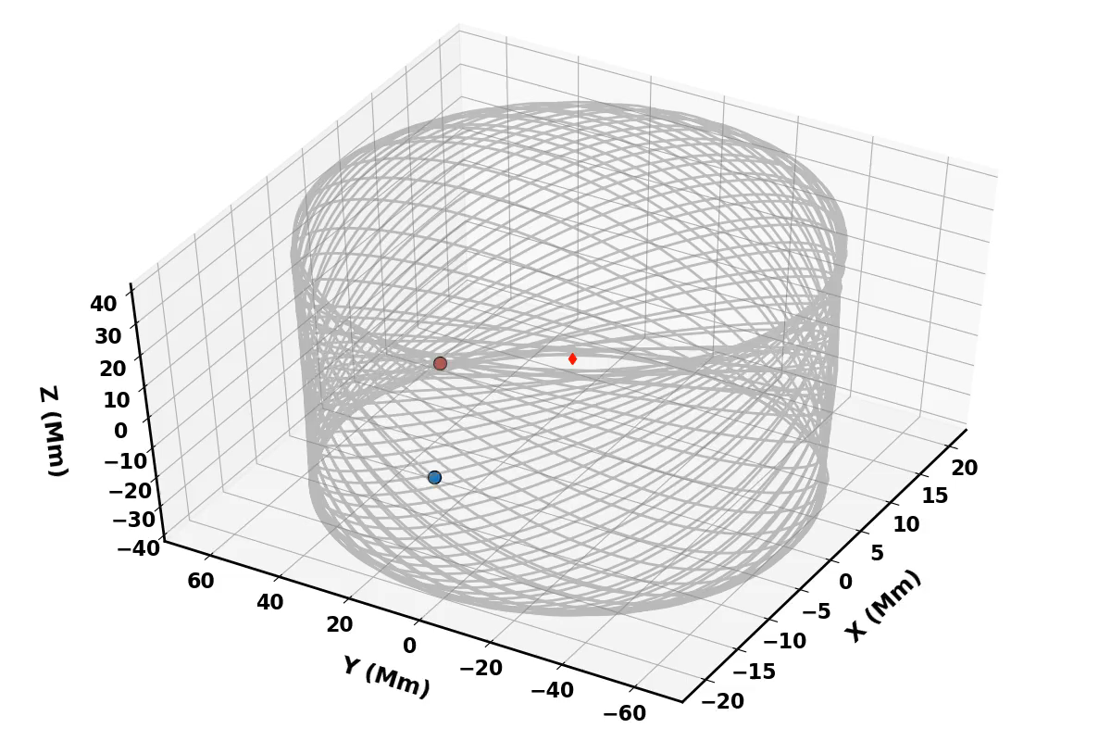
Final Orbit - Lissajous
Found through 2-step differential correction process³
177-day period, about Sun-Earth L2 ecliptic
³K. C. Howell and H. Pernicka, “Numerical Determination of Lissajous Trajectories in the Restricted Three-Body Problem,” Celestial Mechanics, Vol. 41, 1988
Notes:
The staging area of the mirror assembly will occur on a Lissajous orbit.
We compute the Lissajous using the unperturbed CR3BP equations using a 2-step differential correction process.
There is a ~177 day period, about half a year, for it to cross the ecliptic plane twice in the z-direction

Slide 8
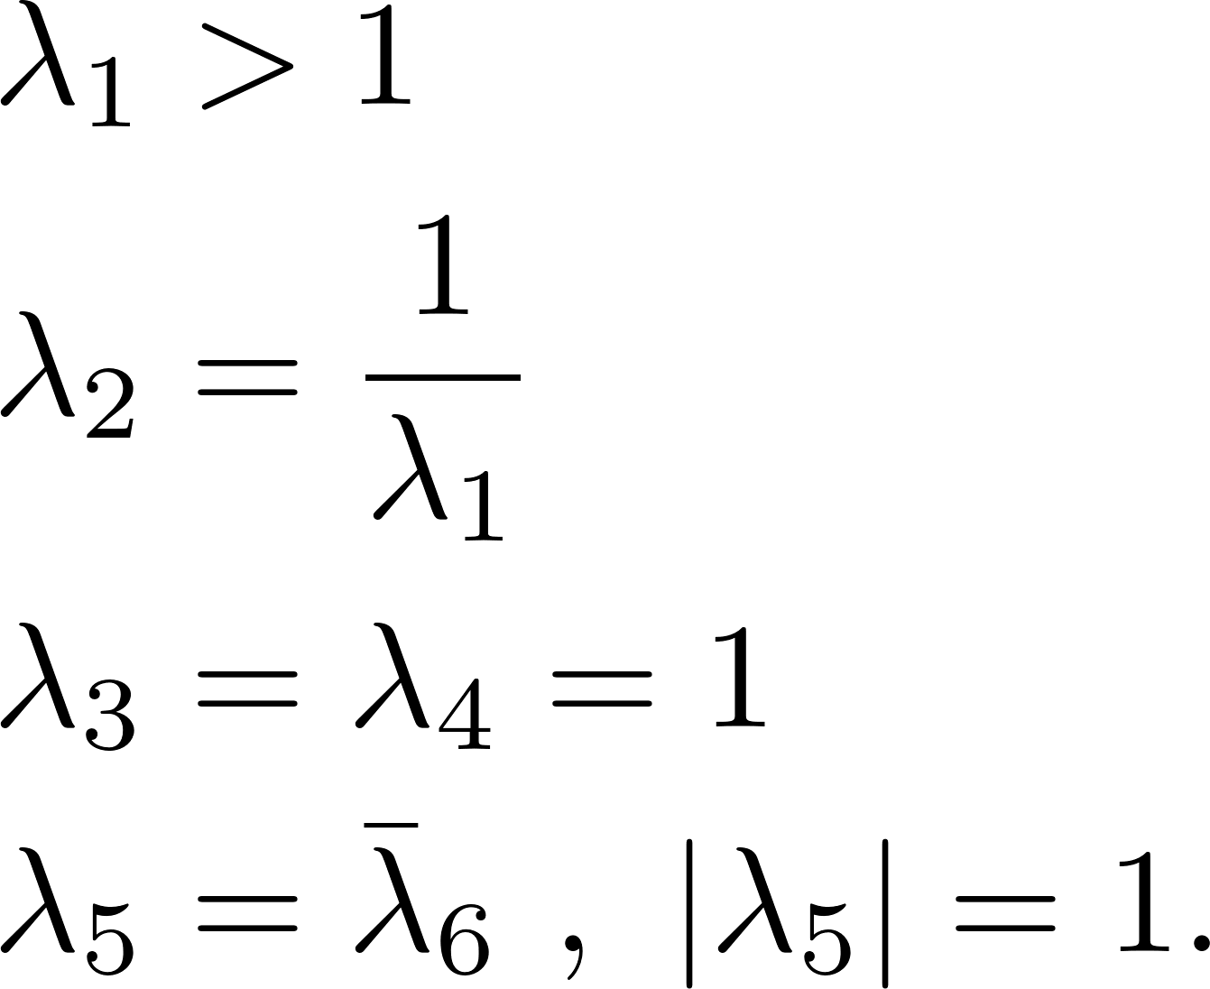
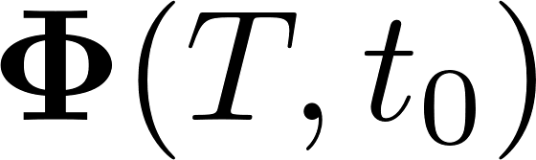
Invariant Manifold Analysis
State transition matrix found for periodic orbit
  Vertical Lyapunov
Monodromy Matrix
Point on Vertical Lyapunov
Unstable eigenvector
⁴W. S. Koon, M. W. Lo, J. E. Marsden, and S. D. Ross, Dynamical Systems, the Three-Body Problem and Space Mission Design (2011)
Notes:
In order to get to the Lissajous, we use the help of invariant manifolds near L2.
The invariant manifolds are computed through the monodromy matrix of a periodic orbit – we use a vertical Lyapunov for reference.
The monodromy matrix is the state transition matrix evaluated after a full period and has six eigenvalues:
The first two correspond to unstable and stable motion, the next two are neutral, and the last two correspond to rotational motion.
We create manifolds by perturbing a point on the periodic orbit in the direction f the unstable eigenvector by an amount epsilon, then integrating those initial conditions.

Slide 9
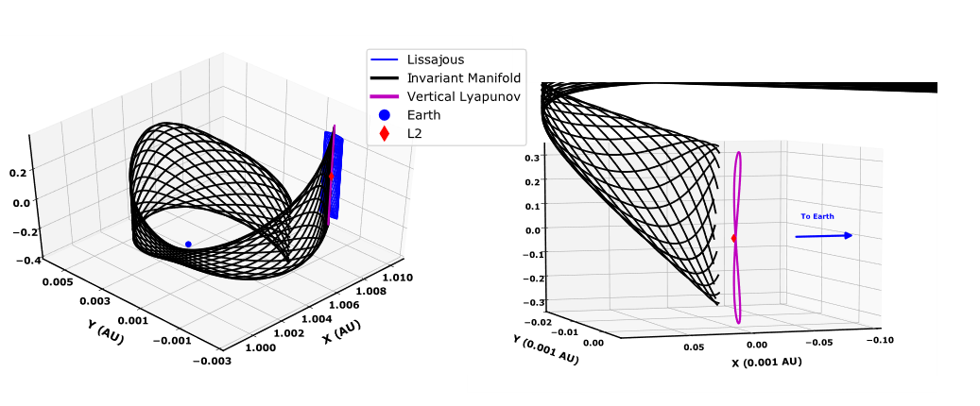
Invariant Manifold Analysis
Notes:
The results can be seen on these figures, where a trajectory wraps around the Earth towards L2 and therefore the periodic and quasi periodic orbits.
On the right is a zoomed in view of the starting point of the invariant manifold.
I picked several spots along the figure-8 shaped vertical Lyapunov and created several initial conditions offset by the unstable eigenvector of the monodromy matrix, then integrated them.

Slide 10
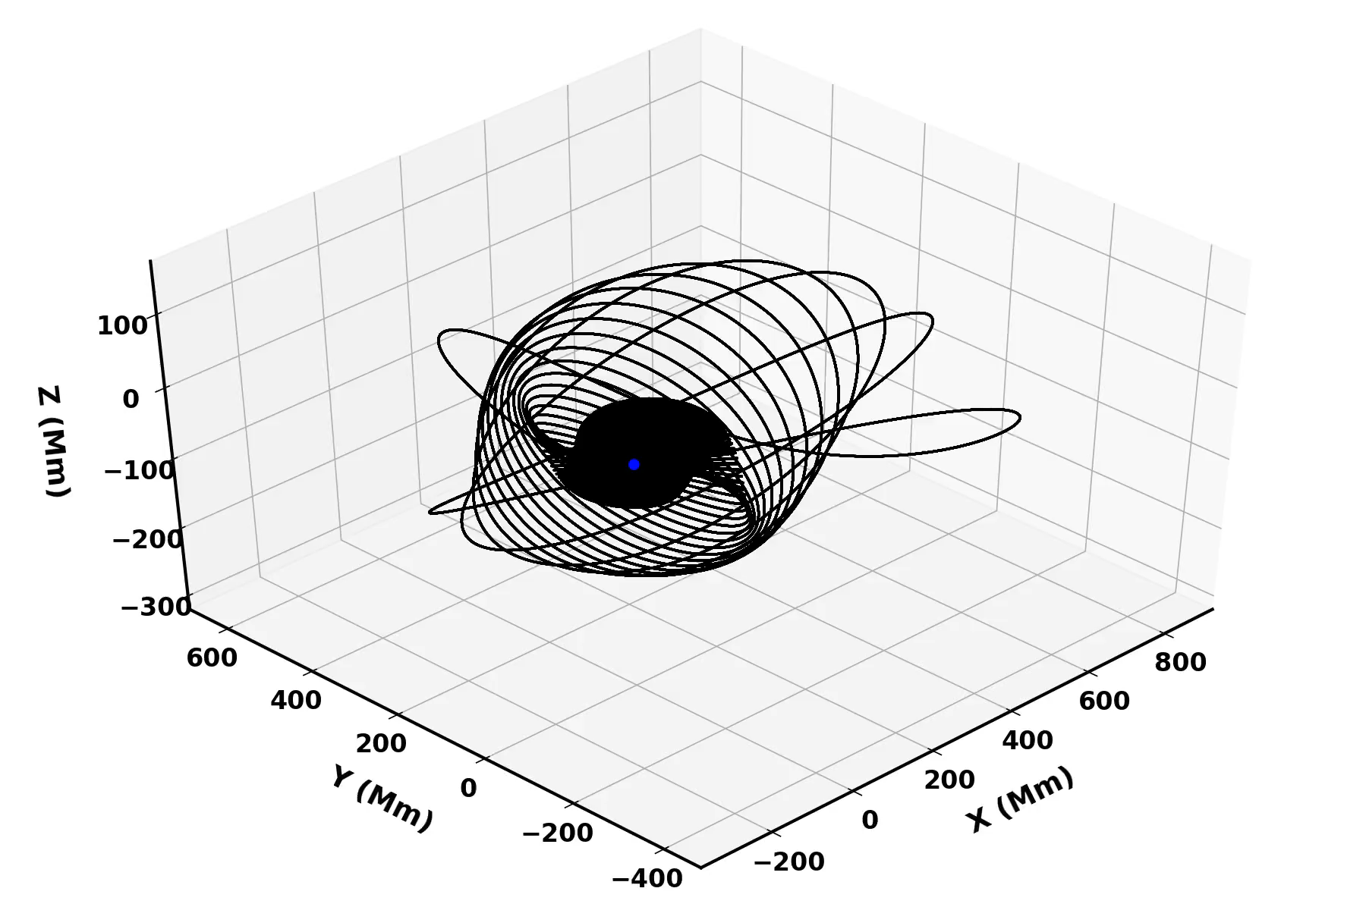
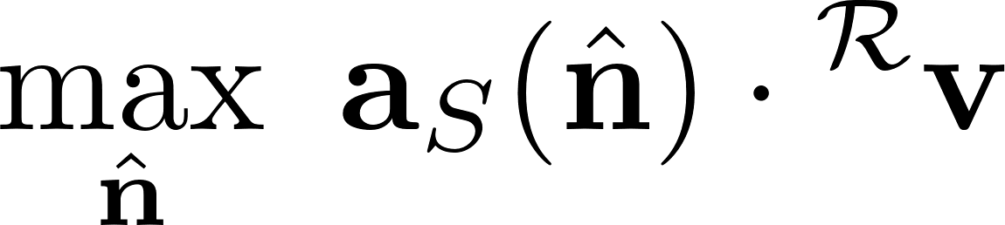
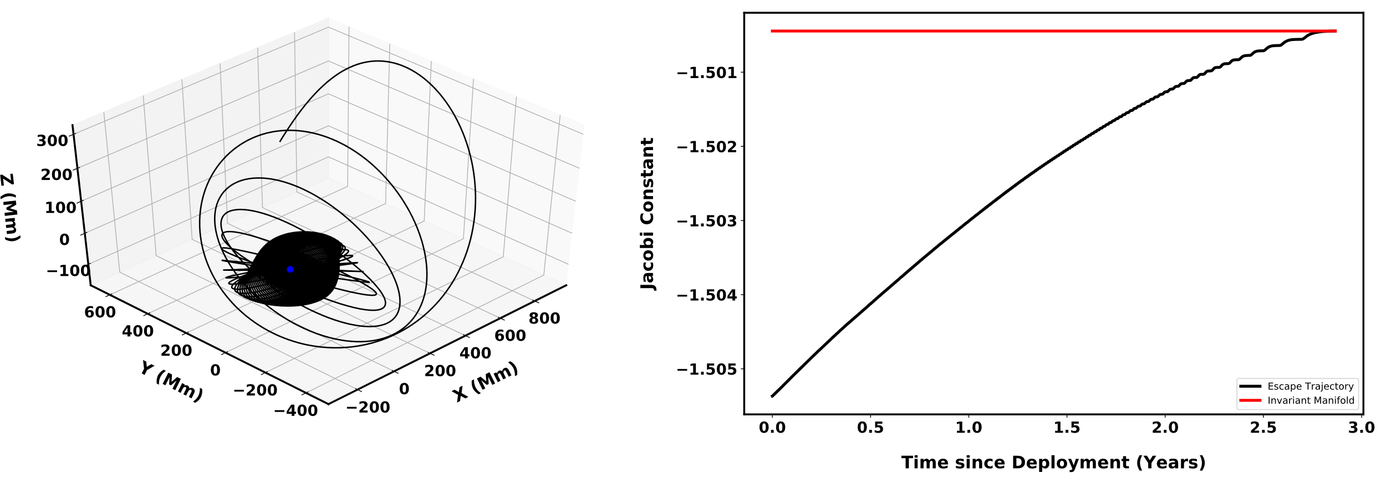
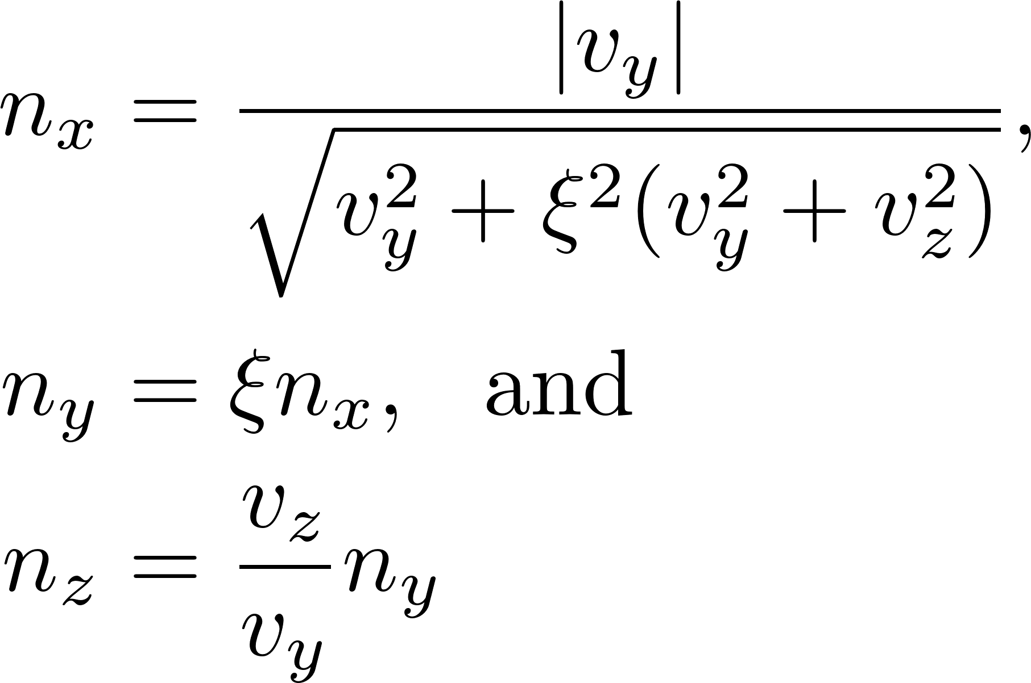
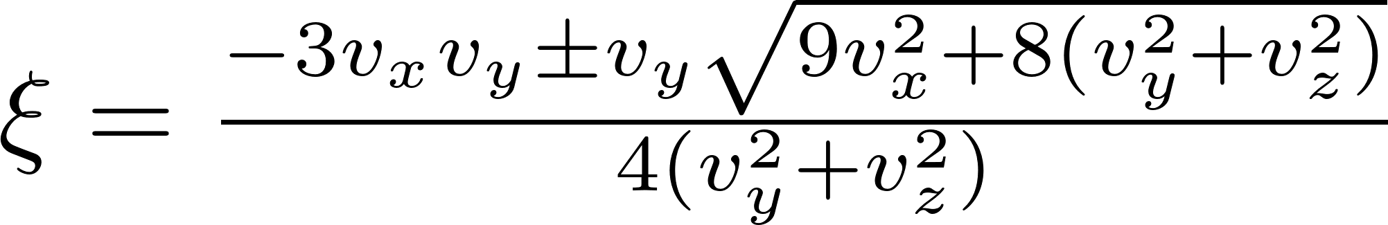
Earth Escape Trajectories
Energy maximization control law⁵ in rotating frame
⁵Coverstone, “Technique for Escape from Geosynchronous Transfer Orbit Using a Solar Sail,” JGCD, 2003
Notes:
Now we have a way to get from Earth to L2, all that is needed is to inject the modules into that manifold when it’s near the Earth.
We do that by adopting an energy maximization control law, which maximizes the projection of the acceleration onto the velocity vector in the rotating frame.
Conducting that maximization problem using constrained optimization gives us three optimal control laws for the direction of the normal vector n.
We can see here that applying the control law throughout the integration steadily increases the Jacobi constant of the module over time.
We introduce a terminal event function to stop integration once the Jacobi constant reaches that of the invariant manifold

Slide 11
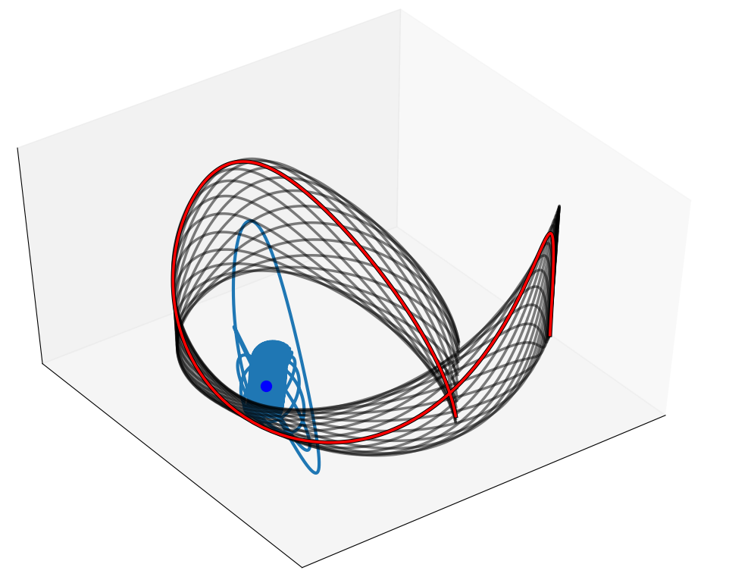

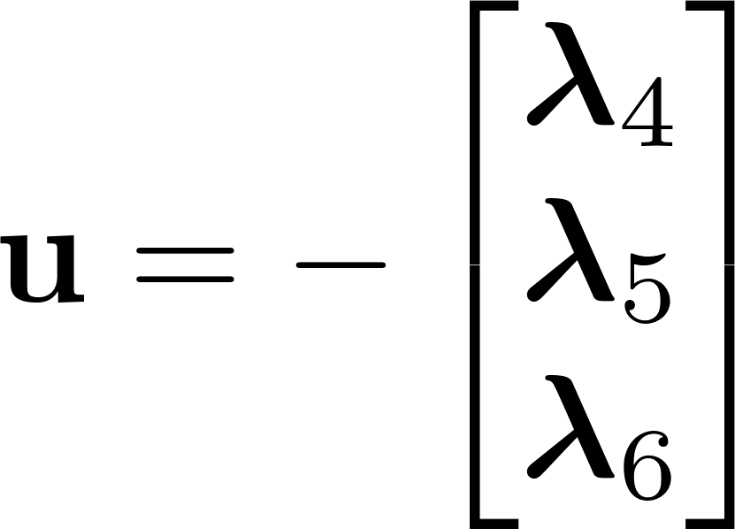
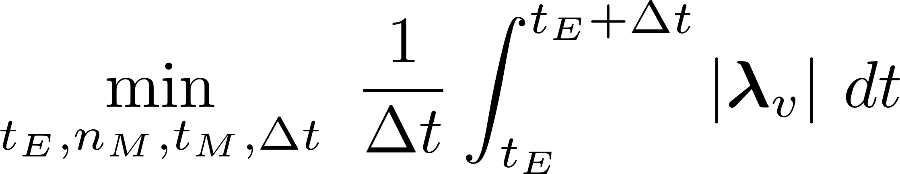

Transfer to the Manifold
Start with unconstrained thruster model
Solve a boundary value problem using collocation algorithm
  solve_bvp from scipy
Best initial guess for solar sail: trajectory with smallest average thrust
Notes:
But just increasing the energy of the spacecraft doesn’t mean it automatically makes it onto the manifold, so some more precise control must be applied.
We guide the modules onto the manifold by first using an unconstrained thruster model, with the following control laws (also adopting 6 more costates and equations of motion).
The trajectory from escape to the manifold has four open parameters: the time on the escape trajectory when the module branches off, the specific branch of the manifold and location on it we choose to target, and the flight time of the transfer.
And, ultimately, we want a good initial guess for the solar sails because constrained low thrust trajectories are hard.
What we deem as the ‘best’ trajectory is one where the average magnitude of the velocity costates (and therefore the control input) is smallest throughout the trajectory.
We solve these trajectories as boundary value problems using a collocation algorithm within scipy.
We vary the four optimization variables and solve trajectories until we find one with the lowest average thrust. Heuristically, I’ve found that the most sensitive parameters are the last two.

Slide 12
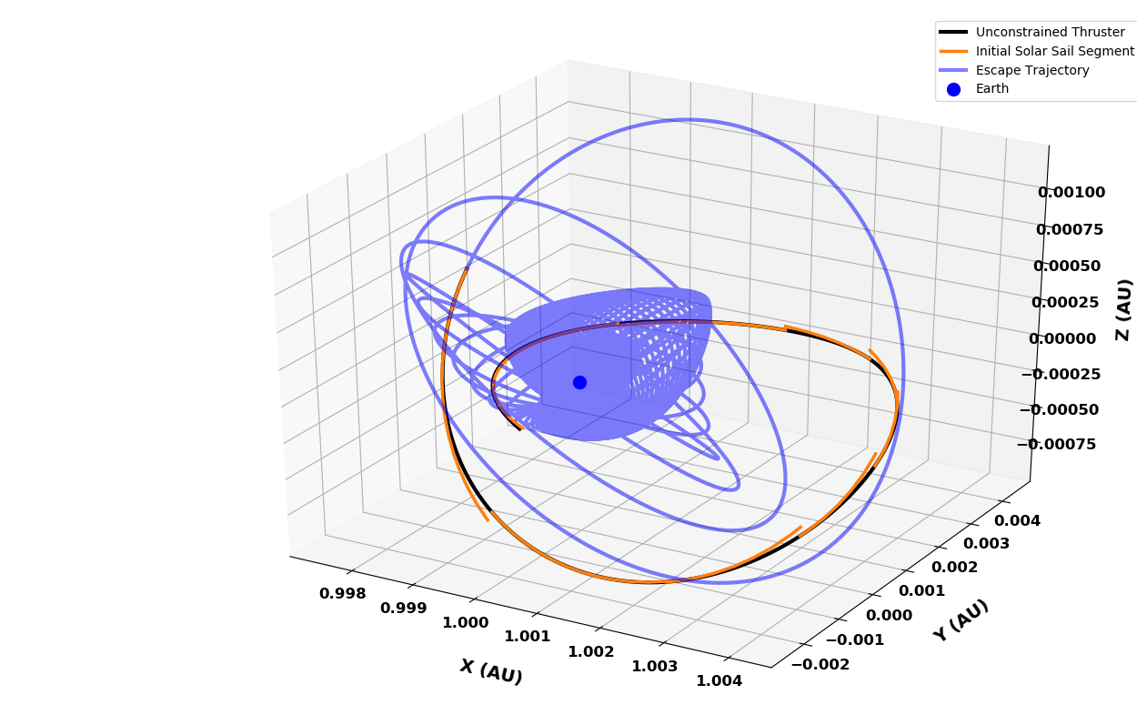
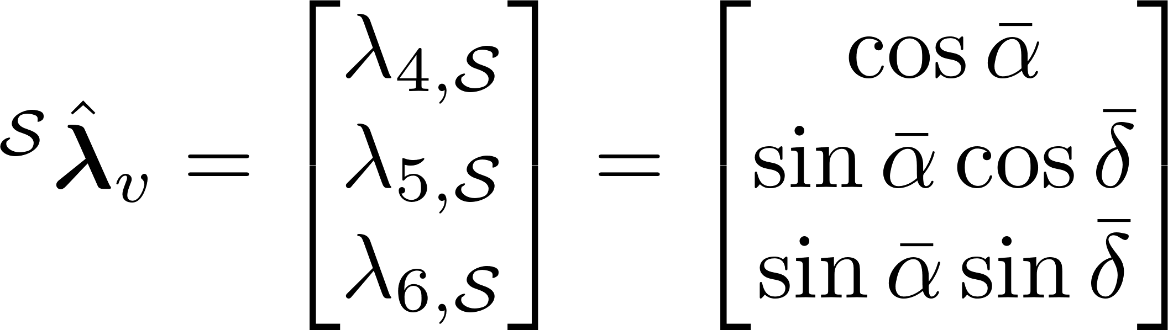

Transfer to the Manifold
Convert “best” velocity costates to angles
Solve a multiple shooting problem⁶ with N = 10 segments
Start with large and decrease after each convergent optimization
  scipy.minimize with SLSQP method
⁶M. Diehl, H. G. Bock, H. Diedam, and P.-B. Wieber, “Fast Direct Multiple Shooting Algorithms for Optimal Robot Control,”
Fast Motions in Biomechanics and Robotics, 2005.
Notes:
With our initial guess, we translate the best thrust values and directions into “pitch” and “clock” angles for the solar sail.
The best method that has worked so far for the solar sail is a multiple shooting strategy, where we discretize the trajectory into segments.
We use 10 segments and on each segment the control angles are held constant. The figure on the right shows what the method looks like during the first iterations.
The constrained optimizations finds the trajectories where the state difference at the intermediate and terminal nodes are below a certain tolerance.
To further help the computation, we start off with a very large sail performance factor and decrease it after each successful optimization until we reach our desired beta.

Slide 13
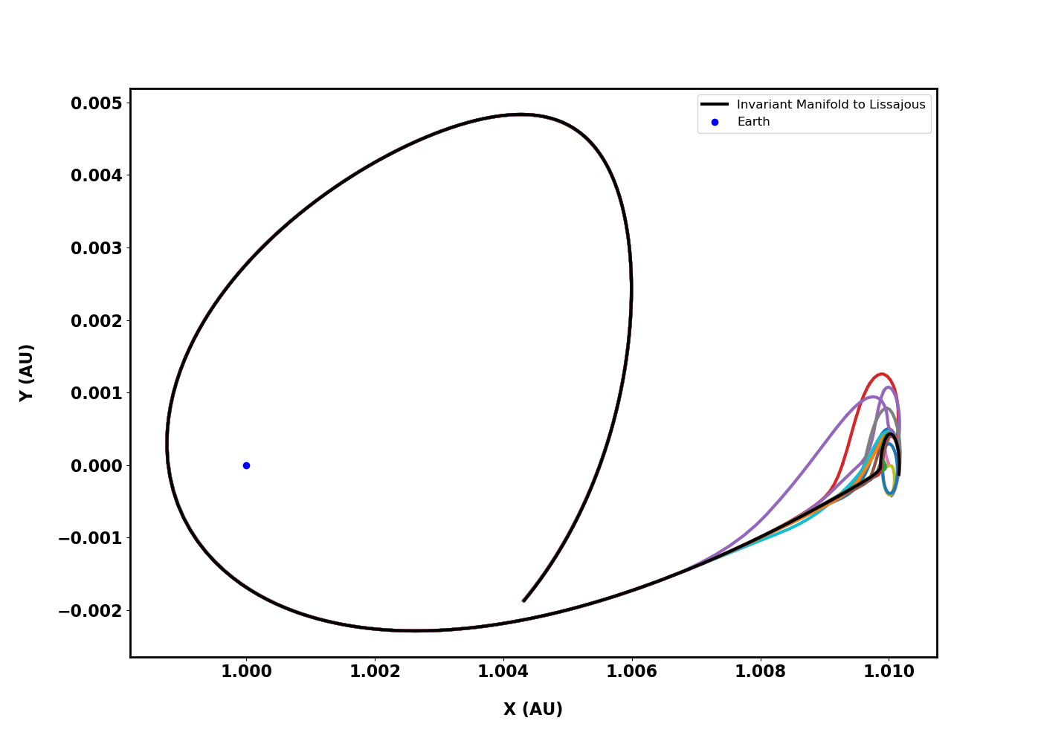
Transfer to the Lissajous
Branch-off point from Manifold
Notes:
The same process is done at the other end of the manifold, since the manifold doesn’t directly lead to an L2 orbit.
At some point near L2, the spacecraft branches away and begins control of its solar sails.
I’ve chosen to inject each module at random points of the Lissajous orbit for now.

Slide 14
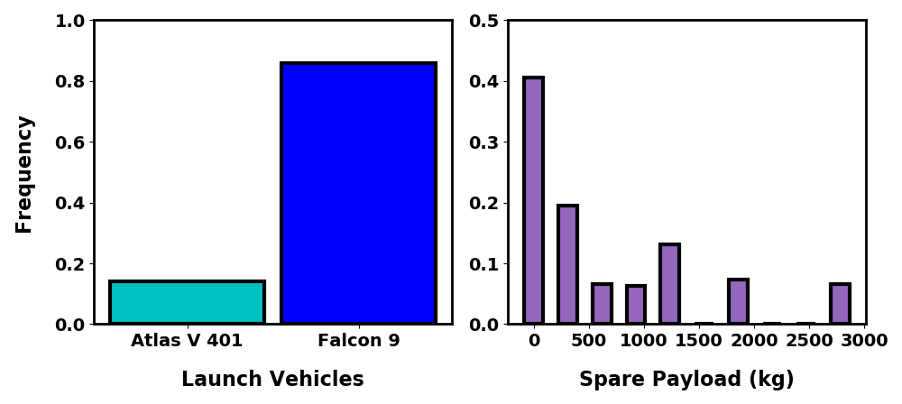
Launch Analysis
Data taken from Launch Log in: http://www.planet4589.org/space/log/launch.html
Notes:
Finally, we know a method of getting to the assembly stage!
But remember that we are looking at 840 of these individual modules.
We looked at launch data from 2016-2018 to see what future launch schedules could look like for these payloads of opportunity.
We found that for the most part, the Falcon 9 was the most frequent launch vehicle to provide opportunities where the fairing and payload was not maximized, followed by the Atlas V 401.
Even then, not every launch could carry spare payload, as shown on the histogram on the right.

Slide 15
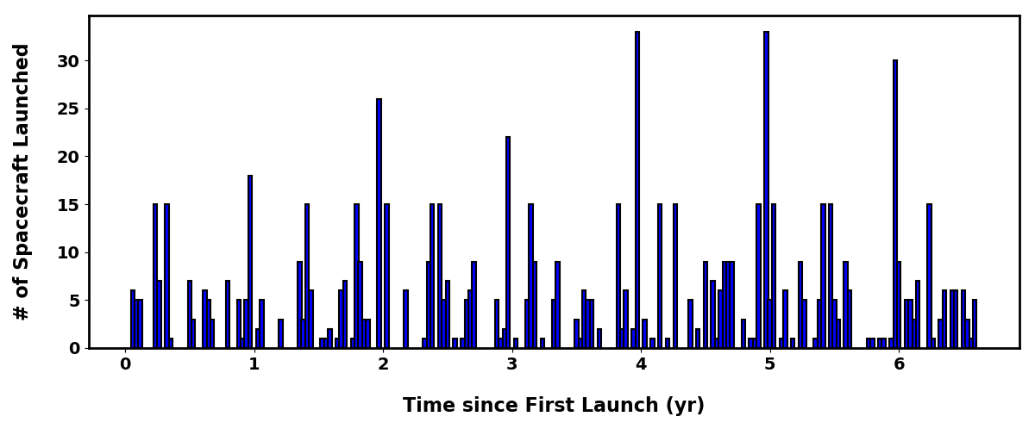
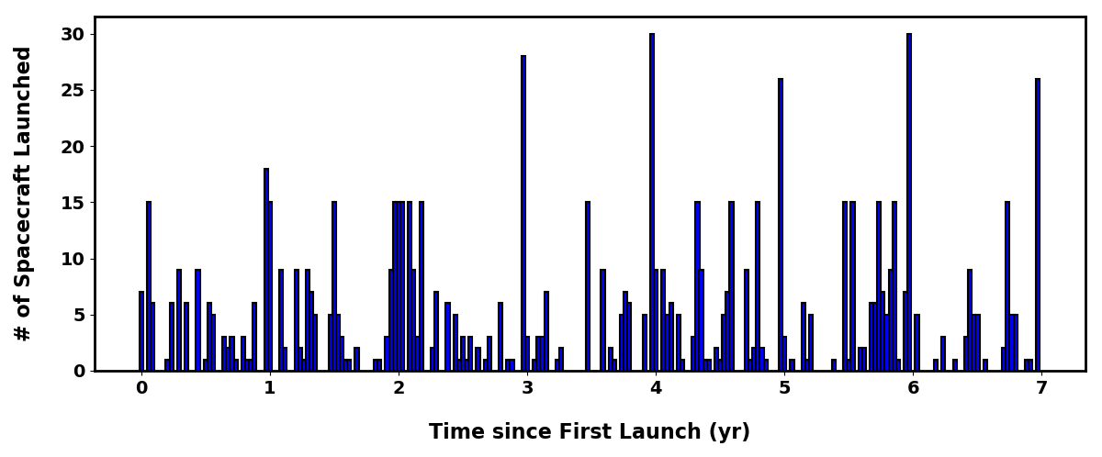
Design Reference Mission
Notes:
But we can use this launch data to predict which and how many future launches would be able to carry payloads of opportunity.
In doing so we are making the conservative estimate that doesn’t project any growth in the orbital launch market.
Sampling from the data we can create a launch schedule as shown here.
We are assuming a total spacecraft mass of around 200 kg and we used that number to quantify the amount of spacecraft launched at a time.
As shown, we can successfully launch every single one of the 840 modules as payloads of opportunity within 6 years without needing dedicated launches.

Slide 16
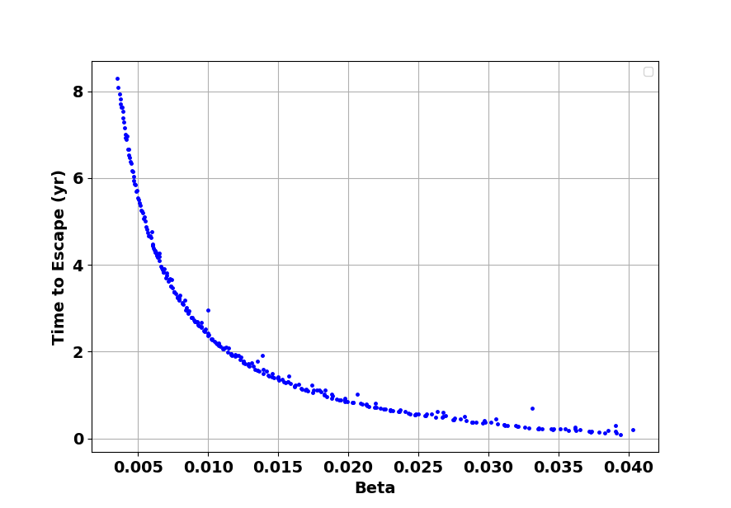
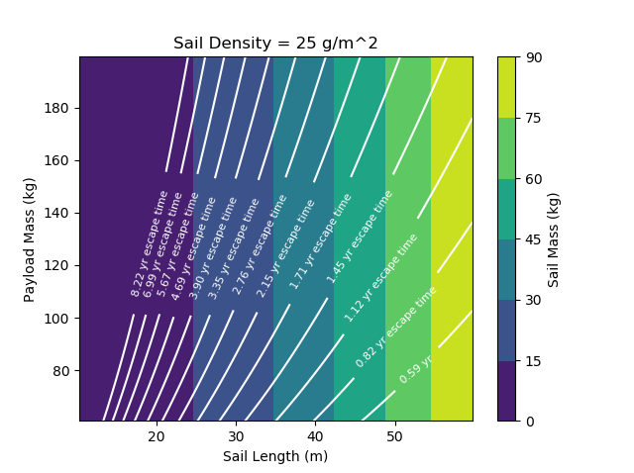
Designing the Sail
Notes:
To design the actual sailcraft, we studied the parameter space of the sail and combined it with some results from our dynamic model.
We chose a fixed sail density (sigma s) as 25 g/m2, similar to the JPL’s NEA scout including all support structures.
In parallel, we simulated Earth escape trajectories using different sail performance values and found an inverse relationship between the two.
On the right, we made a contour map of the Beta parameters as a function of sail length and payload mass but replaced Beta parameters with their corresponding Earth escape times.
We used this contour map

Slide 17
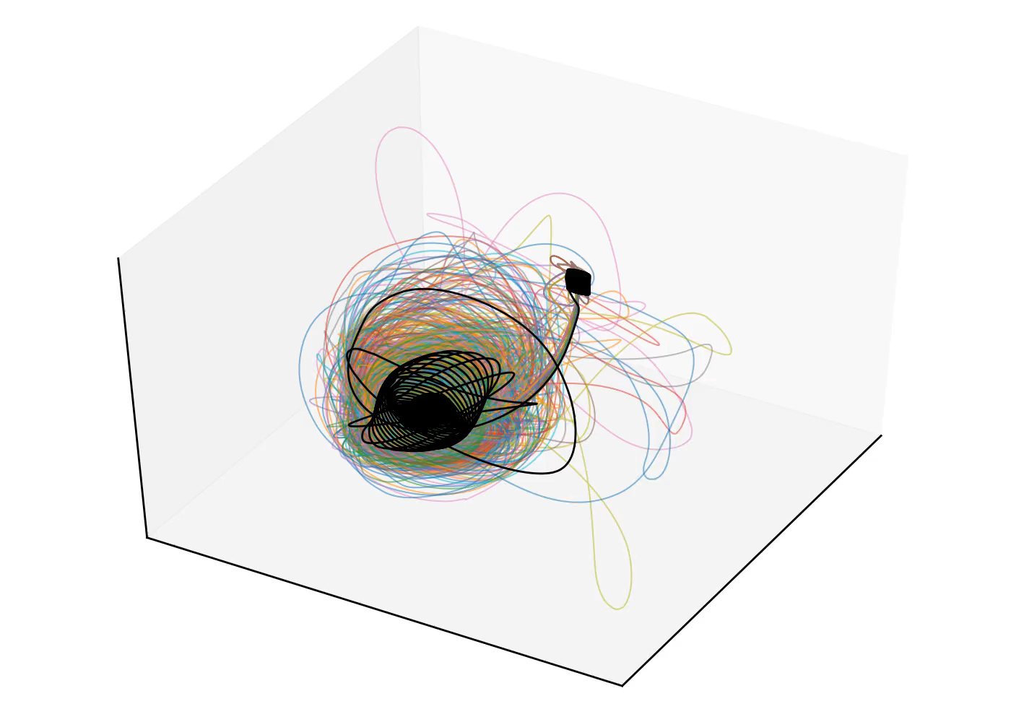
Full Trajectories from Earth to L2

Slide 18
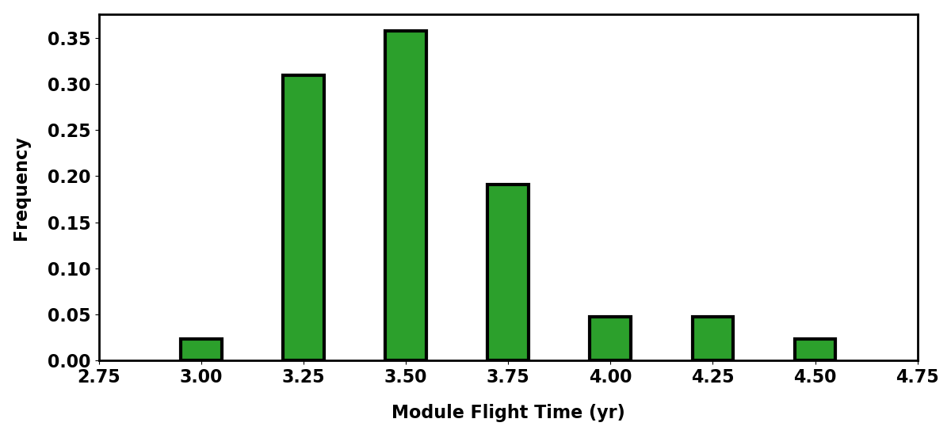
Full Trajectories from Earth to L2

Slide 19
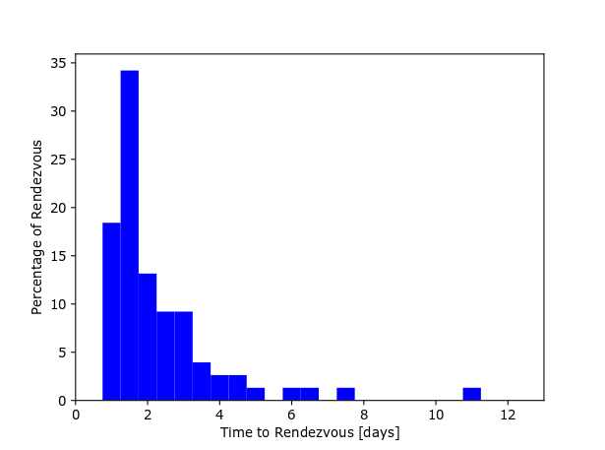
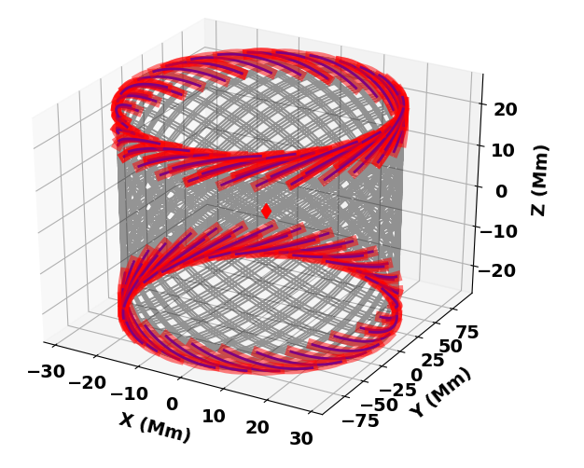
Rendezvous

Slide 20
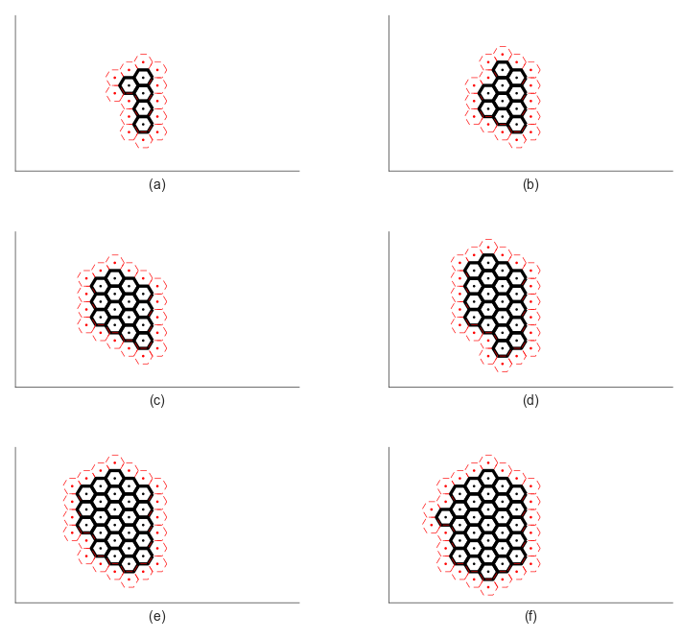
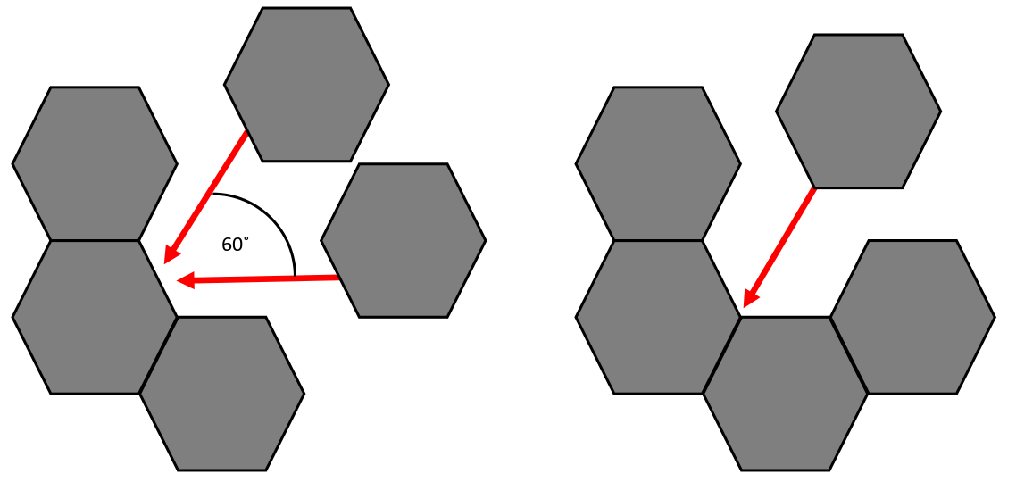
Docking

Slide 21
Conclusions
Simulate future launch schedules using 2016-2018 launch data
  840 modules launched within 6-7 years
  All injected into Lissajous within 11 years
Developed tools to simulate full mission from Earth to L2 Lissajous orbits
  Uses standard Python packages including numpy and scipy
  Design tools for selecting sail parameters coupled with Earth escape times
Close encounters (within 1000 km) occur when spacecraft are n periods apart
  Solar sail rendezvous takes, on average, about 2 days

Slide 22

Solar Sail Trajectories and Orbit Phasing of Modular Spacecraft for Segmented Telescope Assembly about Sun-Earth L2
Gabriel Soto, Erik Gustafson, Dmitry Savransky, Jacob Shapiro, Dean Keithly
Paper Number: AAS 19-774
15th August 2019
This work was supported by NIAC Grant 80NSSC18K0869.

Slide 23
Backup Slides

Slide 24
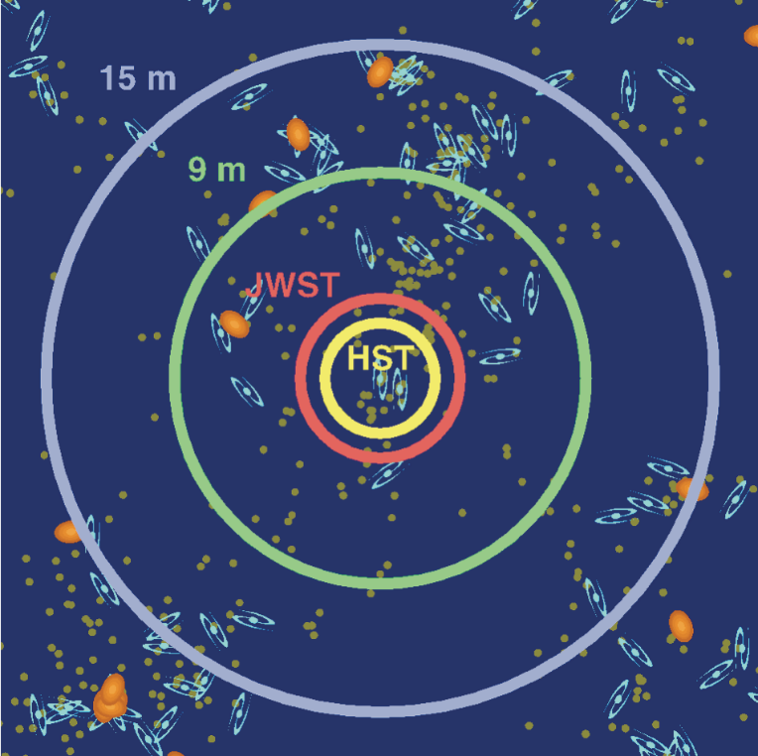
Observe Main Sequence Turnoff Point
Observability of main sequence turnoff at different telescope scales
  SNR = 5
  100 hours of integration time
  V and I bands
  Captures the local group
31 m telescope would effectively be sensitive throughout the entire observable universe.
From: LUVOIR Interim Report¹.
Figure by T. Brown.

Slide 25
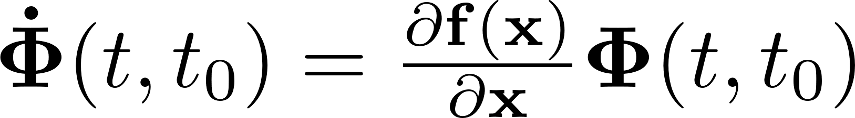
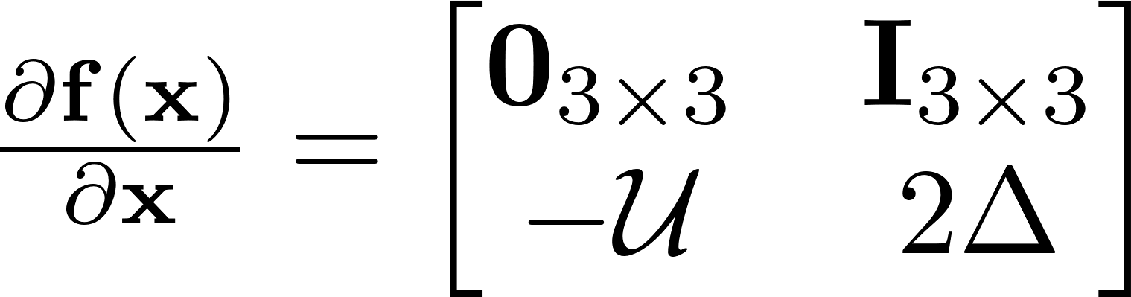
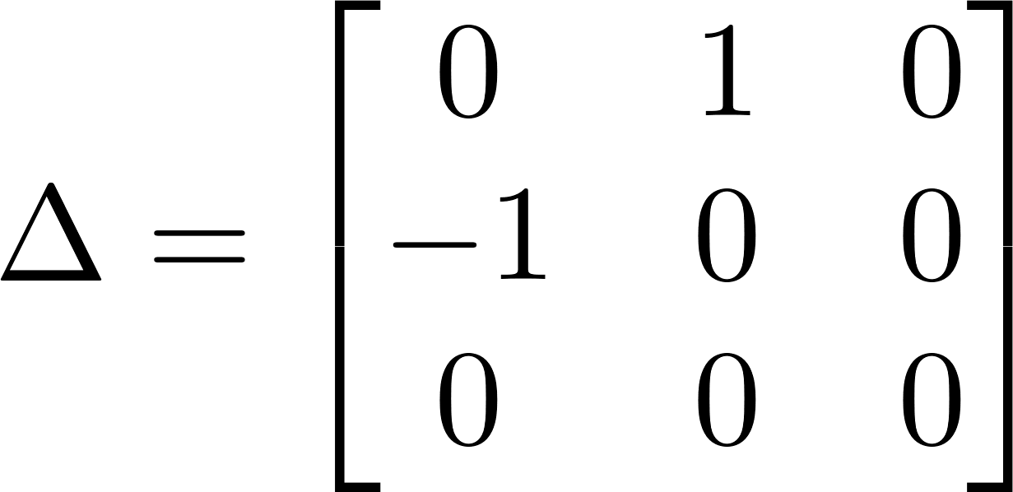
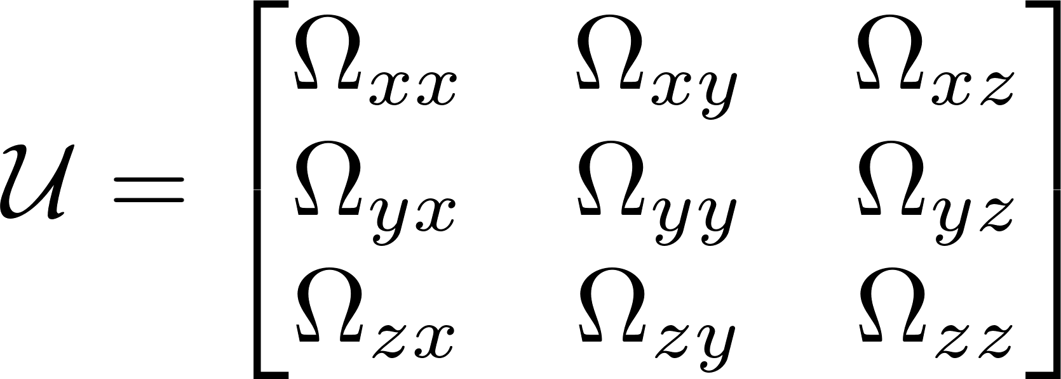
Invariant Manifold Analysis
Differential Correction
Monodromy Matrix
Notes:
In order to get to the Lissajous, we use the help of invariant manifolds near L2.
The invariant manifolds are computed through the monodromy matrix of a periodic orbit – we use a vertical Lyapunov for reference.
The monodromy matrix is the state transition

Slide 26
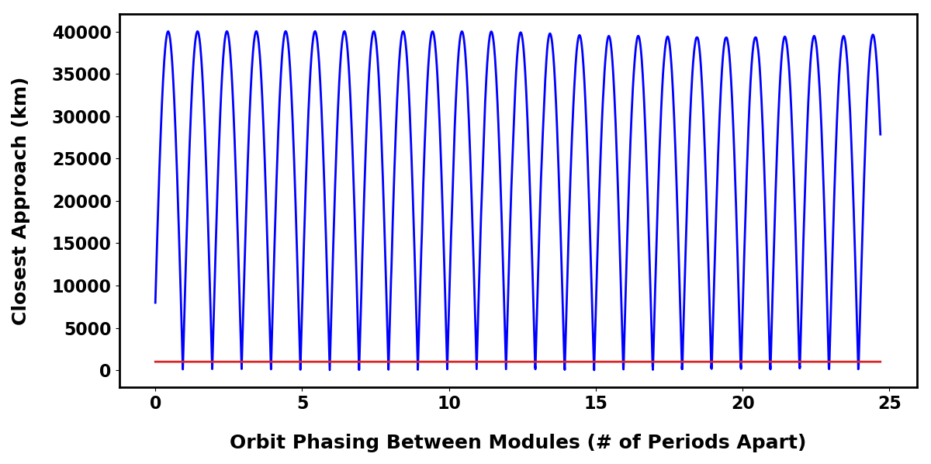
Orbit Phasing

Slide 27
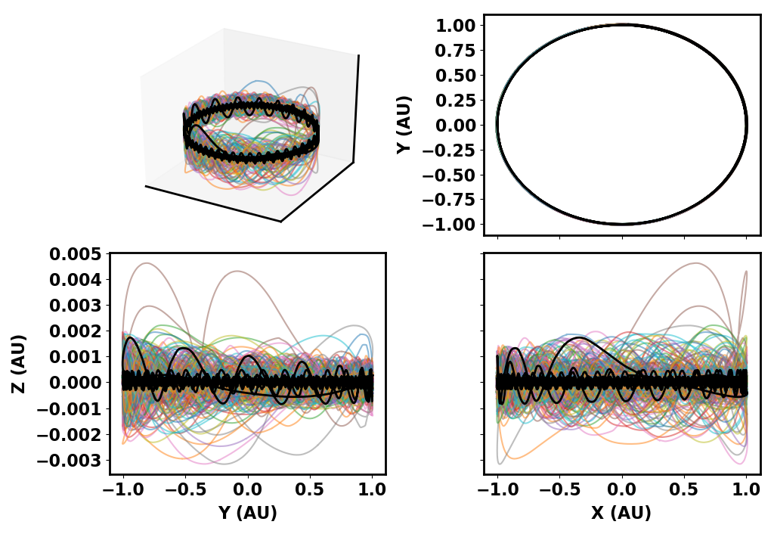
Full Trajectories in the Inertial Frame

