Slide 1



Identifying Exoplanets with CSP Filtering and a Forward Model Matched Filter
Jan 7, 2020
AAS #342.04
Jacob Shapiro, Dmitry Savransky, Jean-Baptiste Ruffio
This work is supported by NASA Grant No. NNX16AI13G

Slide 2
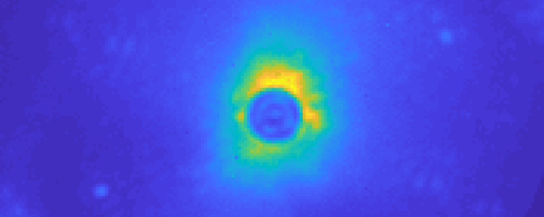
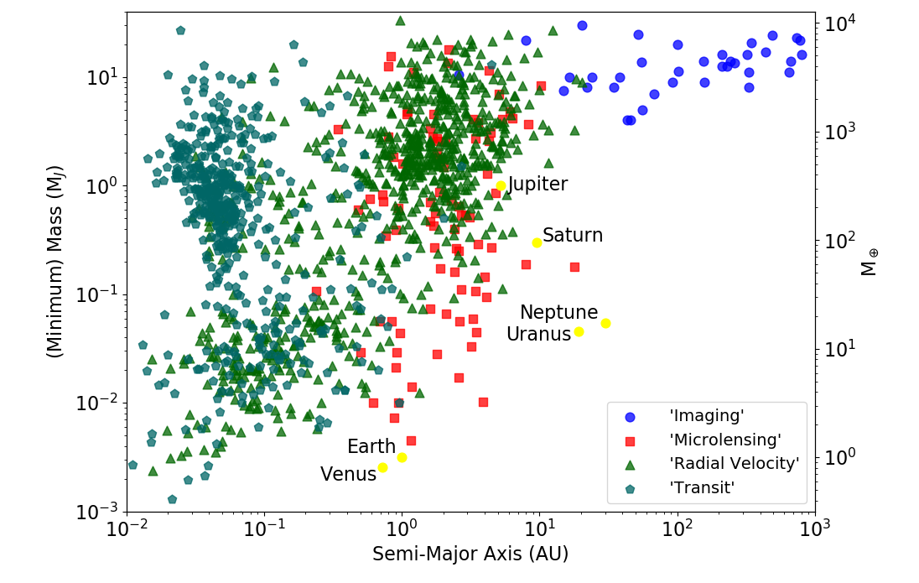
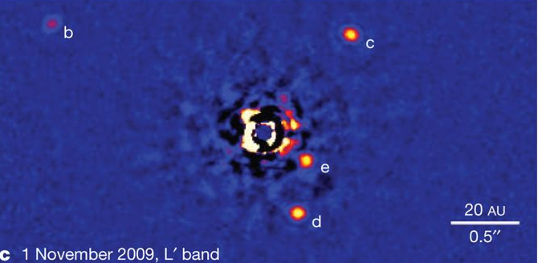
Direct Imaging
Direct Imaging Overview | Using Image Data | PCA & CSP | FMMF | Initial Results | Statistical Results
Marois, 2010
Notes:
What is it?
Why is it hard?
What’s a coronagraph?

Slide 3
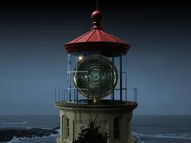
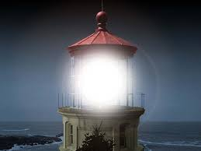
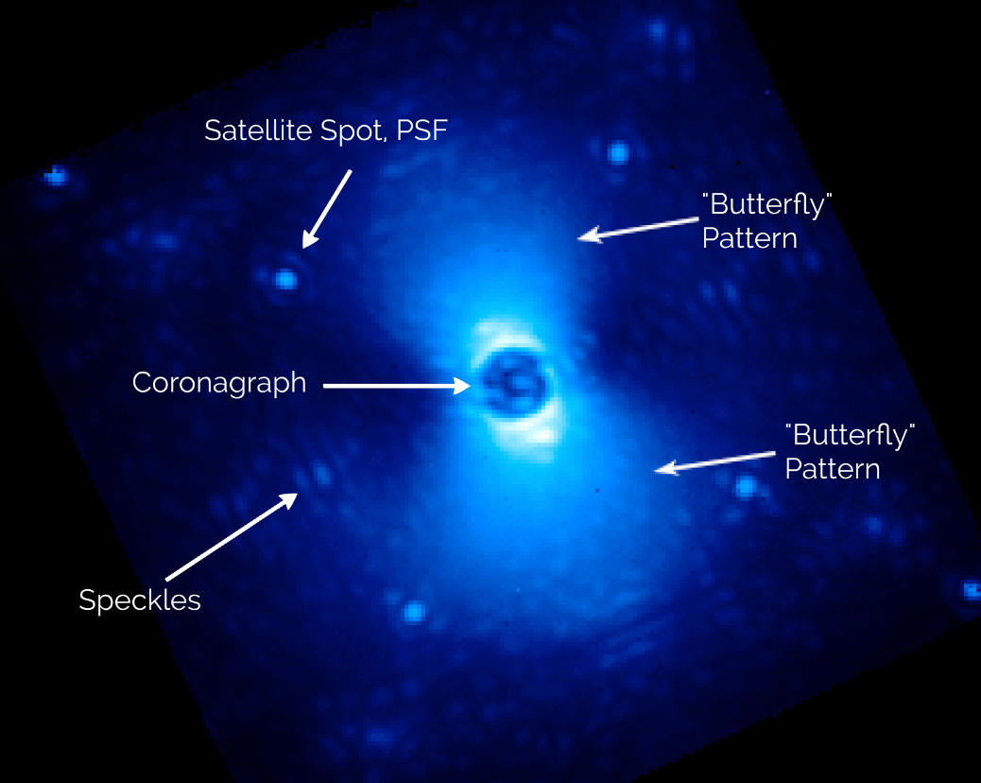
Noisy Images
Direct Imaging Overview | Using Image Data | PCA & CSP | FMMF | Initial Results | Statistical Results
University of Texas
Perrin, 2014

Slide 4
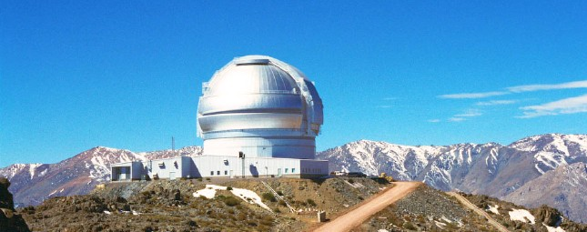
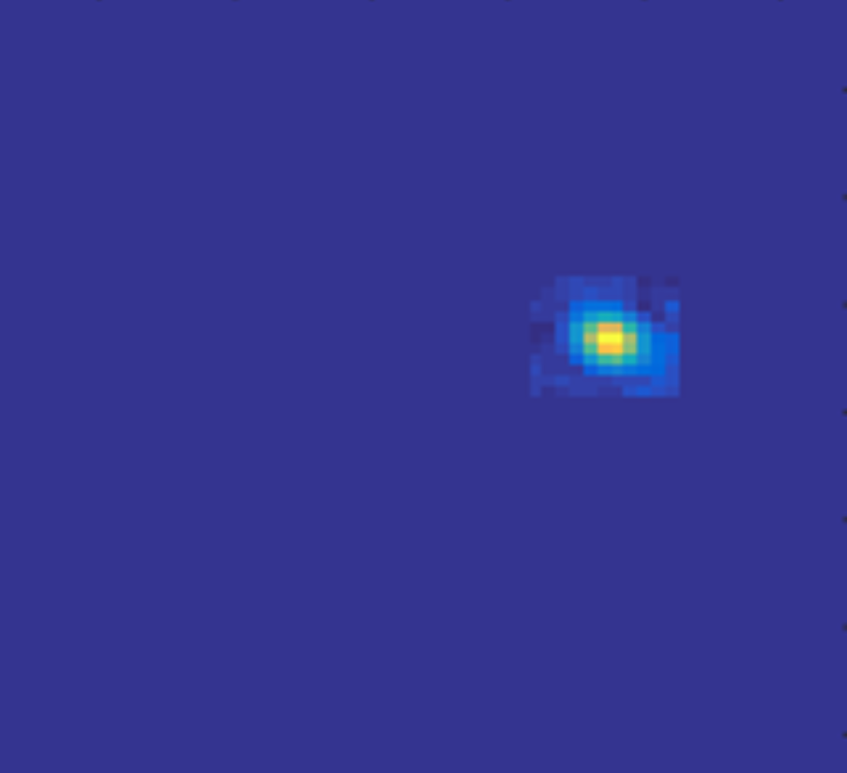
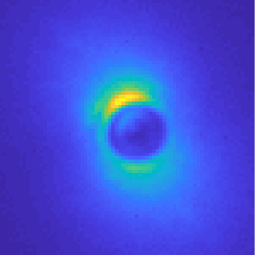
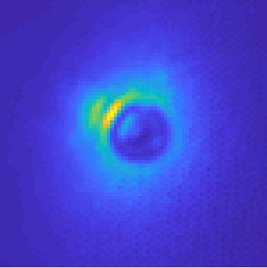
Data Used
Direct Imaging Overview | Using Image Data | PCA & CSP | FMMF | Initial Results | Statistical Results
Gemini Planet Imager
Near Infrared
Like Observations:
  H-Band
  Star Magnitude
  AO Performance
Injected Planet Sample
HD 14706
Β Pictoris
Notes:
Gemini South, All the way from Chile

Slide 5
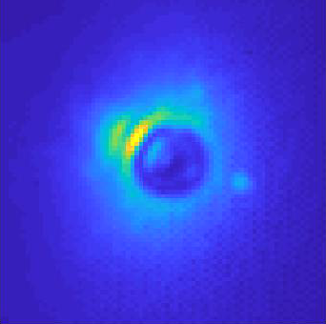
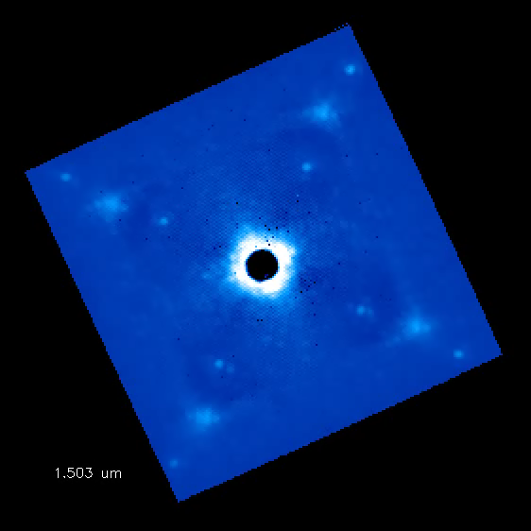
Spatial Diversity of the Planet Signal
Direct Imaging Overview | Using Image Data | PCA & CSP | FMMF | Initial Results | Statistical Results
Temporal
Wavelength
Notes:
I made left one, in both the planet signal is severely exaggerated.

Slide 6
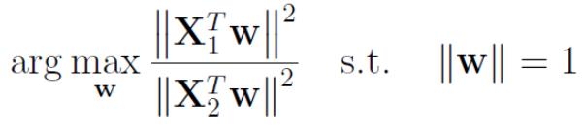
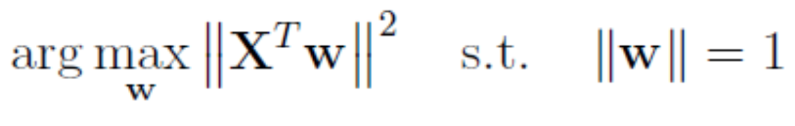
PCA vs CSP
Direct Imaging Overview | Using Image Data | PCA & CSP | FMMF | Initial Results | Statistical Results
Principal Component Analysis
Common Spatial Pattern Filtering
Finds direction of maximum variance
Models the noise
Subtracts the noise
Finds direction of maximum difference
Planet should be part of the “difference”
Models the planet signal

Slide 7
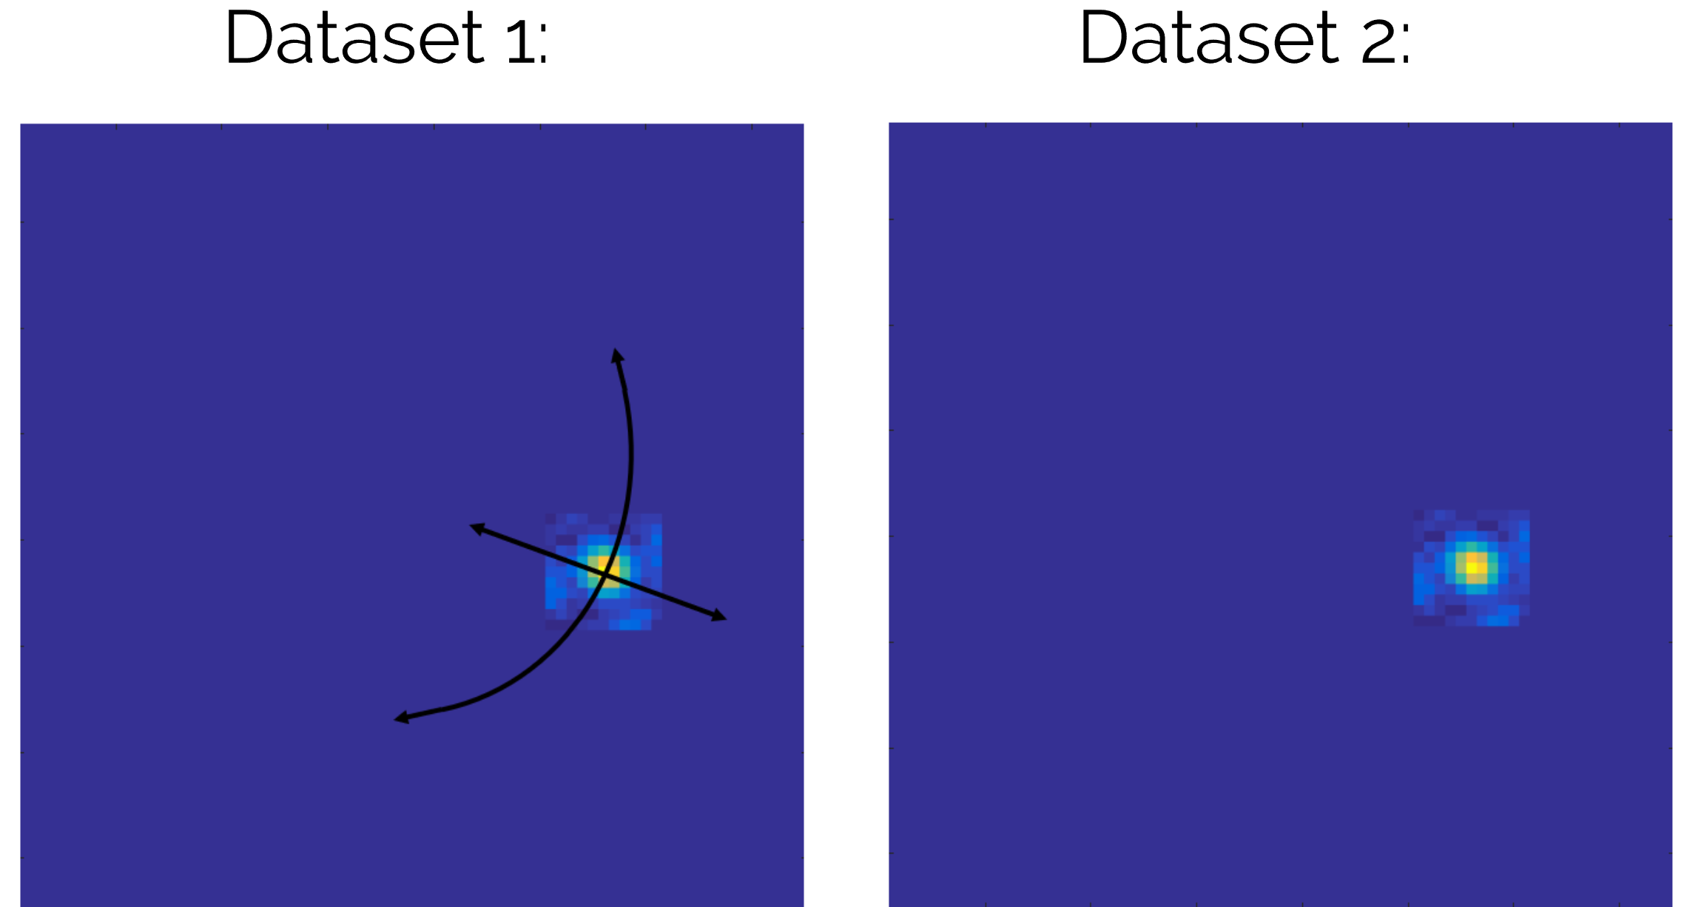
CSP: Designing X₁ and X₂
Direct Imaging Overview | Using Image Data | PCA & CSP | FMMF | Initial Results | Statistical Results

Slide 8
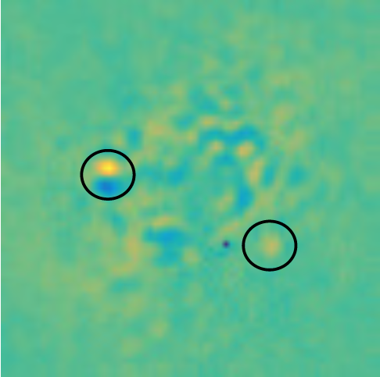
CSP: Processed
Direct Imaging Overview | Using Image Data | PCA & CSP | FMMF | Initial Results | Statistical Results
Pretty Lousy

Slide 9

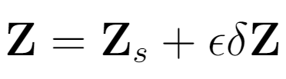
New Strategy – Forward Model, Matched Filter
Direct Imaging Overview | Using Image Data | PCA & CSP | FMMF | Initial Results | Statistical Results
We want:
Increase signal to noise ratio
Remove false positives
Model only the effects of the planet
Original Science Images
Do CSP
CSP Results
Higher SNR
Matched Filter
Perturbation Model Images
Forward Model
Difference Due to Planet

Slide 10
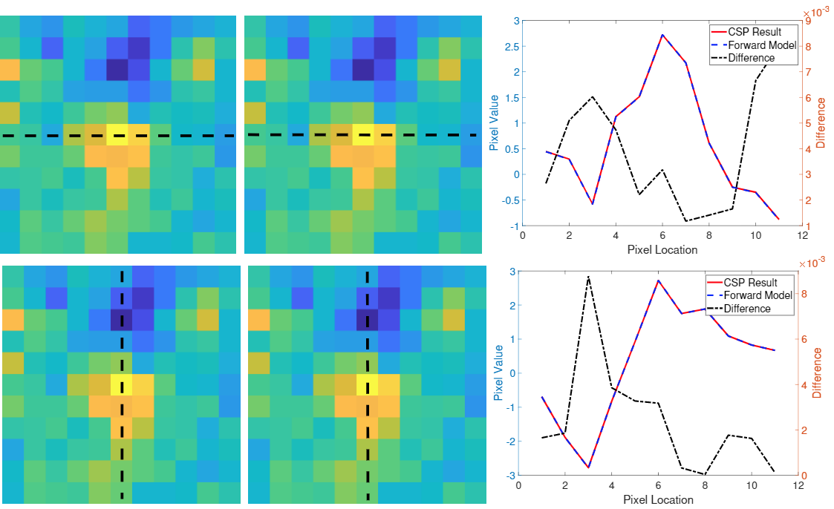
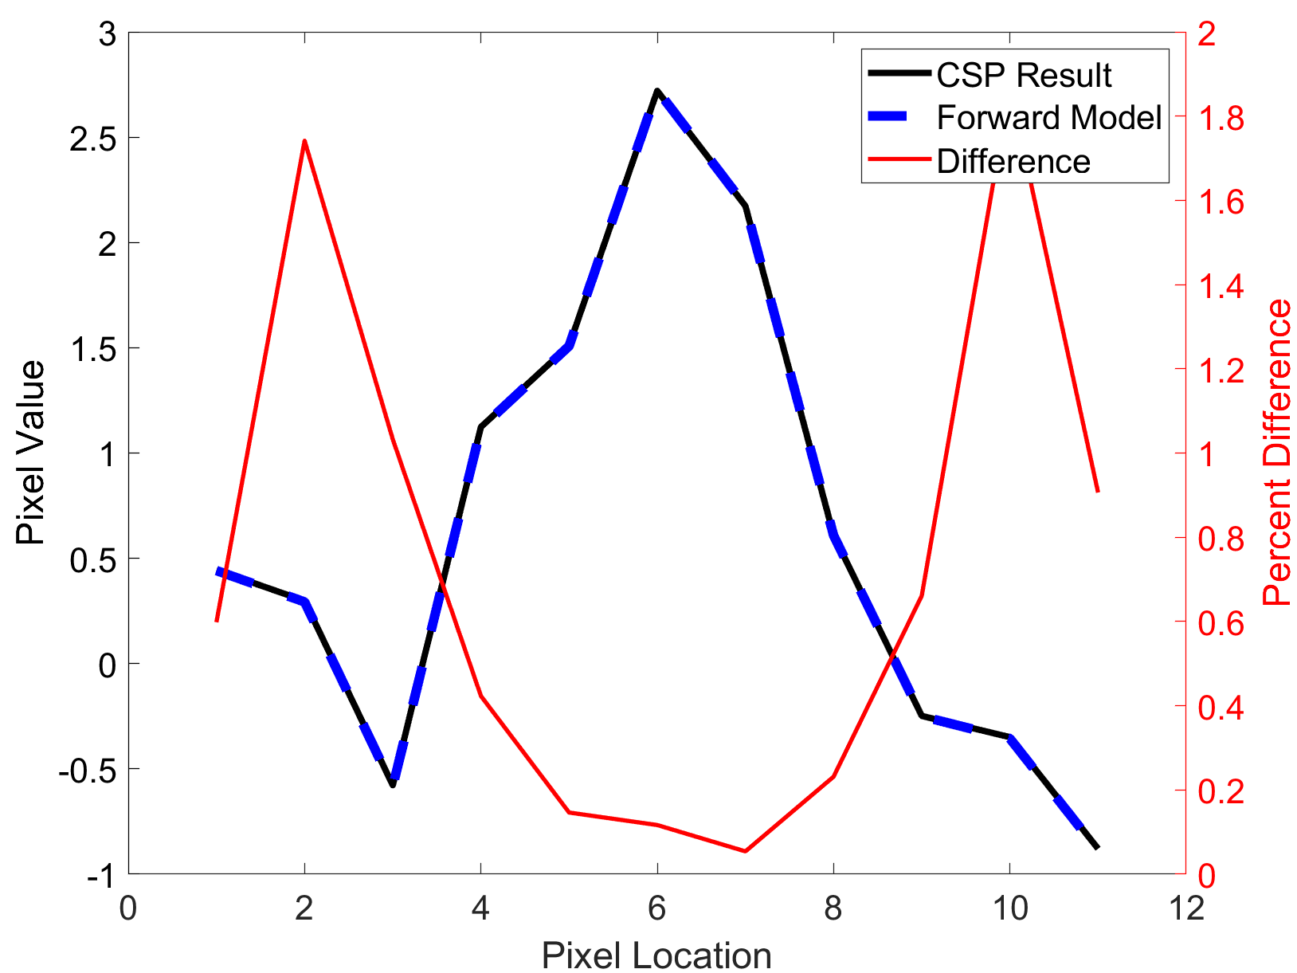
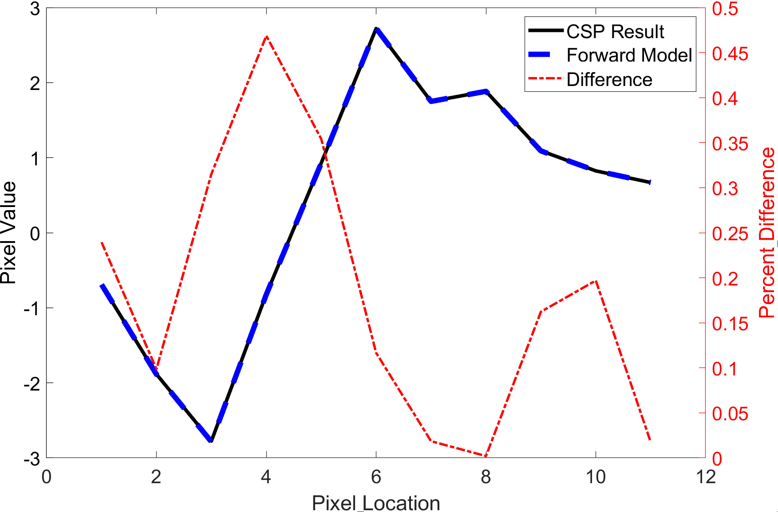
Forward Model Accuracy
Direct Imaging Overview | Using Image Data | PCA & CSP | FMMF | Initial Results | Statistical Results

Slide 11
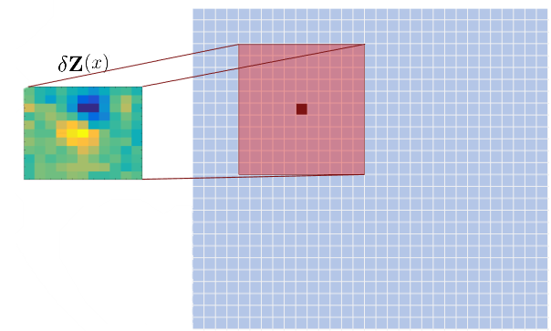
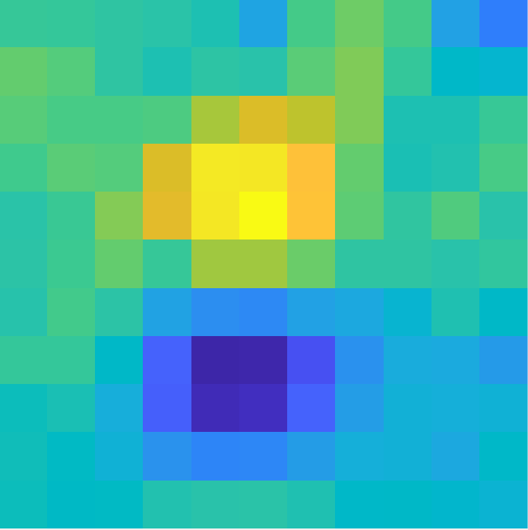
Matched Filter
Direct Imaging Overview | Using Image Data | PCA & CSP | FMMF | Initial Results | Statistical Results
Compare the template to a set of pixels
Repeat for every pixel in the image

Slide 12
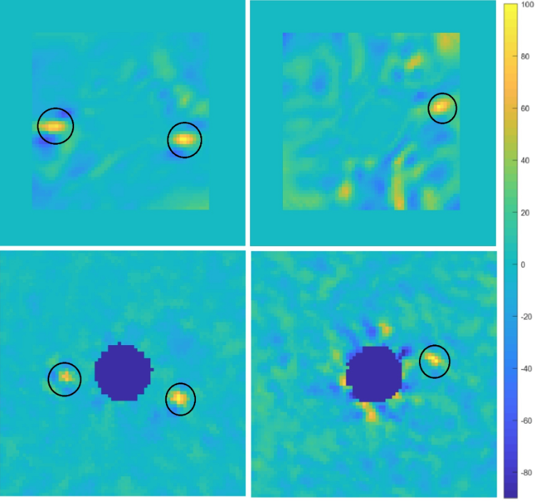
Results
Direct Imaging Overview | Using Image Data | PCA & CSP | FMMF | Initial Results | Statistical Results
β Pictoris HD 14706
CSP
PCA
Signal to Noise Ratios
 | CSP | PCA
Β Pic 1 | 14.47 | 13.05
Β Pic 2 | 11.79 | 9.97
HD 14706 | 6.90 | 10.65

Slide 13
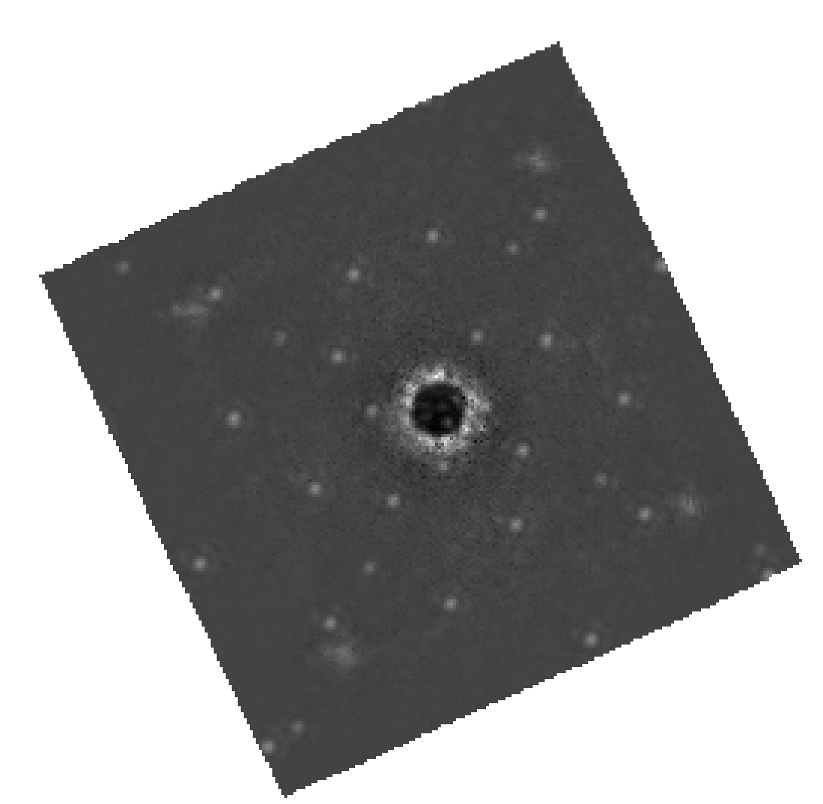
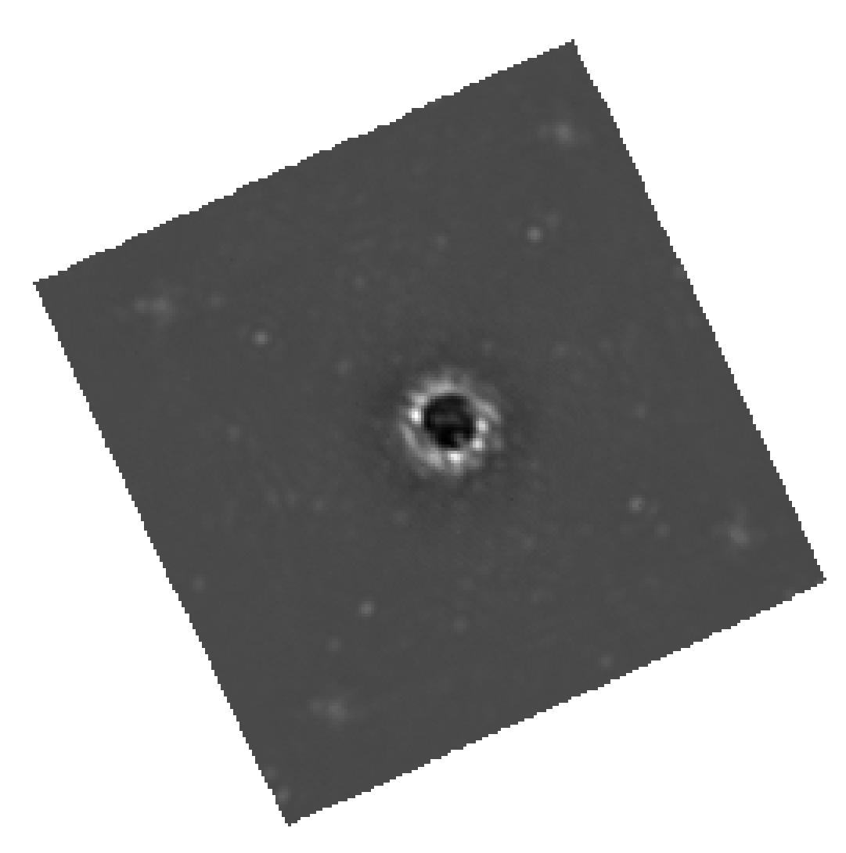
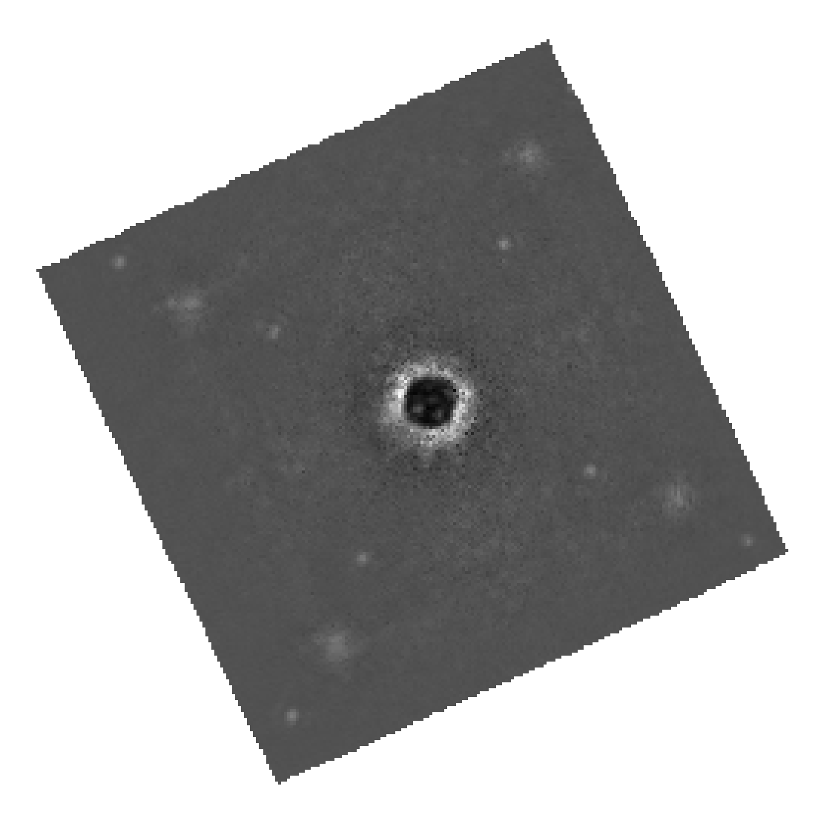
Many Planets, Locations, and Datasets
Direct Imaging Overview | Using Image Data | PCA & CSP | FMMF | Initial Results | Statistical Results

Slide 14
Determining Metrics
Direct Imaging Overview | Using Image Data | PCA & CSP | FMMF | Initial Results | Statistical Results
Use 3 Contrast levels:
  10⁻⁵ – Above critical SNR
  10⁻⁶
  10⁻⁸ – Below critical SNR
For given injection, interpolate SNR
Build contrast map:
  Separation vs. contrast
  SNR contours
Build ROC curve to measure false-positive rate

Slide 15
Conclusions
Direct Imaging Overview | Using Image Data | PCA & CSP | FMMF | Initial Results | Statistical Results
Summary
Common Spatial Pattern Filtering is used in a new technique for direct imaging
Directly measures planet signal
A forward model of the process improves the SNR of detections
SNR is comparable to current methods
Next Steps
Compute across many datasets
Determine critical SNR for this method
Develop Contrast maps
Compare across different noise regimes

Slide 16
Identifying Exoplanets with CSP Filtering and a Forward Model Matched Filter
Jan 7, 2020
AAS #342.04
Jacob Shapiro, Dmitry Savransky, Jean-Baptiste Ruffio
This work is supported by NASA Grant No. NNX16AI13G

