Slide 1
Planning Direct Imaging Observations of Exoplanets with Precursor Data
Corey Spohn

Slide 2
Direct Imaging
The Search for Habitable Worlds
Radial Velocity
“[to search for biosignatures around Sun-like stars] only an ultra-stable, space-based telescope equipped to block the star’s light and directly image the planet can reach this level of sensitivity”
– Astro2020 Decadal
“For a direct imaging mission precise radial velocities will identify terrestrial exoplanets orbiting nearby stars and determine when they are situated at quadrature”
– Astro2020 Decadal

Slide 3
Exoplanet Orbits

Slide 4
Radial Velocity

Slide 5
Direct Imaging

Slide 6
The problem

Slide 7
Orbits consistent with the RV data

Slide 8
Obscuration constraint

Slide 9
Photometric constraint

Slide 10
Probability of Detection

Slide 11
Direct imaging telescopes
 | Nancy Grace Roman Space Telescope “Roman” | HabEx | LUVOIR | Habitable Worlds Observatory “HWO”
Description | NASA telescope launching in 2027 | Mission concept studied for 2020 decadal | Mission concept studied for 2020 decadal | Proposed mission concept in response to 2020 decadal ~2040 launch
Primary mirror | 2.4 meter | 4 meter | 8 or 15 meter | 6 meter
Relevance | - Coronagraph technology demonstration - Directly image exozodiacal dust | - Directly image habitable planets | - Directly image habitable planets | - Directly image habitable planets

Slide 12
Calculating a realistic photometric constraint

Slide 13
What can the Roman Space Telescope detect?
Observing mode
Narrow field
Spectrometer
Wide field
Integration time
1 day
30 days
Assumed errors

Slide 14
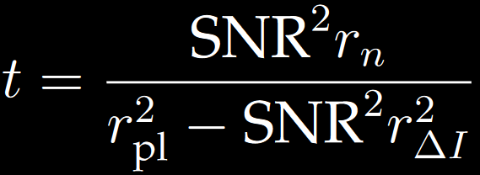
Inverting an exposure time calculator
Signal-to-noise Ratio
Noise count rate
Necessary exposure/integration time
Planet signal count rate
Residual speckle count rate
Nemati, B., Stahl, H. P., Stahl, M. T., Ruane, G. J. J. & Sheldon, L. J. Method for deriving optical telescope performance specifications for Earth-detecting coronagraphs. https://doi-org.proxy.library.cornell.edu/10.1117/1.JATIS.6.3.039002 6, 039002 (2020).

Slide 15
Rate coupling
Speckle noise
Local zodiacal light
Exozodiacal light
Detector noise
Nemati, B., Stahl, H. P., Stahl, M. T., Ruane, G. J. J. & Sheldon, L. J. Method for deriving optical telescope performance specifications for Earth-detecting coronagraphs. https://doi-org.proxy.library.cornell.edu/10.1117/1.JATIS.6.3.039002 6, 039002 (2020).

Slide 16
Rate coupling
Detector noise
Dark current
Clock induced charge
CCD read noise
Dark current
Pixels of image area (planet region)

Slide 17
Minimization results

Slide 18
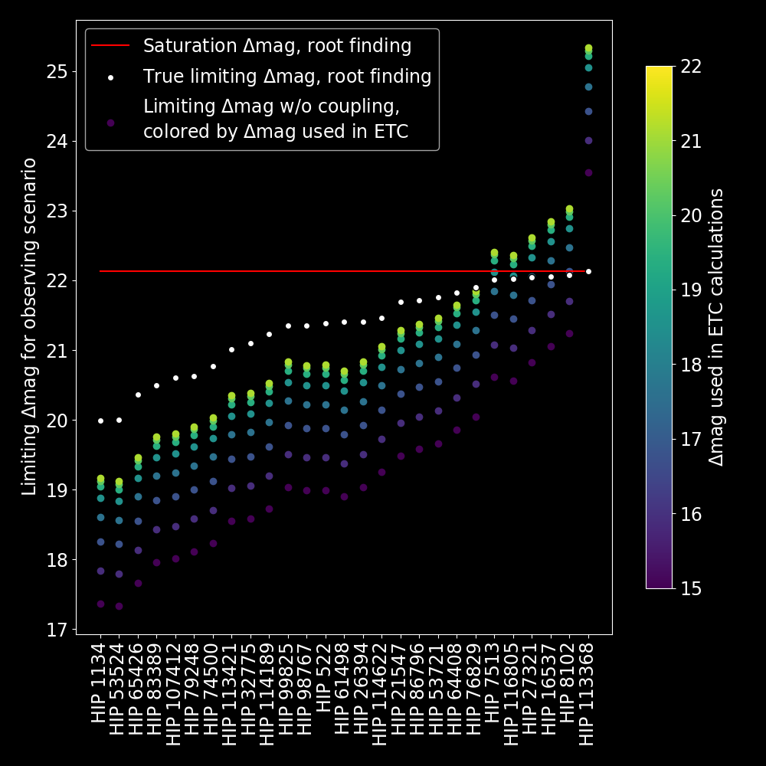
Errors when done analytically

Slide 19
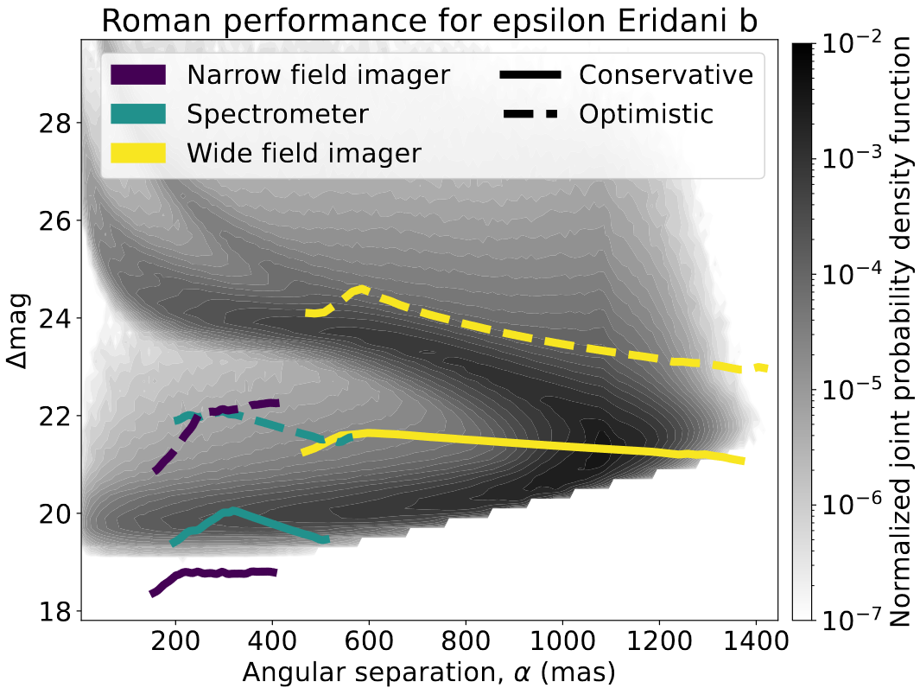
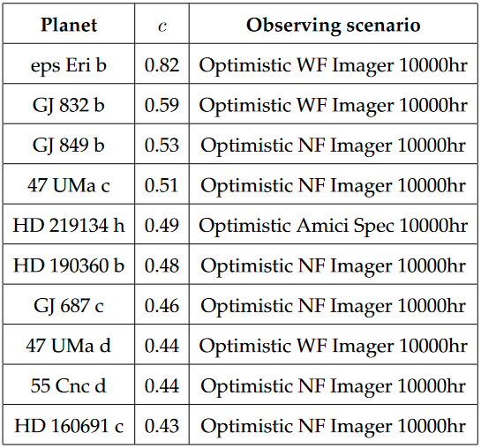
Observing scenario completeness

Slide 20
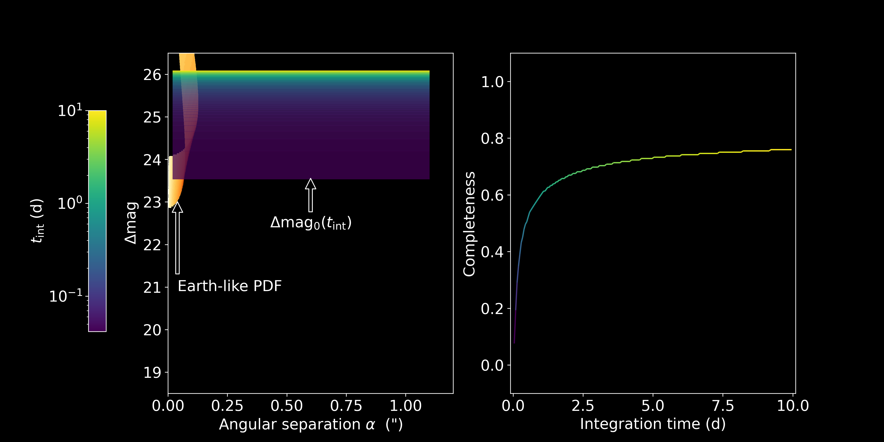
Integration time dependence

Slide 21
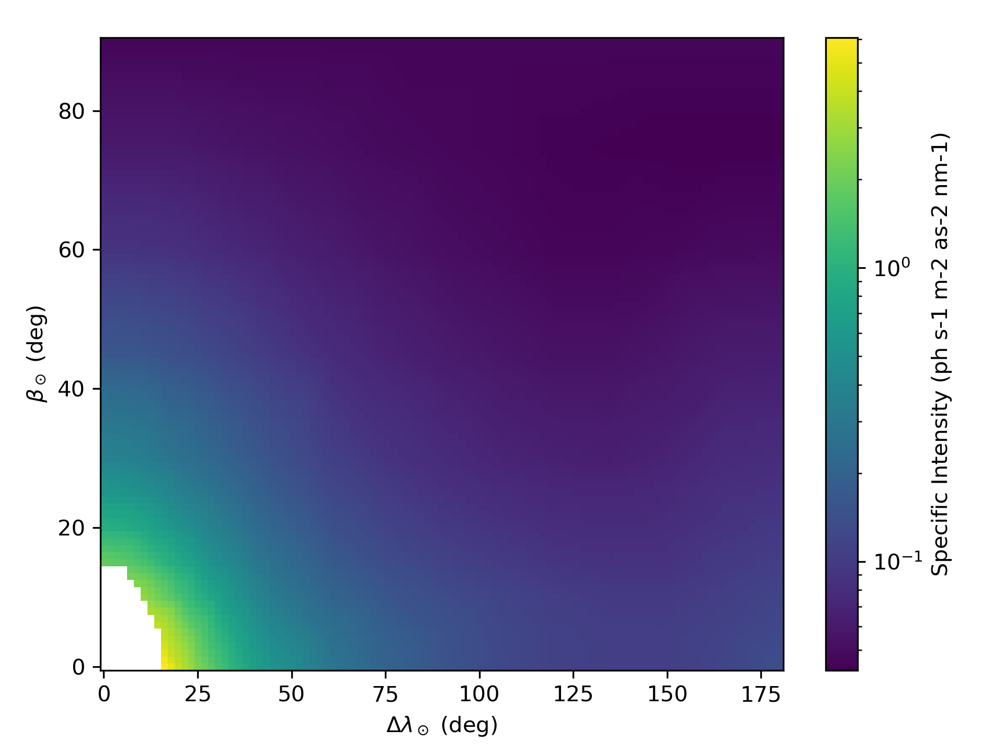
Zodiacal Light
Local zodiacal light is light reflected off dust in the solar system and into the telescope
Distribution taken from
Leinert, C. et al. The 1997 reference of diffuse night sky brightness. Astron. Astrophys. Suppl. Ser. 127, 1–99 (1998).

Slide 22
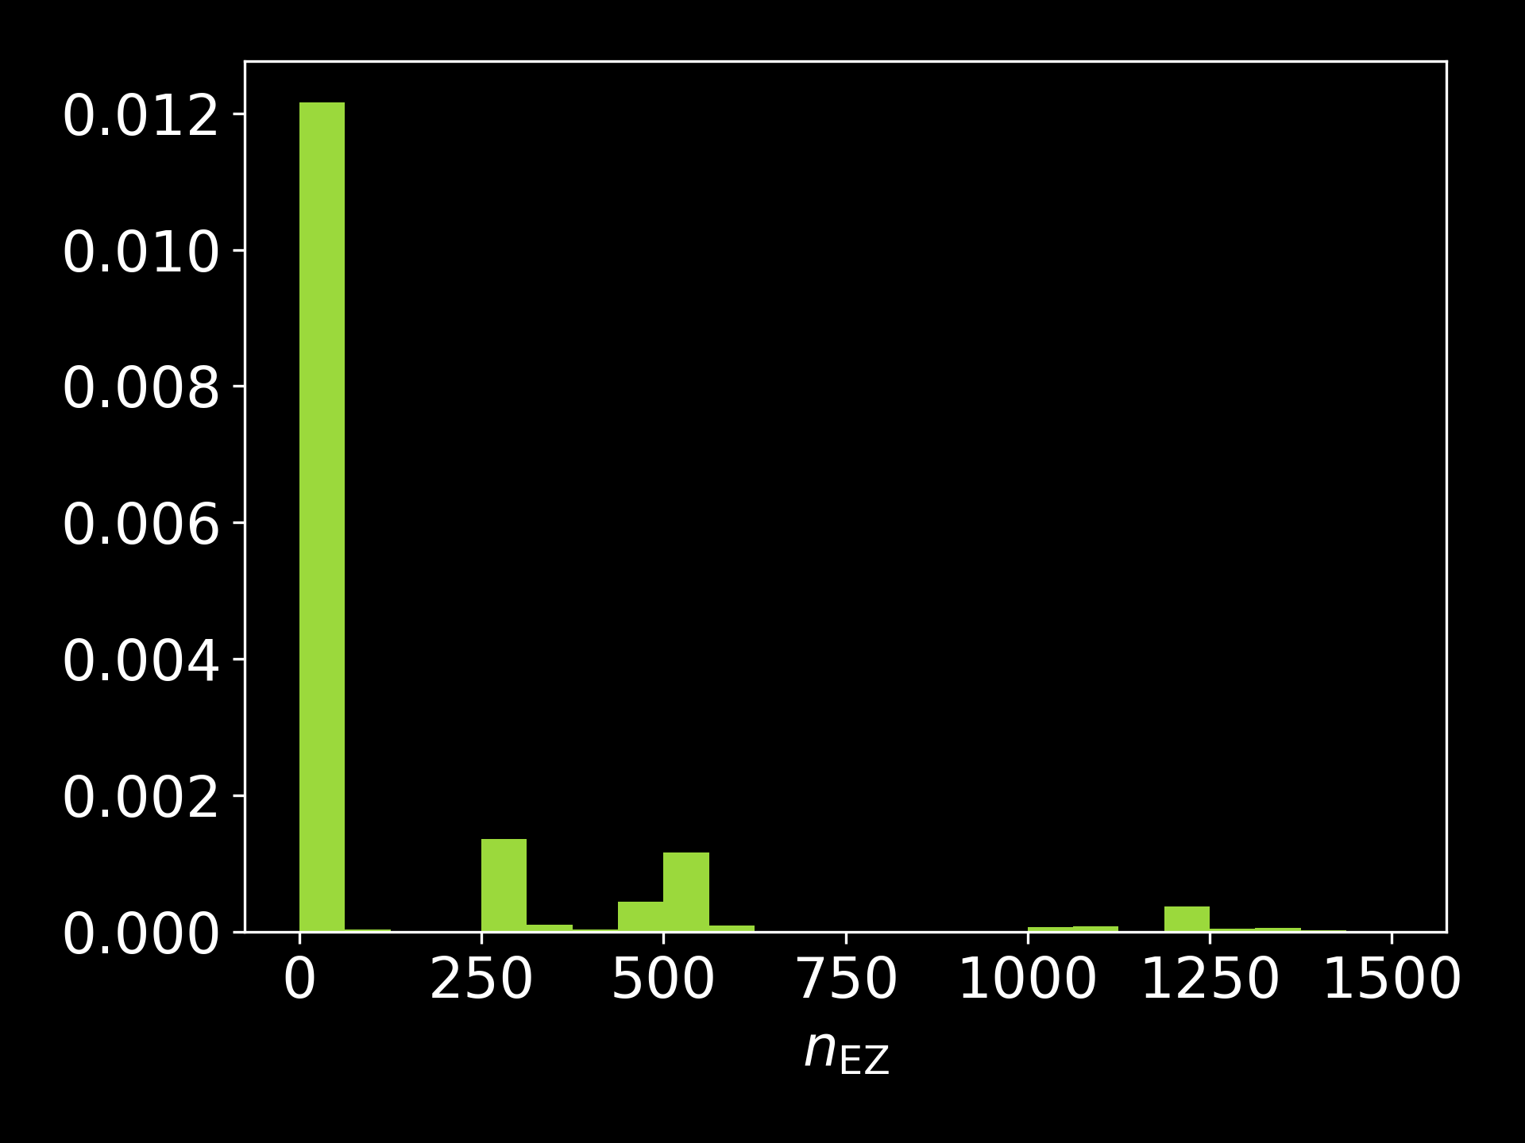
Exozodiacal light
Amount of dust in the target planetary system
n_{EZ}=1 “zodi” represents an equivalent amount of dust to the solar system
Distribution taken from HOSTS survey done at the Large Binocular Telescope Interferometer (LBTI)
Ertel, S. et al. The HOSTS Survey for Exozodiacal Dust: Observational Results from the Complete Survey. The Astronomical Journal 159, 177 (2020).

Slide 23
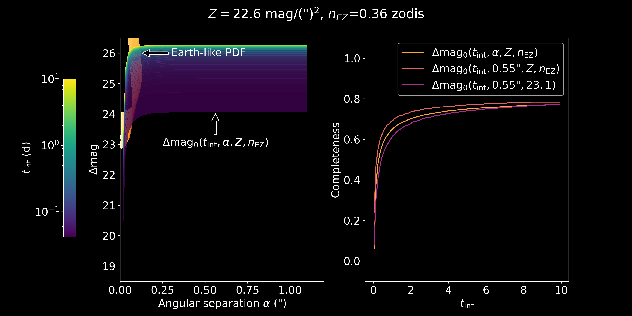

Slide 25
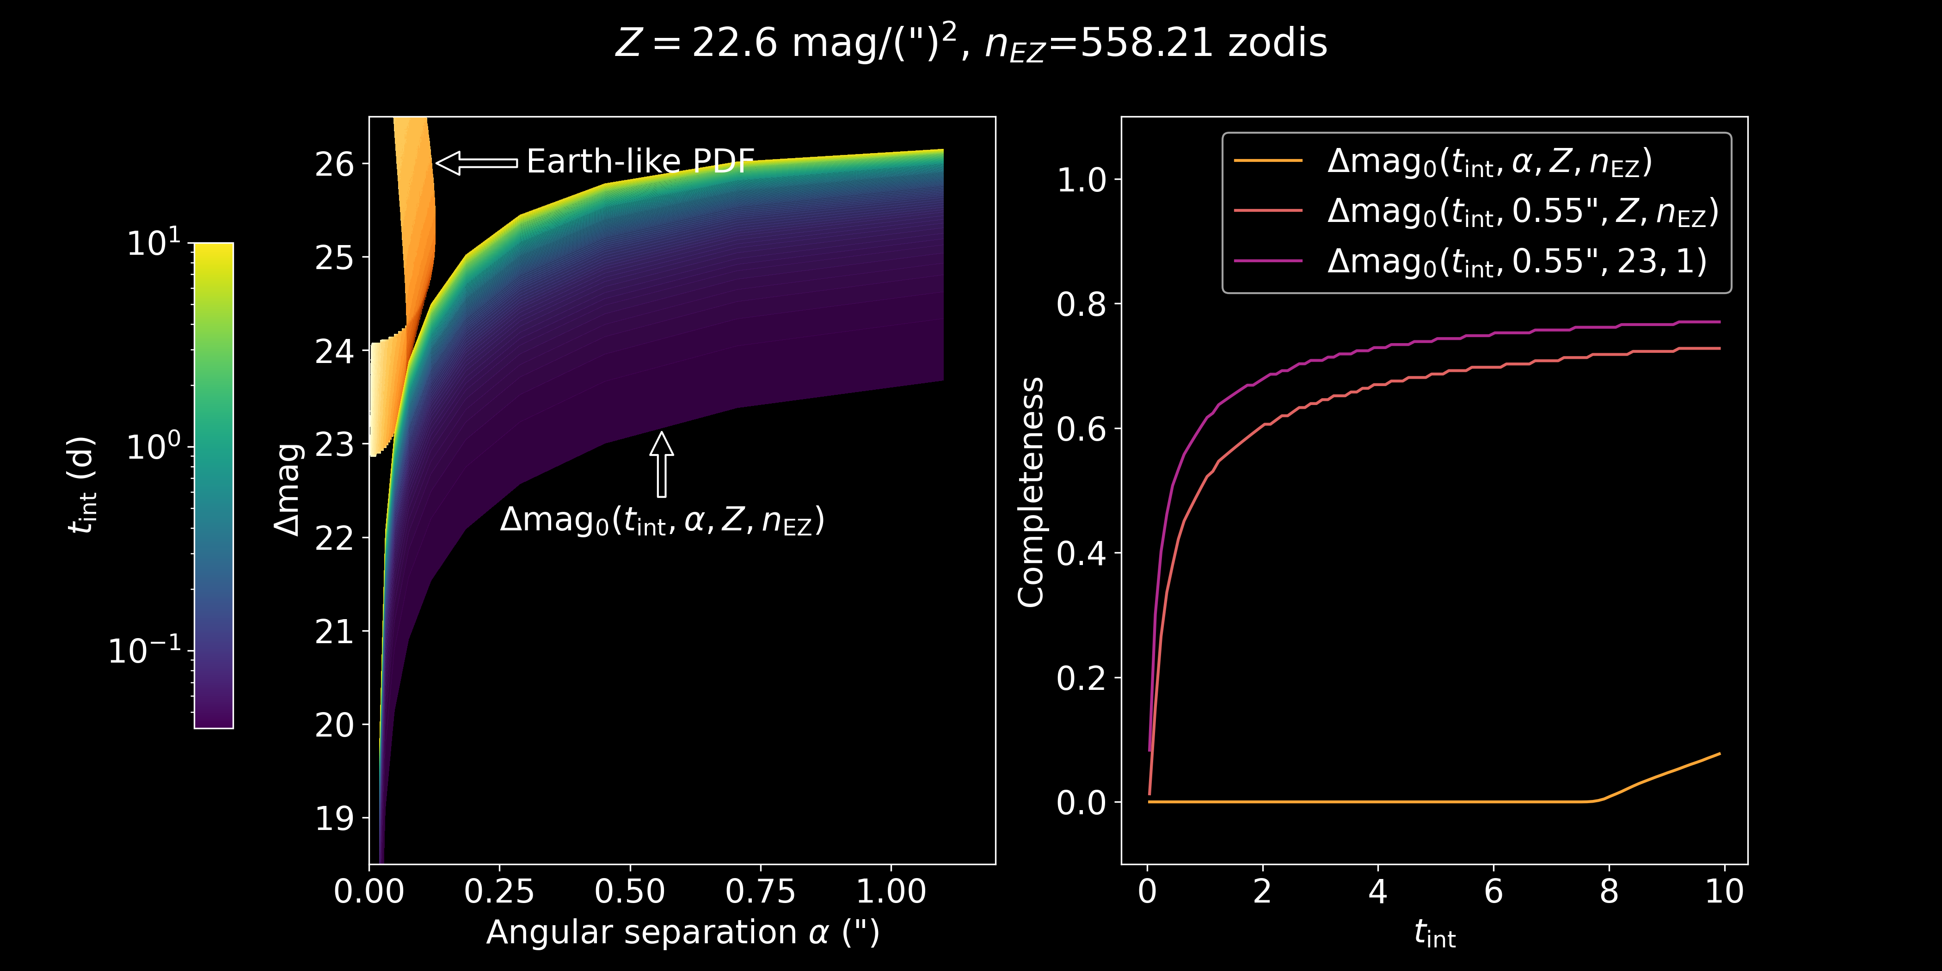

Slide 26
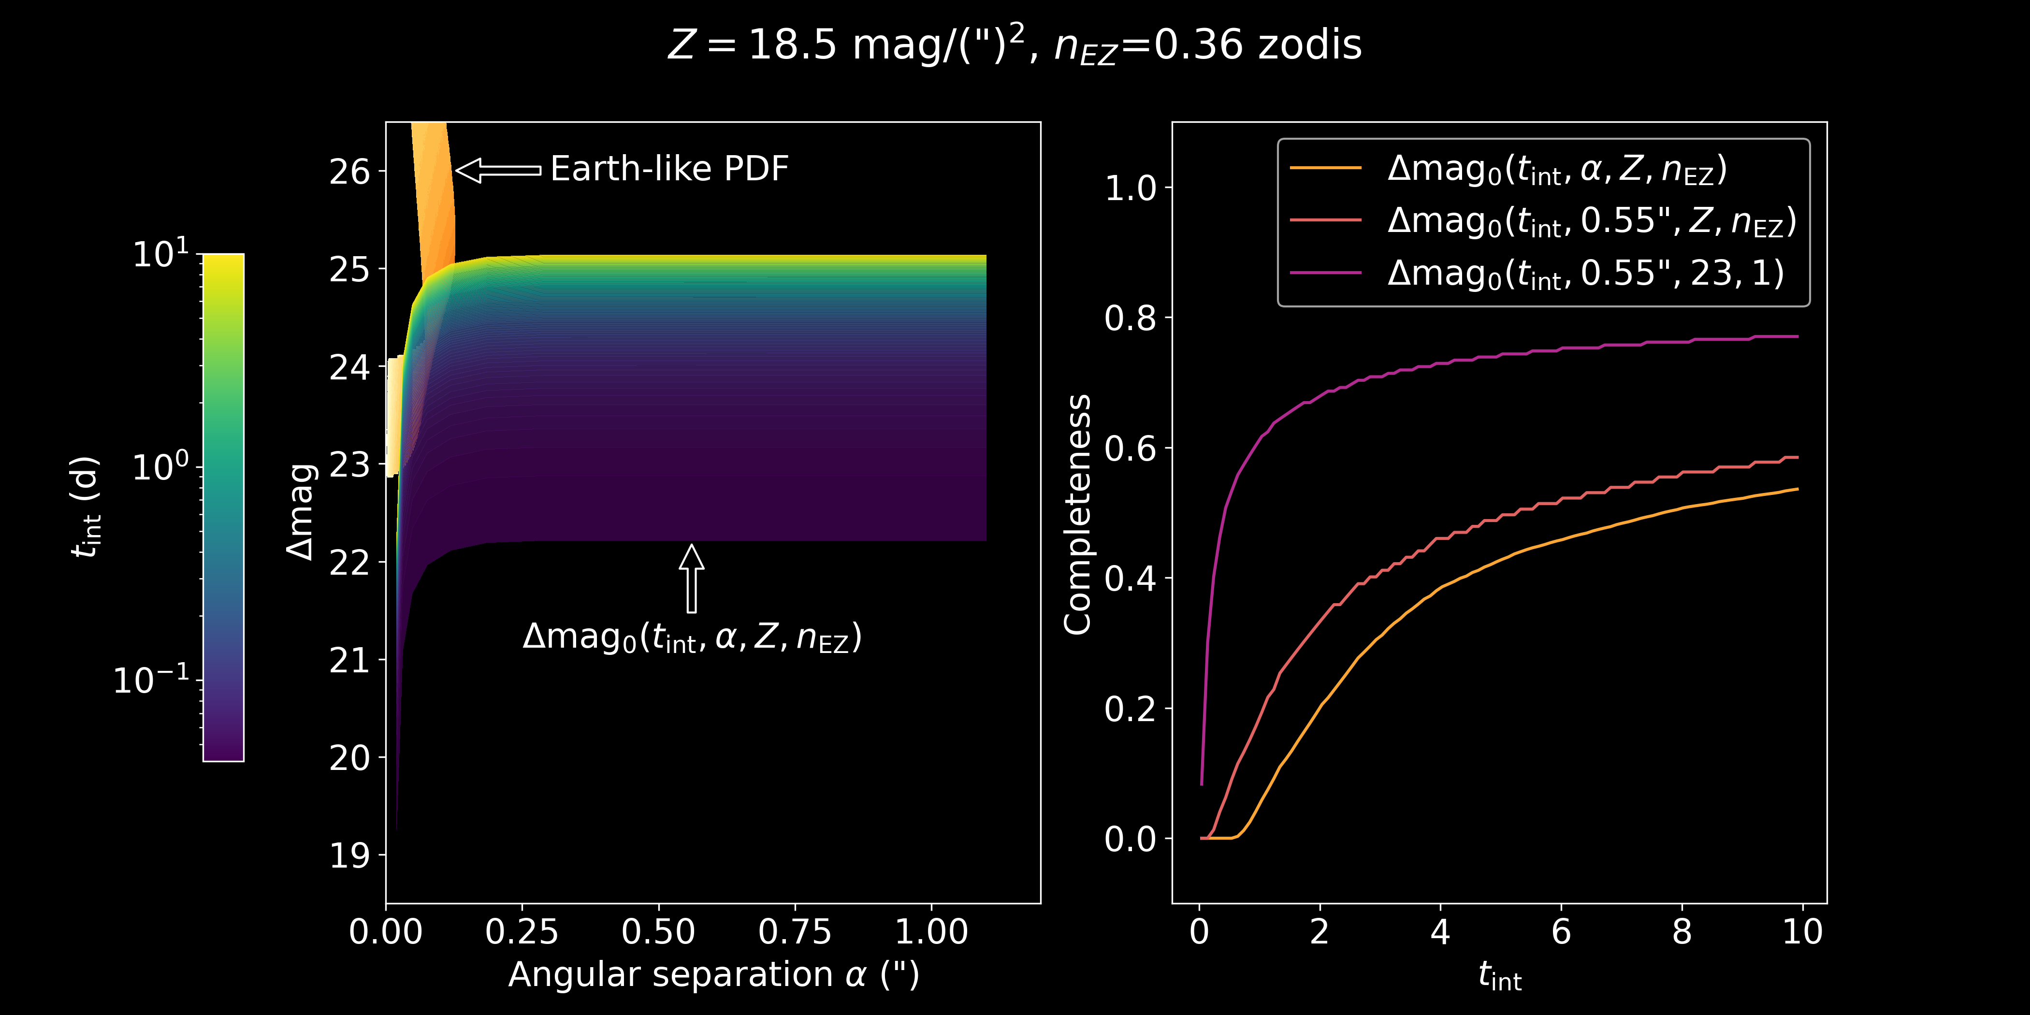

Slide 28
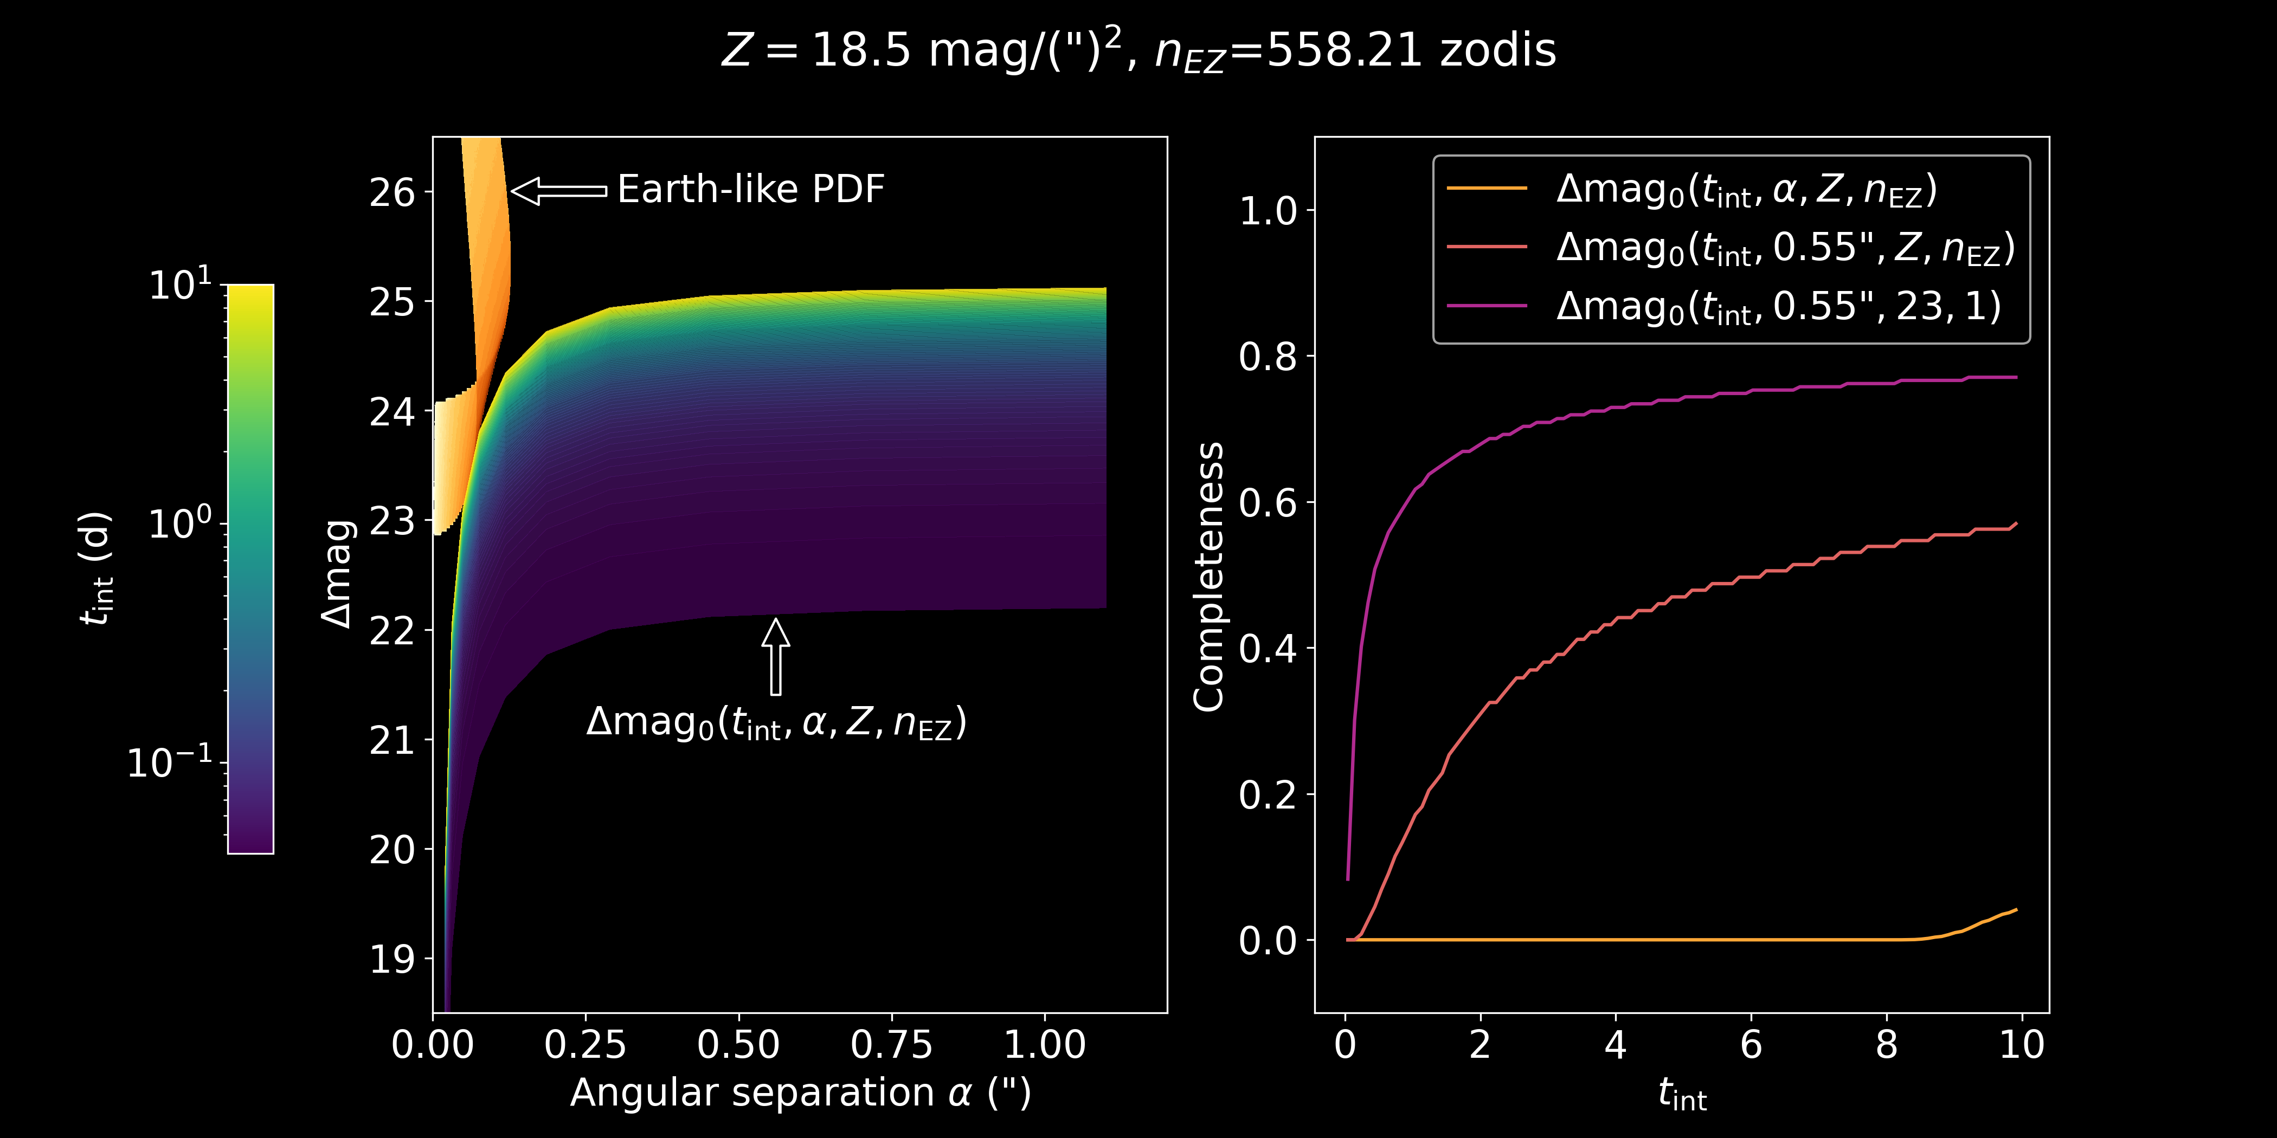

Slide 29
Error when treating Δmag₀ as flat

Slide 30
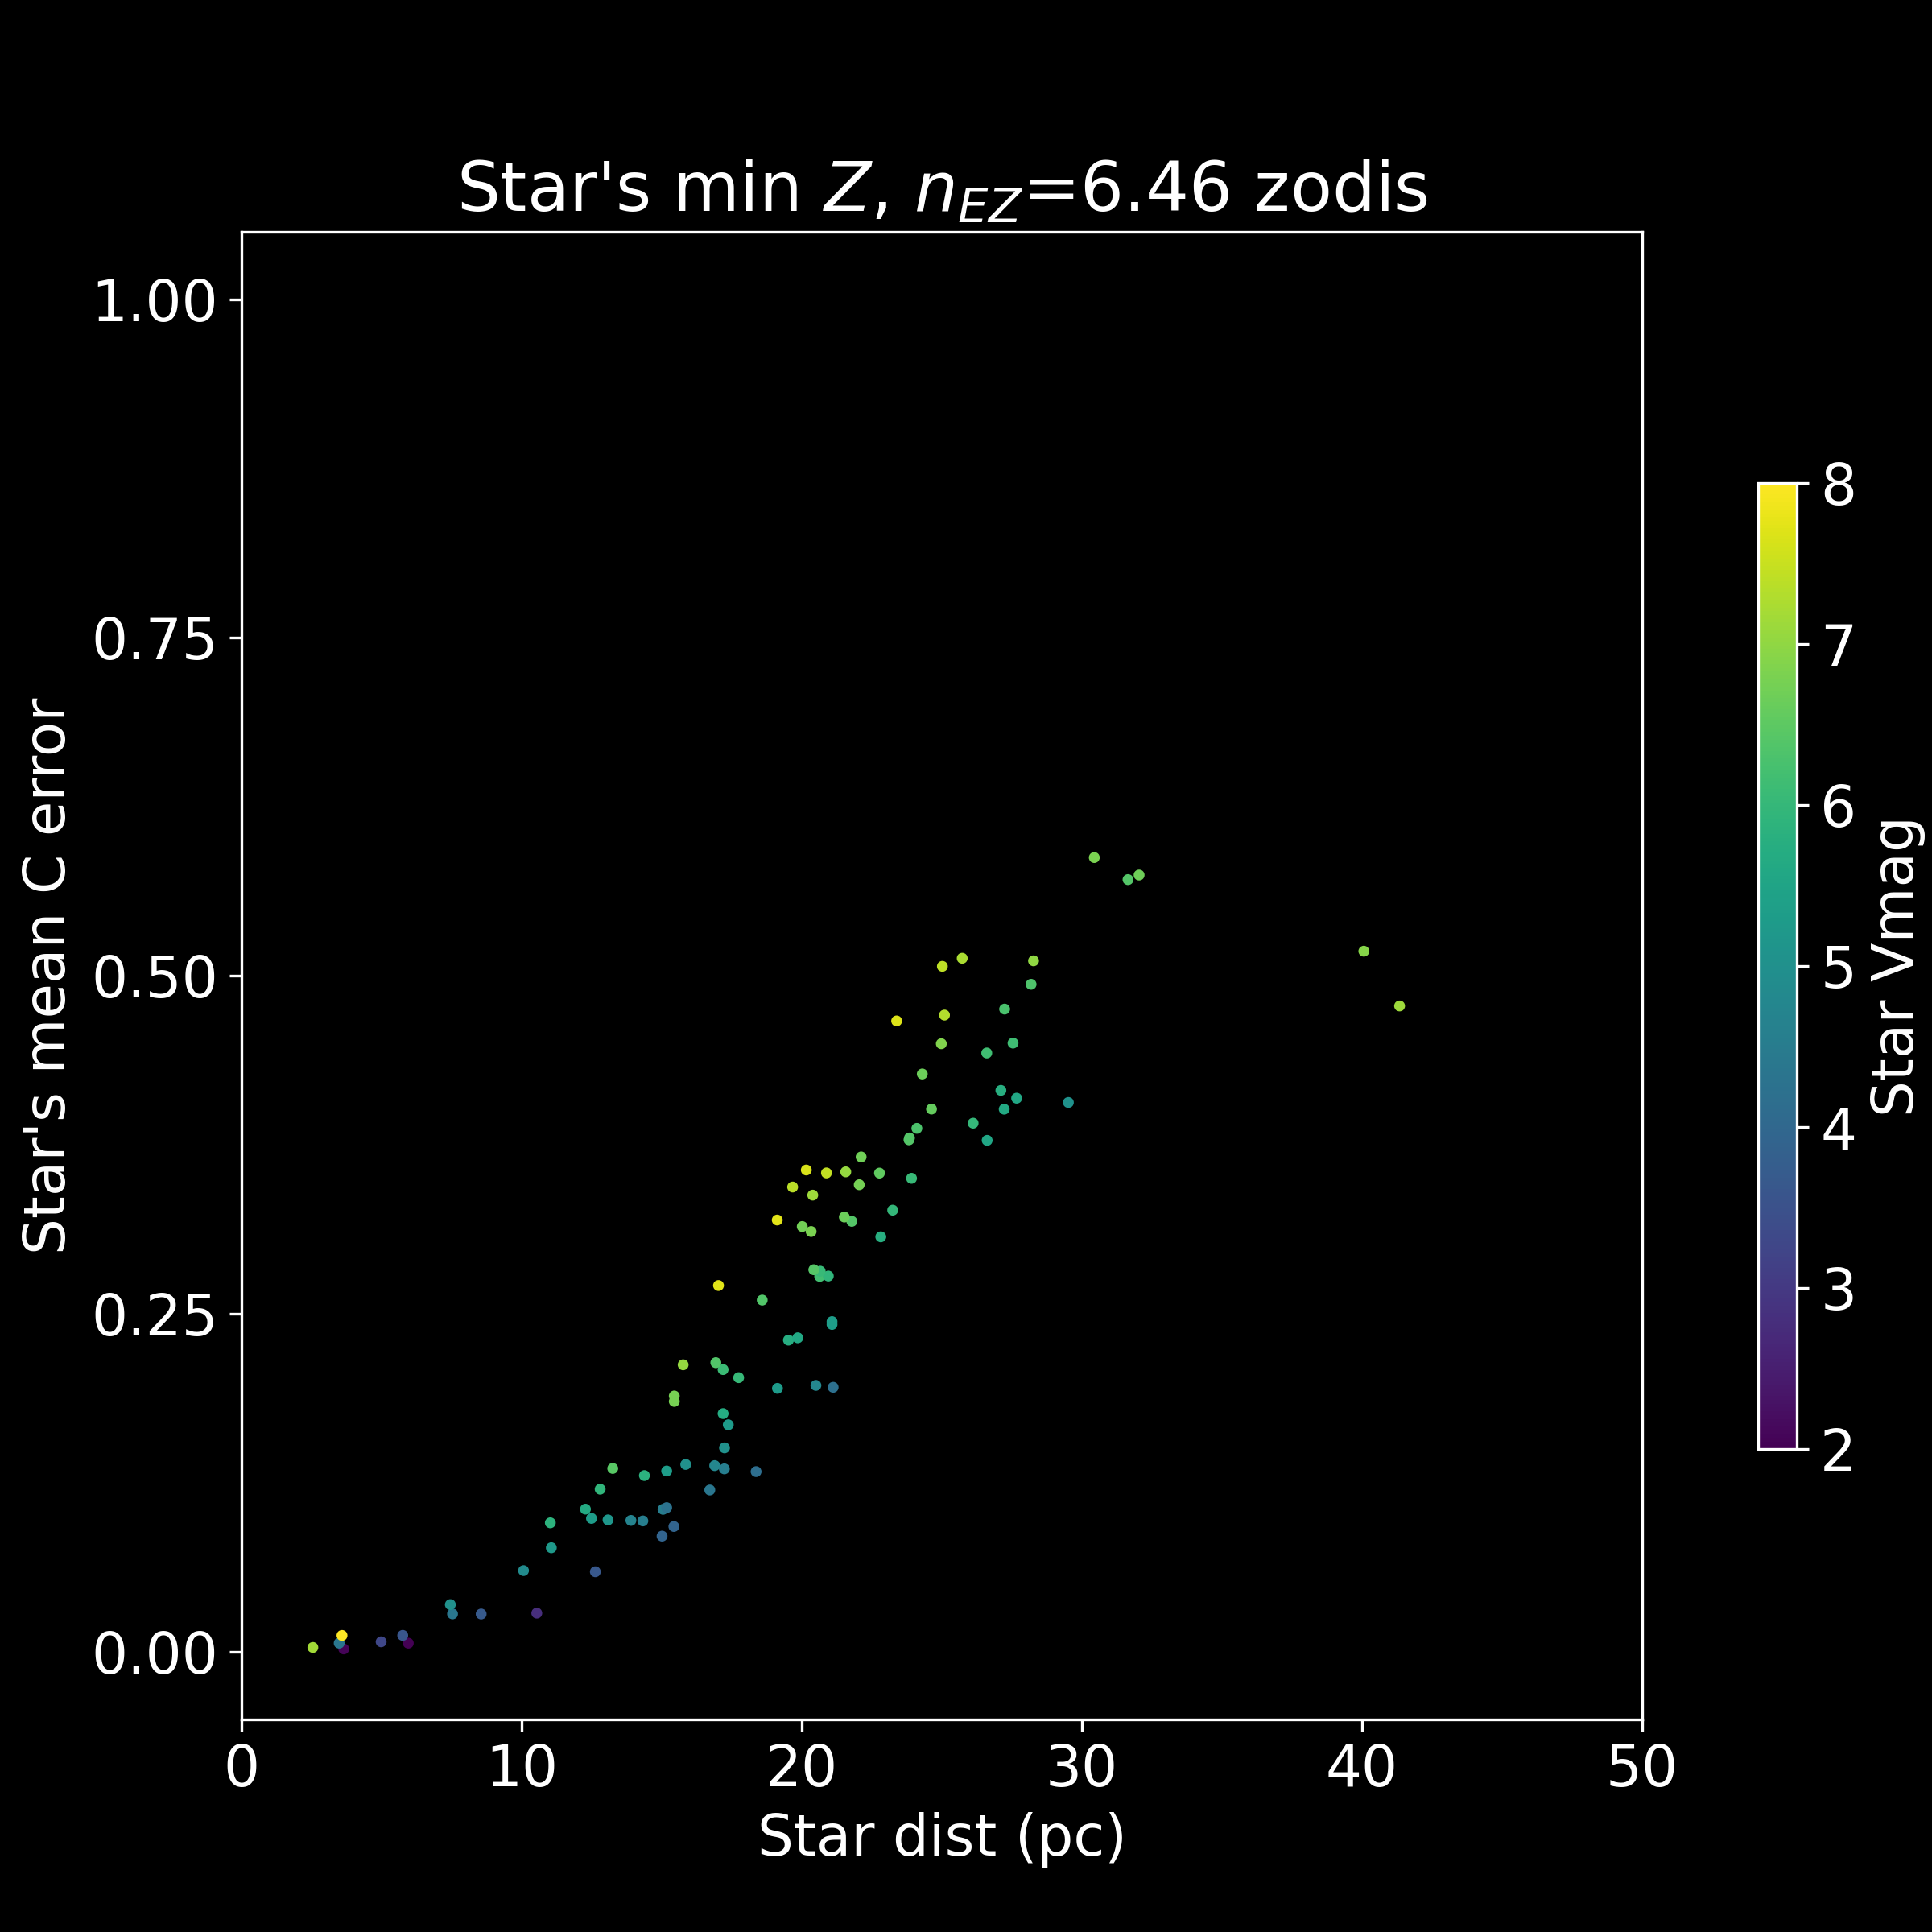
Error when treating Δmag₀ as flat

Slide 31
Observation Time
Zodiacal light is a function of observation time
Fitted orbits are a function of observation time

Slide 32
Probability of Detection

Slide 33
Metric Failures

Slide 34
Validation

Slide 35
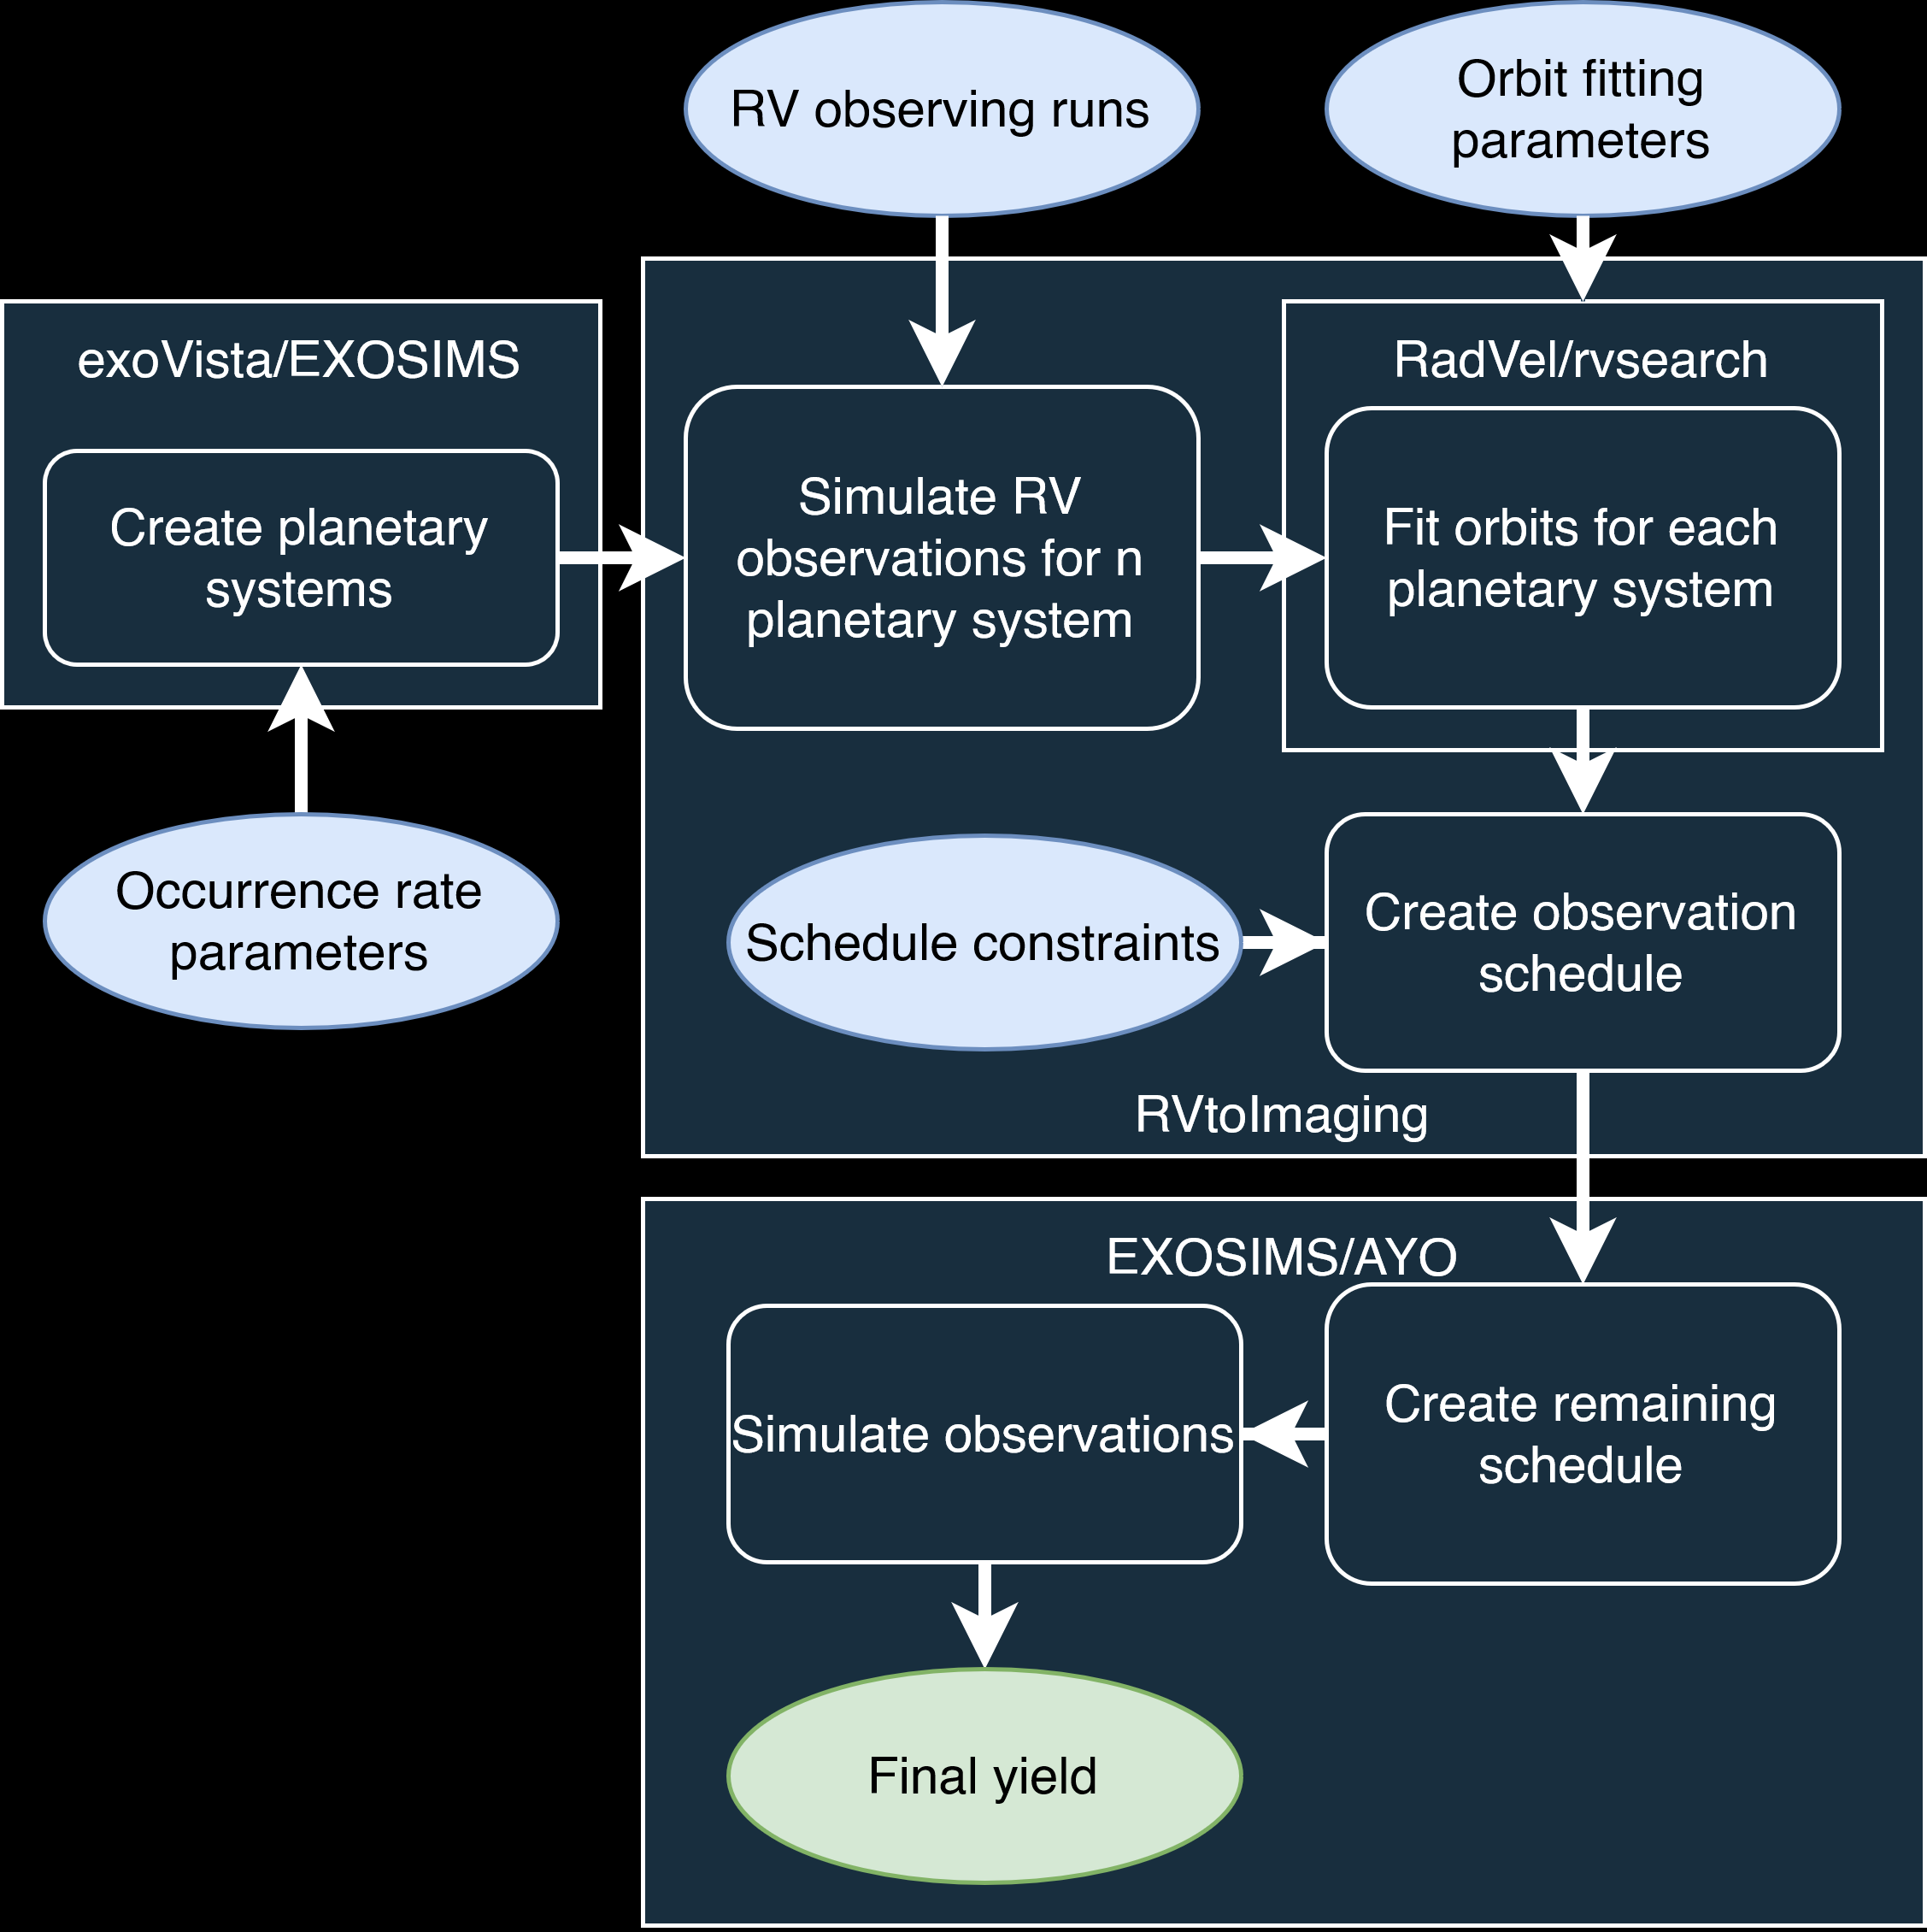
RVtoImaging
Full simulation of radial velocity generation and fitting
Probability of detection calculations
Scheduling
Observation simulation

Slide 36
Multi-planet systems

Slide 37
Multi-planet fitting and orbit construction
Rosenthal, L. J. et al. The California Legacy Survey. I. A Catalog of 178 Planets from Precision Radial Velocity Monitoring of 719 Nearby Stars over Three Decades. ApJS 255, 8 (2021).

Slide 38
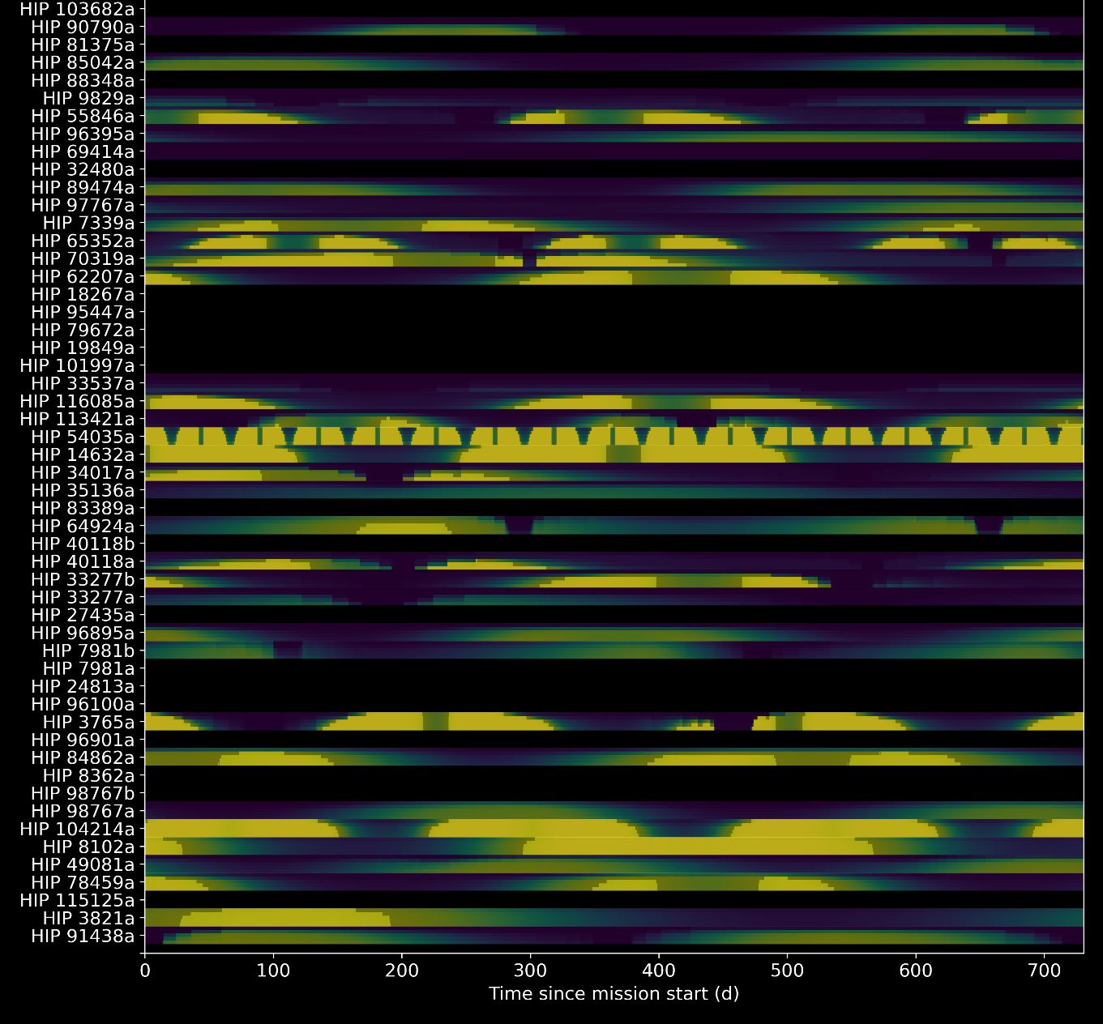
Probability of detection values

Slide 39
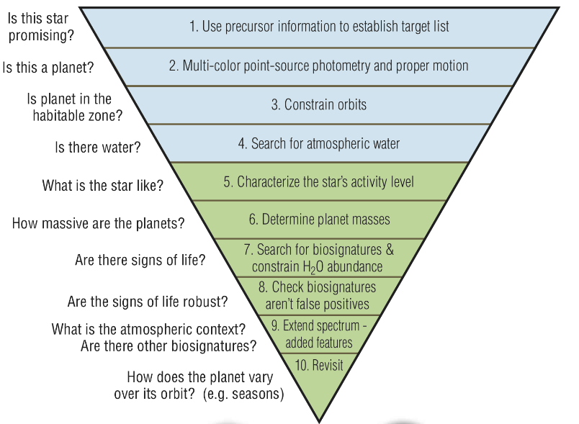
Scheduling goals
Three well-spaced detections to understand orbit before spectral characterization
Only considering initial part of mission
The LUVOIR Team. The LUVOIR Mission Concept Study Final Report. (2019).

Slide 40
Constraint Programming Scheduler
Using OR-Tools Constraint Programming Satisfiability solver “CP-SAT”
Constraint programming
Set of variables
Set of constraints
Find variable values that meet the constraints
Maximize some objective function
Satisfiability
Have Boolean formula F of a set of variables X with AND/OR relations
Can we find values of the X variables such that F=True
If not, F is unsatisfiable
Perron, L. & Furnon, V. OR-Tools. (2022).

Slide 41
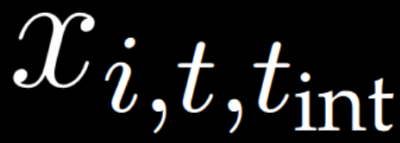
Modelling an observation
Boolean decision variables
Interval variables
Star i
Time t
Integration time t_{int}
Integer
Integer
Boolean

Slide 42
Discretization
Set a minimum “block length”, 2 hours
Observation start times are discretized to the block length
Integrations times must be multiples of the block length
A discrete number of integration times must be defined
e.g. 2 hour, 12 hour, 1 day, 5 days, 30 days
One assumed n_{EZ} value

Slide 43
Channeling constraints
If (c_{start} == a) & (c_{size} == b) & (c_{active} == True):
x_{i,a,b} = True
Else:
x_{i,a,b} = False

Slide 44
Mapping to P_{det} values
Want to maximize the number of planets that meet the 3-detection threshold
Set a desired value of P_{det}, P_{thresh}
New integer variable for each planet, range [0,3]
For planet i around star j

Slide 45
Objective function
CP-SAT is given

Slide 46
Constraints
Observations cannot overlap
Leave time to move telescope between observations
Wait before observing star again

Slide 47
Study – Astrophysical inputs
Instrument
RV instrument at Keck with 3 cm/s precision
Observing run
2038-2043, 100 random nights a year, 20 minutes per exposure
Target List from NEID Earth Twin Survey – Gupta 2021
Inputs
Dulz 2020 planet occurrence rates but guarantee an Earth-like planet exists
Simulate HWO-like observations with EXOSIMS
L2 orbit for HWO for two year initial observation schedule
Remove planets not in Habitable zone

Slide 48
Initial observation schedule for orbit fitting
Probability of detection
10000 constructed orbits without likelihood weighting
1 hour to 30-day integration times
Integration times of
6 hours, 1 day, 5 days, 10 days, 30 days
0.95 probability of detection threshold
Two hours of run time with 10 cores
Assume 1.75 exozodi

Slide 49
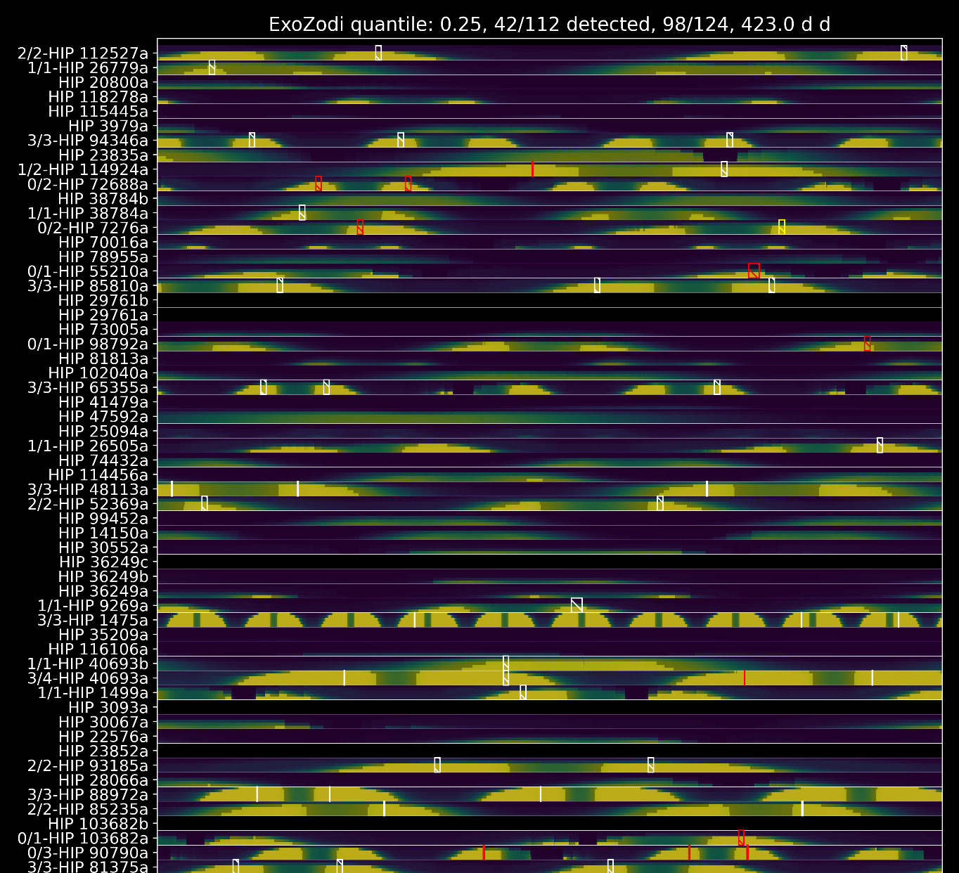
Example schedule

Slide 50
Random walk scheduler
Same set of stars and planets
Randomly choose star to observe
Integration time per star is the time required to reach Δmag=25
2 years to observe

Slide 52
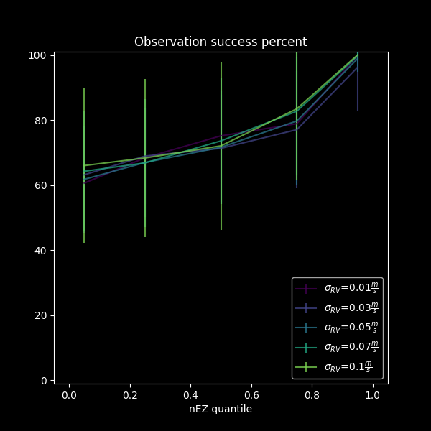
Precision and exozodi parameter sweeps

Slide 53
Summary
Calculating photometric constraint when there is a coupling between planet and background count rate
Full simulation of the radial velocity fitting process
Estimation of planet detectability
Scheduler with constraint programming
Scheduler outperforms blind search

Slide 54
Future work
Updating fits based on direct imaging data
Information theory
Effect of different occurrence rates, RV precision, RV observation schedules on planet yield
Exozodi handling

Slide 55
Publications
Conferences
Scheduling Direct Imaging Observations Based on Radial Velocity Orbital Fits: Best Practices for Translating Orbits and Failure Modes
Corey Spohn, Dmitry Savransky, Rhonda Morgan
The Astronomical Journal 163.4 (Mar. 11, 2022) p. 163. IOP Publishing, 2022
Integration Time Adjusted Completeness
Dean Keithly, Dmitry Savransky, Corey Spohn
Journal of Astronomical Telescopes, Instruments, and Systems 7 (July 1, 2021) p. 037002. 2021
Suppressing Condensation Frosting Using an Out‑of‑Plane Dry Zone
Corey A. Spohn, S. Farzad Ahmadi, Saurabh Nath, Jonathan B. Boreyko
Langmuir 36.51 (Dec. 29, 2020) pp. 15603–15609. American Chemical Society, 2020
Scheduling direct imaging observations based on radial velocity data
Corey Spohn, Dmitry Savransky
Emerging Researchers in Exoplanet Science, 2023, New Haven, Connecticut
Direct Imaging Mission Planning with Precursor Radial Velocity Data: Process and Validation
Corey Spohn, Dmitry Savransky
SPIE: Space Telescopes and Instrumentation 2022: Optical, Infrared, and Millimeter Wave, 2022, Montreal, Quebec
Dynamically Scheduling Direct Imaging Missions
Corey Spohn, Dmitry Savransky
AAS Winter: Extrasolar Planets: Direct Imaging, 2020, Honolulu, Hawaii
How Orbital Fit Uncertainties Impact Dynamic Scheduling
Corey Spohn, Dmitry Savransky
SPIE Astronomical Telescopes + Instrumentation: Observatory Operations: Strategies, Processes, and Systems VIII, 2020, Online
Orbital Error Propagation for Direct Detection
Corey Spohn, Dmitry Savransky
Emerging Researchers in Exoplanet Science, 2019, Ithaca, New York
3D Printing Icicles with Evaporating Droplets
Corey Spohn, Farzad Ahmadi, Jonathan Boreyko
APS DFD: Gallery of Fluid Motion, 2017, Denver, Colorado
A Bridge Too Far: Suppressing Frost Using an Out‑of‑Plane Dry Zone
Corey Spohn, Farzad Ahmadi, Saurabh Nath, Jonathan Boreyko
APS DFD: Drops: Anti‑icing and Deicing, 2017, Denver, Colorado

Slide 56
Acknowledgements
Funded by Roman Science Investigation #NNG16PJ24C (team prime award), #NNX15AB40G (NASA grant)
EXOSIMS contributors: Christian Delacroix, Daniel Garrett, Dean Keithly, Gabriel Soto, Corey Spohn, Walker Dula, Sonny Rappaport, Michael Turmon, Rhonda Morgan, Grace Genszler, and Dmitry Savransky, with contributions by Patrick Lowrance, Ewan Douglas, Jackson Kulik, Jeremy Turner, Jayson Figueroa, Owen Sorber and Neil Zimmerman.
OR-Tools, an open-source software suite for optimization made by Google Inc. with community support.
Imaging Mission Database, which is operated by the Space Imaging and Optical Systems Lab at Cornell University.
NASA Exoplanet Archive, operated by California Institute of Technology, under contract with the National Aeronautics and Space Administration under the Exoplanet Exploration Program, and from the SIMBAD database, operated at CDS, Strasbourg, France.
Astropy, a Python package for astronomy.
RadVel, a Python package for modeling radial velocity time-series data.

